Slide 1
Your Degree, Your Career: Studying at Sheffield can take you anywhere

Slide 2
This talk will cover...
What can I do with my degree?
How can I develop my employability at the University of Sheffield?
Support from the Careers Service
Notes:
Try and focus the talk on the university supporting employability rather than Career Service support. We can say later about support in programme, support from us etc. show a more holistic offer
How does studying at Sheffield take me anywhere?
Placements
Part-time work/Jobshop
Extracurricular/Students Union

Slide 3
What can I do with my degree?

Slide 4
Your degree,
your career
There are lots of starting points for choosing a career and using your degree subject is one of them
But whatever you study there will be a wide range of future career options open to you
Notes:
There are lots of starting points for choosing a career and using your degree subject is one of them, but whatever you study there will be a wide range of future career options open to you. You could also choose to continue your studies, develop a research career or take time out to travel after your degree. During your time at university you will gain many new experiences, develop a wide range of skills, learn how to reflect on these and plan what you want to do next. The Careers Service provides advice and guidance and a wide range of workshops and events to help you make informed choices. There are also opportunities to benefit from mentoring programmes, and to meet employers and alumni who can assist you in your decision making.

Slide 5
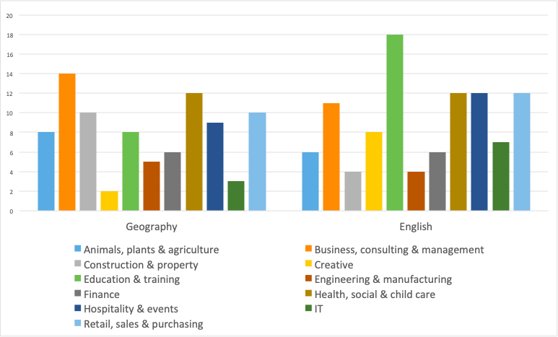
Only 14% employers surveyed required a specific subject degree -
ISE 2019
Source: Destination of Leavers from Higher Education (DLHE) 2016/17

Slide 6
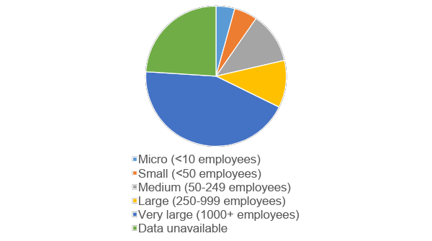
Sheffield is in the top 10 universities targeted by graduate recruiters -
High Flyers Report 2020
Source: Destination of Leavers from Higher Education (DLHE) 2016/17

Slide 7
https://www.sheffield.ac.uk/careers/explore
Explore what our graduates did next through our extensive information resources

Slide 8
How can I develop my employability at the University of Sheffield?
Notes:
During your time at university you will gain many new experiences, develop a wide range of skills, learn how to reflect on these and plan what you want to do next. The Careers Service provides advice and guidance and a wide range of workshops and events to help you make informed choices. There are also opportunities to benefit from mentoring programmes, and to meet employers and alumni who can assist you in your decision making.

Slide 9
Sheffield Graduate Attributes
Adaptable, flexible and resilient
Collaborative
Commercially and globally aware
Communicator
Critical thinker
Efficient
Innovative
Taking ownership
Self-development
https://www.sheffield.ac.uk/sheffieldgraduate
Notes:
These are abbreviated versions of the actual attributes.
All taught programmes provide opportunities for students to develop the attributes of the Sheffield Graduate. These are embedded within the curriculum and identifiable throughout the learning experience. Co- and extra-curricular activities can further enhance development of these.

Slide 10
Your academic programme
Sheffield Graduate Attributes are embedded
Develop the skills and attributes that will equip you to secure successful careers
Placement Opportunities
Option to undertake a placement opportunity to apply and develop your skills in the workplace
Relevant and future proofed
Course design informed by graduate recruiters, professional bodies, alumni and labour market trends
Notes:
There are lots of starting points for choosing a career and using your degree subject is one of them, but whatever you study there will be a wide range of future career options open to you. You could also choose to continue your studies, develop a research career or take time out to travel after your degree. During your time at university you will gain many new experiences, develop a wide range of skills, learn how to reflect on these and plan what you want to do next. The Careers Service provides advice and guidance and a wide range of workshops and events to help you make informed choices. There are also opportunities to benefit from mentoring programmes, and to meet employers and alumni who can assist you in your decision making.

Slide 11
How else can I develop graduate attributes?
Student representative
Group projects
Volunteering
Clubs and Societies
Summer placement
Part-time work
e-Mentoring
Internships
Year abroad
Notes:
Mention the Sheffield Graduate Attributes.
Summer placement
Work experience
Volunteering
Clubs and Societies
Internships
Part-time work
e-Mentoring
1-1 Appointments
Workshops and webinars
Sports team
Year abroad
Student representative
Group projects

Slide 12
Support from the Careers Service
Notes:
During your time at university you will gain many new experiences, develop a wide range of skills, learn how to reflect on these and plan what you want to do next. The Careers Service provides advice and guidance and a wide range of workshops and events to help you make informed choices. There are also opportunities to benefit from mentoring programmes, and to meet employers and alumni who can assist you in your decision making.

Slide 13
How could the Careers Service support you?
Support to find part-time work
1:1 Appointments
Workshops and webinars
Large-scale careers fairs
Placements
Vacancies – Career Connect online portal
Links with almost 4000 employers
Support for graduates for up to 3 years
Notes:
How does studying at Sheffield take me anywhere?
Placements
Part-time work/Jobshop
Extracurricular/Students Union
Video??

Slide 14
For further information, visit our website…
Careers Service
241 Glossop Road
S10 2GW
0114 222 0910
fb.com/UniShefCareers
@UniShefCareers
@UniShefCareers
University of Sheffield
Careers
Notes:
Signposting slide to website

