Slide 1
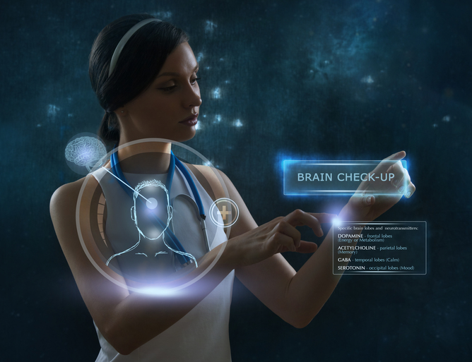
Personal health technologies From Fitbits and dumb patients to democratic data and citizen health
Nick J Fox
University of Sheffield

Slide 2
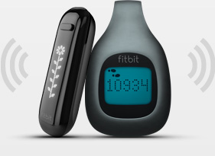
Introduction
New materialism.
What can a PHT assemblage do?
Reverse-engineering PHTs.
Re-engineering PHTs.
PHTs and ‘Citizen Health’.
Conclusions.
https://www.academia.edu/15502936

Slide 3
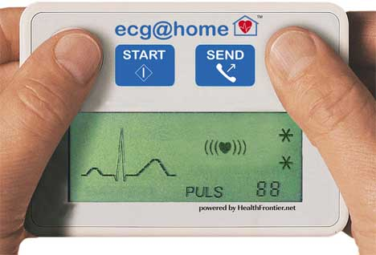
New materialism
Not textualities but matter.
Not entities but relations.
Not agency but affects (the capacity to affect or be affected).
Not structures but un/stable assemblages.
New materialist ontology explores the affect economies that affect matter.
Cuts across micro/macro; nature/culture; mind/body dualisms.

Slide 4
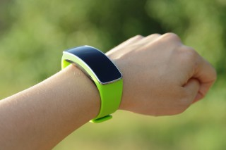
What can a PHT do?
I will reverse engineer three PHTs.
What relations does each comprise?
What affect economies make each work?
What is the defining micropolitics of each?
What capacities does the assemblage produce, including bodies’ capacities to do, feel and think?

Slide 5
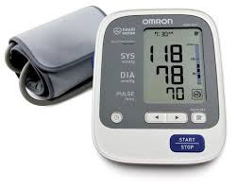
1: Blood pressure monitor
Relations:
device – user - autonomic NS – manufacturer – biomedicine – health professionals
Affect: provides feedback to user on unobservable parameters, to assess risk level.
Micropolitics: user responsible for monitoring and acting; domesticates biomedical gaze on body functions; outsources/privatises medical monitoring.

Slide 6
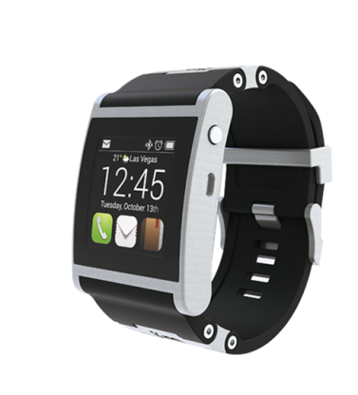
2: iWatch/Fitbit
Relations:
body movement – terrain – device – wearer –manufacturer – other users
Affects: provides quantified data on posture, movement, health indices, encourages action.
Micropolitics: responsibilises user ; encourages behaviours; quantifies daily life; creates competitiveness with self/others; creates routines; commercialises fitness.

Slide 7
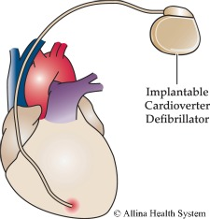
3: Implantable cardiovertor-defibrillator
Relations:
heart muscles - device – electricity - user – surgeon
Affect: monitors heart rhythm; automatically shocks heart to pace/defibrillate.
Micropolitics: technology controls heart rhythm according to biomedical aspirations; user cannot over-ride/choose to die; surgeons may refuse to remove device on ethical grounds.

Slide 8
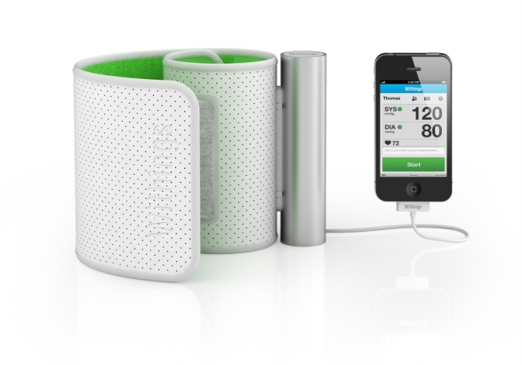
Re-engineering PHTs
If we can reverse engineer PHTs, it is also possible to forward engineer PHTs to produce specific micropolitics and capacities.
This can be done from different perspectives:
Public Health & Biomedicine
Corporate interests
Patients
Resisting citizens (‘Citizen health’)

Slide 9
Public Health/Biomedicine
PMDs can be engineered to produce capacities for:
Population surveillance
Responsibilisation
Reduce patient delay
Manage health care use levels
Control expenditure
Example: wireless-connected personal monitoring devices, enabling both surveillance and to notify wearers of health risks, GP attendances etc.

Slide 10
Critique of this micropolitics
Intrusive and anti-autonomy.
Extends an individualising biomedical model of health and illness.
Domesticates health care technologies, producing a further ‘medicalisation of everyday life.’
Replaces ‘expert patients’ with ‘dumb patients’.
May exacerbate health inequalities and punish non-compliance.
Could be basis for rationing health care.

Slide 11
Corporate Interests
PMDs can be engineered to produce capacities for:
Marketing health and fitness.
Use data from PMDs to target sales.
Monetise technologies via linked advertising/promotions.
Create and exploit health consumerism.
Example: PMDs that pass back data to manufacturer; link to other apps, social media, products; maximise consumer uptake and establish health consumers dependent on technology.

Slide 12
Critique of this micropolitics
Neoliberal marketisation of health and fitness.
Outsourcing of health care to tech businesses.
Extends the privatisation of health care.
Health and fitness become ways to make money rather than ends in themselves.
Turns bodies into elements within a market assemblage.
Data security, privacy, confidentiality issues.

Slide 13
Patient Perspective
PMDs can be engineered to produce capacities for:
Managing a condition
Monitoring internal signs
Intervening to address urgent health needs
Assessing needs for professional advice
Managing prescriptions
Example: an integrated, wireless solution that monitors vital signs; advises on age-appropriate screening/tests; books appointments and repeat prescriptions; notifies professionals; administers pharmaceuticals.

Slide 14
Critique of this micropolitics
As for biomedicine, but also:
Creates dependency on the technology.
Creates dependency on biomedicine and health care systems.
May generate negative emotions e.g. fear.
Dumbing: removes responsibility for daily life.
Raises issues of informed consent.
Funding and the privatisation of health care.

Slide 15
A ‘Resisting’ Perspective
PMDs can be engineered to produce capacities that:
Reject biomedical model of health and illness.
Enable collective responses
Challenge health policy.
Organise against health corporations.
Organise against environmental polluters, purveyors of fast and processed foods, etc.
Synchronise health and environmental sustainability.

Slide 16
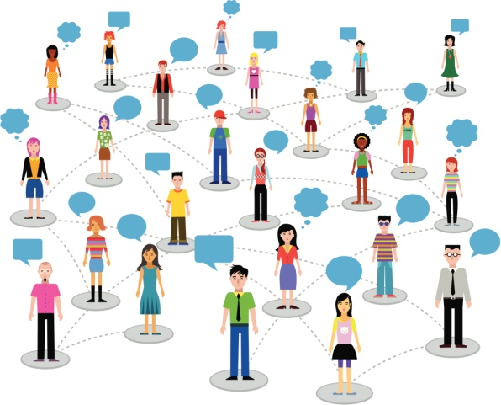
An Example
Connected PMDs that enable:
health and risks to health to be assessed across a locality;
notify communities of policy or risks;
co-ordinate action and build coalitions;
generate and implement policy.

Slide 17
PHTs and ‘Citizen Health’
Potential to use personal health technologies to subvert biomedical or corporate interests.
‘Citizen health ‘rejects an individualised approach to health and the monetisation of health and fitness.
Use PHTs to build networks of connected bodies and social formations that challenge biomedical health care and neo-liberalism.

Slide 18
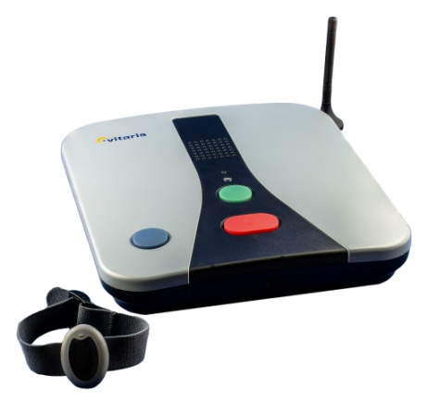
Conclusions
An materialist approach exposes the interactions between bodies, technologies, social formations and abstract ideas.
Reverse engineer PHTs to reveal their micropolitics.
Forward engineer PHTs to produce specific capacities, according to different agendas.
Use this modelling to build citizen health PHTs.

Slide 19
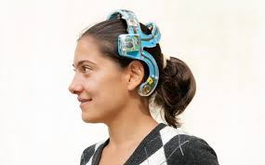
Reference
Fox NJ (2015) Personal health technologies, micropolitics and resistance: a new materialist analysis. Health.
DOI: 10.1177/1363459315590248

Slide 20
Personal health technologies. From Fitbits and dumb patients to democratic data and citizen health
Nick J Fox
University of Sheffield

