Slide 1
Goal Setting
Next slide
Notes:
2A2A57

Slide 2
Instructions
The following session:
Will take 20 minutes to complete.
Will involve some brief activities – grab a pen and paper.
Can be navigated entirely by clicking buttons as instructed.
Involves audio – grab headphones if needed.
Previous slide
Next slide
Notes:
<div>Icons made by <a href="https://www.flaticon.com/authors/freepik" title="Freepik">Freepik</a> from <a href="https://www.flaticon.com/" title="Flaticon">www.flaticon.com</a></div>
Icons made by <a href="https://www.flaticon.com/authors/srip" title="srip">srip</a> from <a href="https://www.flaticon.com/" title="Flaticon"> www.flaticon.com</a>
Icons made by <a href="https://www.flaticon.com/authors/monkik" title="monkik">monkik</a> from <a href="https://www.flaticon.com/" title="Flaticon"> www.flaticon.com</a>

Slide 3
HeppSY
The Higher Education Progression Partnership South Yorkshire (HeppSY) is part of a national programme to help school and college aged students aged 13-19 in South Yorkshire, who are most at risk of missing out on higher education. HeppSY is working in partnerships with Sheffield Hallam University, the University of Sheffield, and South Yorkshire colleges and schools. Visit: www.heppsy.org. Follow: @HeppSYplus
Previous slide
Next slide

Slide 4
Objectives
To understand why setting goals is useful
To learn how to set useful, effective goals
To understand how to put these goals into practise to support achievement
Previous slide
Next slide

Slide 5
My Goals
It can be useful to think about where we are now, where we want to be and how we’re going to get there
Now
Where am I now? What am I doing?
Future
What do I want to be doing?
Previous slide
Next slide

Slide 6
Why Set Goals
It is important to know what you want and how you are going to achieve it
Setting goals will make you more likely to complete a task successfully
Goals will help you to use your time more effectively
To remind you of the things you want to achieve and to motivate you towards them
Previous slide
Next slide

Slide 7
Long term and short term
Long term goals might be less specific and take longer to achieve e.g. I want to have a good job that I enjoy
Short term goals are specific things that you can achieve relatively quickly e.g. I want to do well in my exam next month
Previous slide
Next slide

Slide 8
Long term and short term
Often long term goals can be achieved by breaking them down into multiple short term goals
Previous slide
Next slide

Slide 9
Worksheet Task
Write down your answers for both sections
Choose a career or academic focused goal you want to achieve in the next five years
Previous slide
Next slide

Slide 10
Smart Goals
When we set goals it’s really important that we set them in a certain way. This is where SMART goals come in. SMART goals have 5 key characteristics:
Specific
Measurable
Achievable
Relevant
Time Based
Previous slide
Next slide

Slide 11
Here’s one of ours
I want to do better on my maths exam
I want to get at least 75% on 3 mock papers before May
Click here for audio
Relevant
Specific
Achievable
Time based
Measurable
Previous slide
Next slide

Slide 12
Worksheet Task
Find your long term goal from earlier and write down three SMART goals that will help you achieve it
SMART
Specific
Measurable
Achievable
Relevant
Time based
Possible areas to consider
Motivation
Time management
Effort
Revision skills
Resilience
Previous slide
Next slide

Slide 13
My Goals
Once you’ve had a think about where it is you want to be in your future, SMART goals are a great way to think about how you’re going to get there
Now
Where am I now? What am I doing?
Future
What do I want to be doing?
Previous slide
Next slide

Slide 14
Action Plans
The more specific we are with what we need to get done, the more likely we are to do it
We now have our key SMART goals, the next stage is to work out how we are going to achieve them
We need to choose one of our SMART goals and break it down into all the practical steps we would need to complete in order to achieve that goal. For each step you need a rough completion time
Previous slide
Next slide

Slide 15
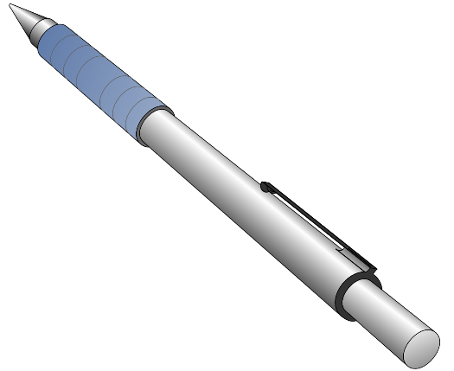
Action Plans
I want to get at least 75% on 3 mock papers before the exam
Tasks that need to be done
Date to be done
Spend four hours revising part B of textbook
Next week
Make a list of areas I am struggling with
Next week
Ask teacher for help with key problem areas
Two weeks time
Complete 1 past paper a week
Until April
Previous slide
Next slide

Slide 16
Worksheet Task
Choose one of your SMART goals and create an action plan by breaking it down into at least three tasks
Previous slide
Next slide

Slide 17
Organisation
It’s worth putting your tasks somewhere you can see them easily, whether this ends up being a full timetable or a phone notification is up to you
1
6:00pm – Past paper
Previous slide
Next slide
Notes:
Trello

Slide 18
Resilience
Goals can also help you plan out solutions to short term, unexpected issues. What SMART goals might you set in this scenario?
Scenario:
You have received your exam timetable and you find that your two hardest exams are both scheduled for the same day and you’ve also got three other exams in that week
For example: ‘Today I will write a revision plan for the next three weeks to make sure I use my time as efficiently as possible’
Previous slide
Next slide

Slide 19
After the Session
Hang on to your goals, try and actually use them
Keep your goals visible, just looking at them will have a positive effect
When making goals, remember the priority is to keep them SMART
Don’t let them get you stressed. Breaking challenges down into manageable goals should be a way of making them less stressful!
Previous slide
Next slide

Slide 20
Goals Achieved!
Previous slide
This programme is supported by HeppSY, a South Yorkshire initiative helping students who are most at risk of missing out on higher education to make an informed decision. HeppSY is supported by both Sheffield universities and the local higher education colleges, and is working with 38 schools and six colleges across the region.

