Slide 1
Medicine at The University of Sheffield
Next slide

Slide 2
Instructions
The following session:
Will take 45 minutes to complete.
Will involve some brief activities – grab a pen and paper.
Can be navigated entirely by clicking your left and right arrow key/ buttons as instructed.
Involves audio – grab headphones if needed.
Previous slide
Next slide
Notes:
<div>Icons made by <a href="https://www.flaticon.com/authors/freepik" title="Freepik">Freepik</a> from <a href="https://www.flaticon.com/" title="Flaticon">www.flaticon.com</a></div>
Icons made by <a href="https://www.flaticon.com/authors/srip" title="srip">srip</a> from <a href="https://www.flaticon.com/" title="Flaticon"> www.flaticon.com</a>
Icons made by <a href="https://www.flaticon.com/authors/monkik" title="monkik">monkik</a> from <a href="https://www.flaticon.com/" title="Flaticon"> www.flaticon.com</a>

Slide 3
HeppSY
The Higher Education Progression Partnership South Yorkshire (HeppSY) is part of a national programme to help school and college aged students aged 13-19 in South Yorkshire, who are most at risk of missing out on higher education. HeppSY is working in partnerships with Sheffield Hallam University, the University of Sheffield, and South Yorkshire colleges and schools. Visit: www.heppsy.org. Follow: @HeppSYplus
Previous slide
Next slide

Slide 4
Hello and Welcome…
Welcome to our interactive presentation and quiz about Medicine at The University of Sheffield.
This presentation has been produced by students from Sheffield Widening Access to Medical School (SWAMS) and will give you a flavour of what it’s like to study medicine.
We hope you enjoy looking through it!
Previous slide
Next slide

Slide 5
What does a doctor look like?
Task: Spend 30 seconds imagining what a doctor looks like. Click ‘next slide’ when you are done!
Previous slide
Next slide

Slide 6
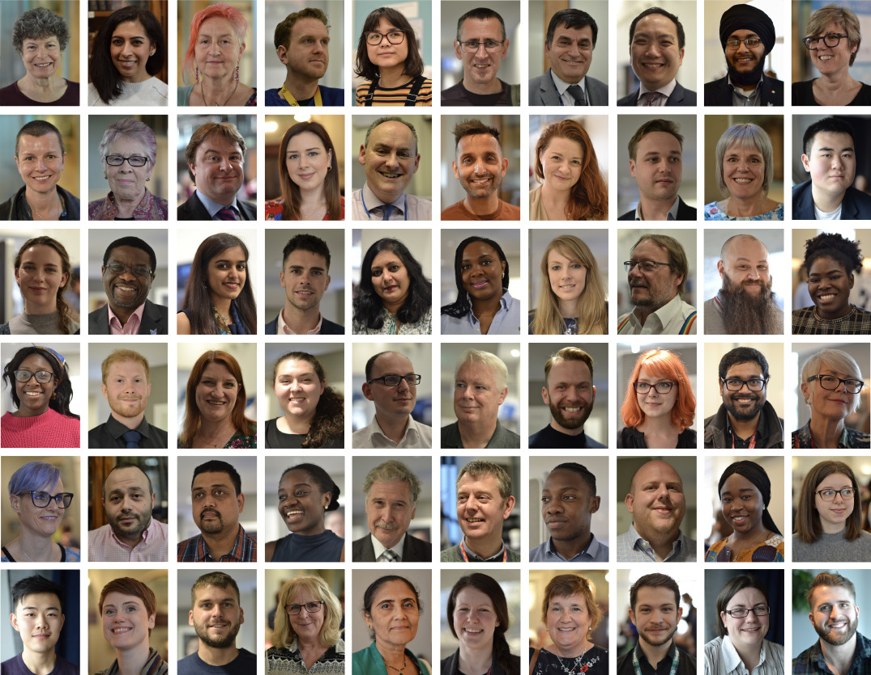
What does a doctor look like?
Anyone! There is no ‘one image’ of what a doctor looks like!
These are all faces of real NHS Doctors
Previous slide
Next slide
Notes:
Image source: https://www.bmj.com/content/366/bmj.l4728

Slide 7
What does a medical student look like?
Medical students come from a whole variety of backgrounds and have different motivations to study medicine and unique aspirations within health care
For most, a mix of social and scientific interests lead them to medicine – is this something you relate to?
But after the 5 years studying medicine, what happens…?
Previous slide
Next slide

Slide 8
You become a doctor!
…but this is a very broad term as there are many different types of doctor
Take a minute to look at the NHS careers website at everything you could become
Doctors are scientists, professionals, practitioners and scholars
Previous slide
Next slide

Slide 9
What is it like to study medicine?
To get started, take a look at the short video on the next slide which shows a day in the life of a medical student at the University of Sheffield.
Previous slide
Next slide

Slide 10
A day in the life of a medical student
Previous slide
Next slide
Notes:
https://www.youtube.com/watch?v=4jexc0giwKI

Slide 11
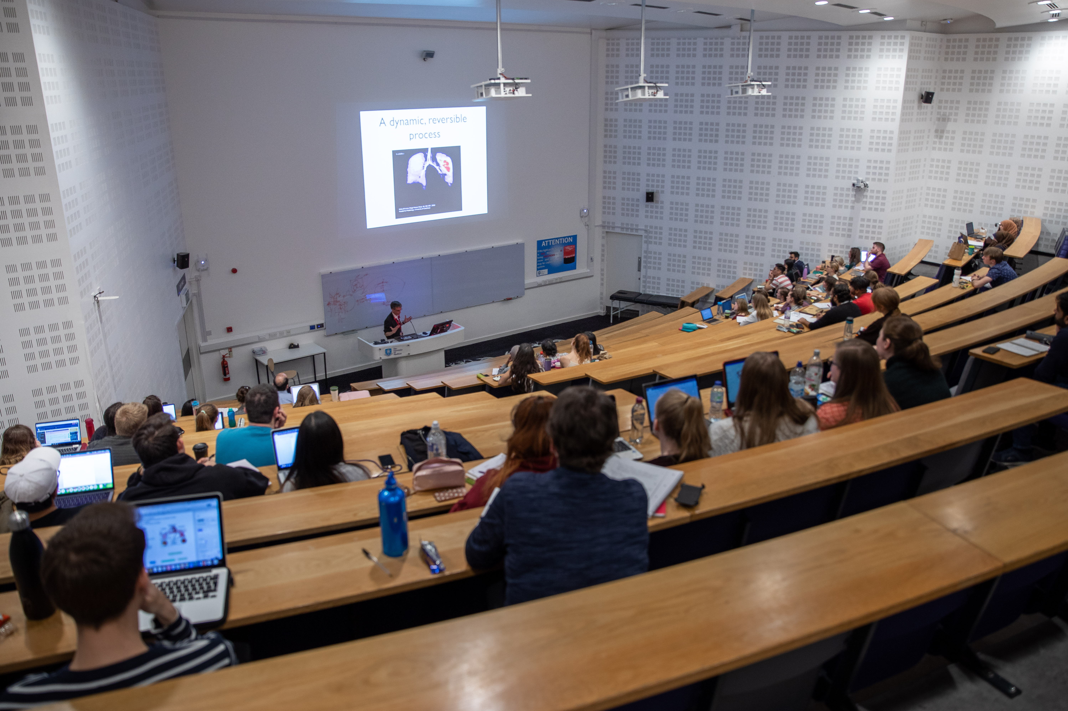
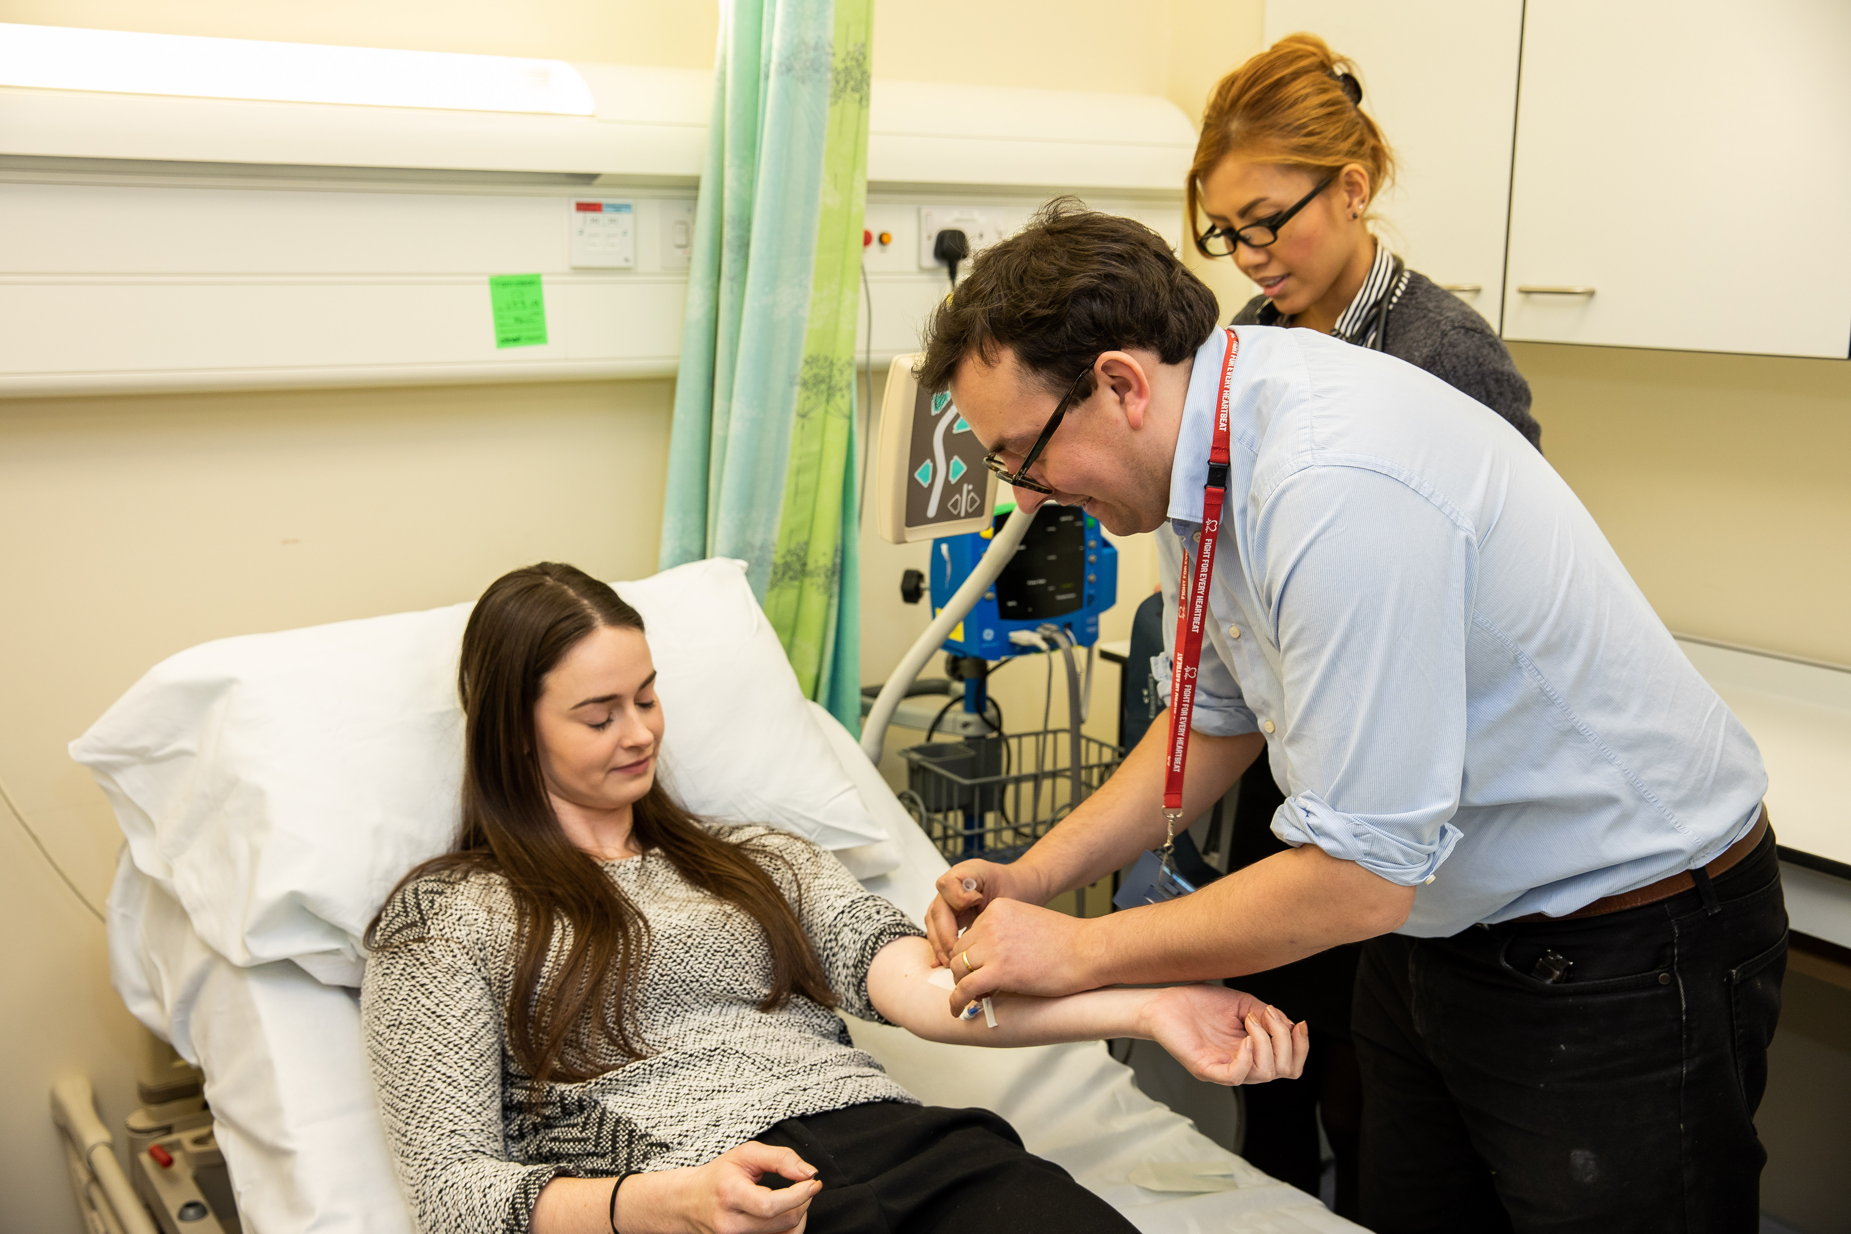
What is it like to study medicine?
At Sheffield, our course starts off teaching normal functioning of the body in Year 1, moving to understanding how disease happens in Year 2, and clinical placements in hospitals in Years 3-5.
Previous slide
Next slide

Slide 12
Activity Time!
Previous slide
Next slide

Slide 13
What is it like to study medicine?
We thought we’d give you a taste of this in the next few slides, by taking you through a quick activity on heart attacks.
By the end you’ll understood how information you have already learnt can be put into a medical context !
Previous slide
Next slide

Slide 14
An achy, breaky heart
Let’s start by refreshing your knowledge of the heart, using this fun game – click here to launch. Come back to this page when you’re done.
Don’t worry if you don’t know it all, have a go!
Previous slide
Next slide

Slide 15
An achy, breaky heart
Task: Spend a couple of minutes writing down anything you know about heart attacks
Now, let’s think about what a heart attack actually is...
Previous slide
Next slide

Slide 16
An achy, breaky heart
Heart attack key facts:
Heart attack is commonly used to describe myocardial infarction.
This is when the heart muscle cells don’t get enough oxygen or nutrients, and they start to become damaged or die.
Heart attacks can vary depending on how many muscle cells are affected.
Previous slide
Next slide

Slide 17
An achy, breaky heart
But what causes the lack of oxygen and nutrients to the heart?
Isn’t the heart full of blood?
Well, yes, but the heart muscle actually gets its blood supply from arteries on its surface – the coronary arteries.
It’s these arteries that get blocked during a heart attack.
Previous slide
Next slide

Slide 18
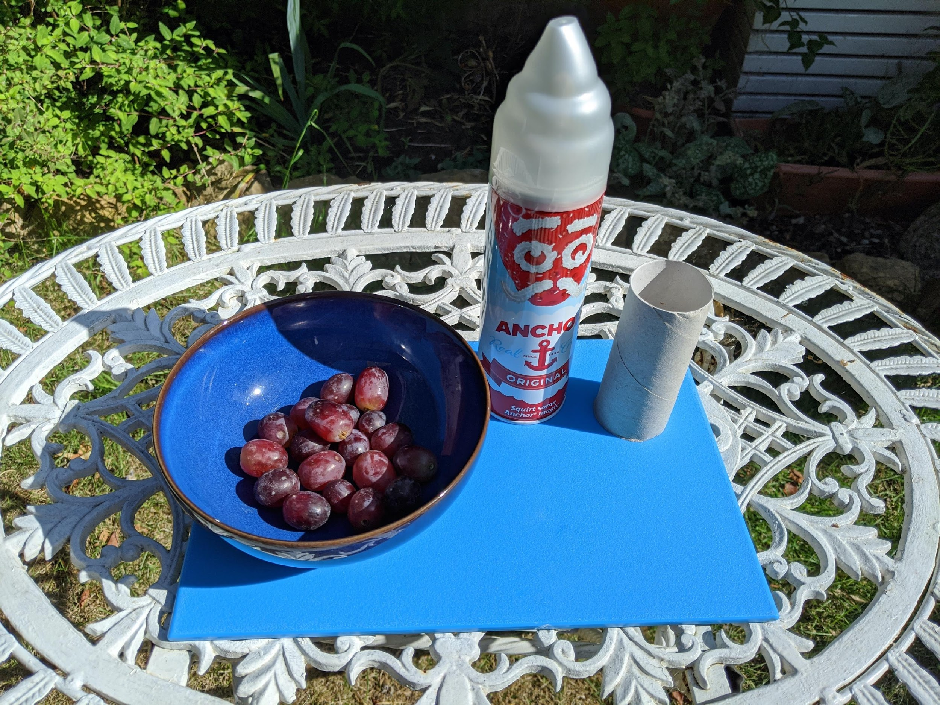
An achy, breaky heart
Let’s see how this happens using some common items…
For this activity, you’ll need:
Toilet roll/rolled up paper
Grapes/marbles
Squirty cream/shaving foam
Cellotape/book
Previous slide
Next slide

Slide 19
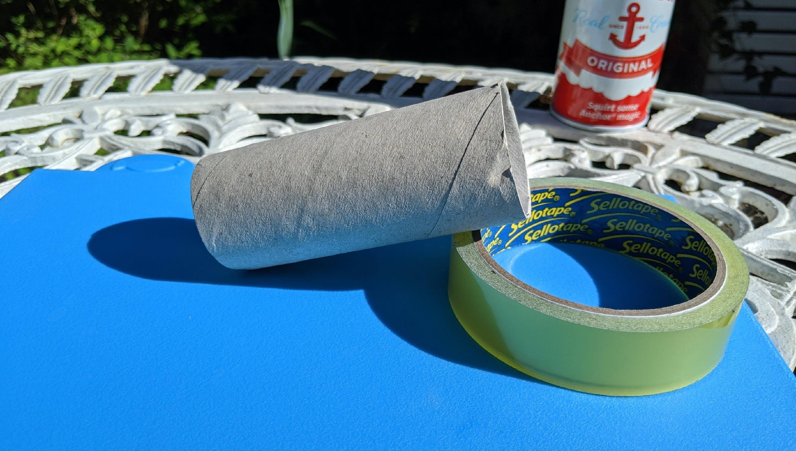
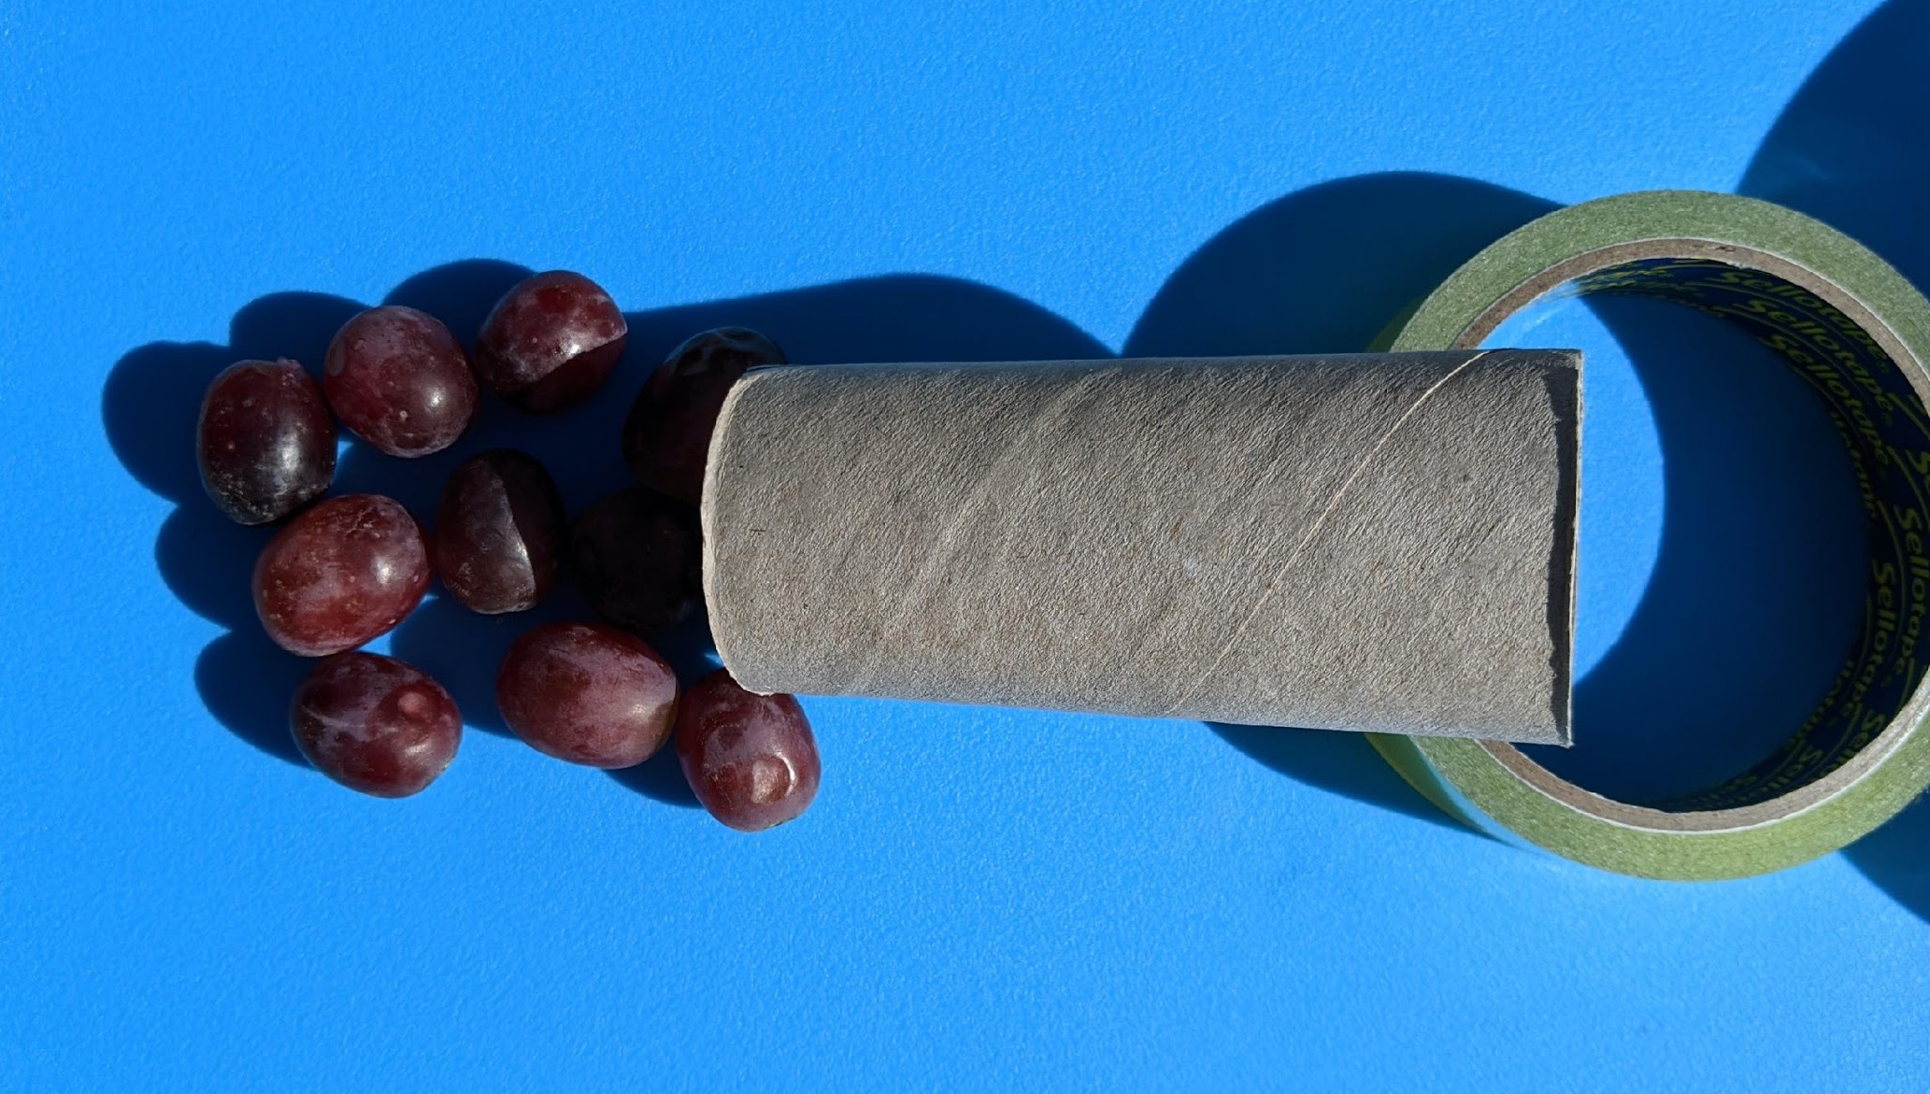
An achy, breaky heart
Hold your tube at a 45-degree angle. Try and roll the grapes down the tube. Easy, right?
This is how blood flows normally – nothing gets in the way and it flows smoothly.
Next slide

Slide 20
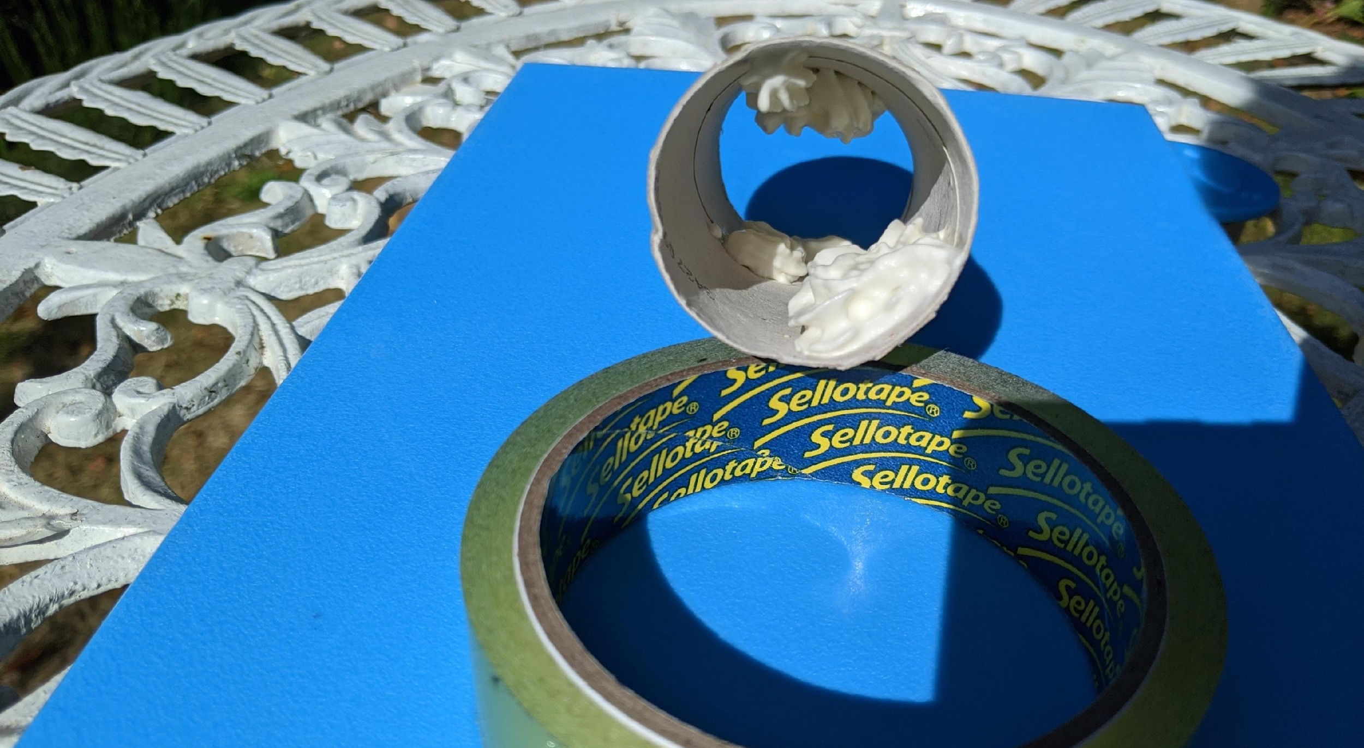
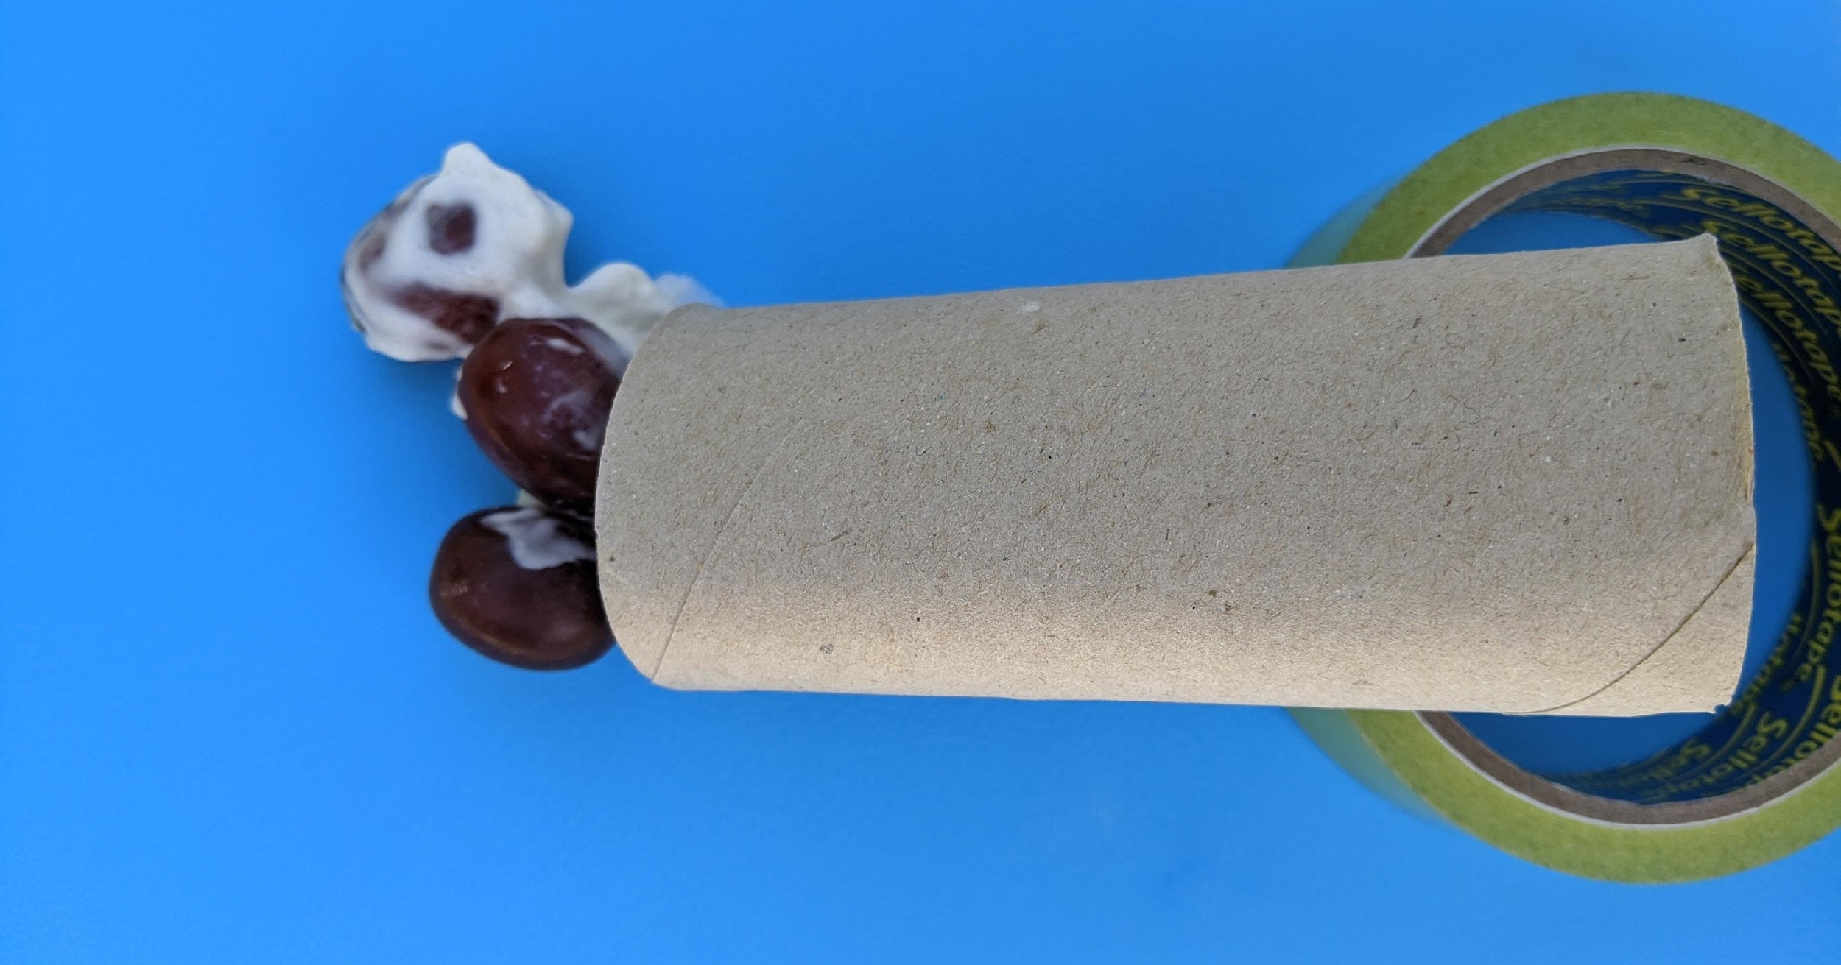
An achy, breaky heart
Now, grab the whipped cream and spray some into the tube on each side. Try and roll the grapes down. Not so easy right?
This is what it’s like when fat, cholesterol and other nasties come together to form plaques in the arteries, in a process called atherosclerosis.
Previous slide
Next slide

Slide 21
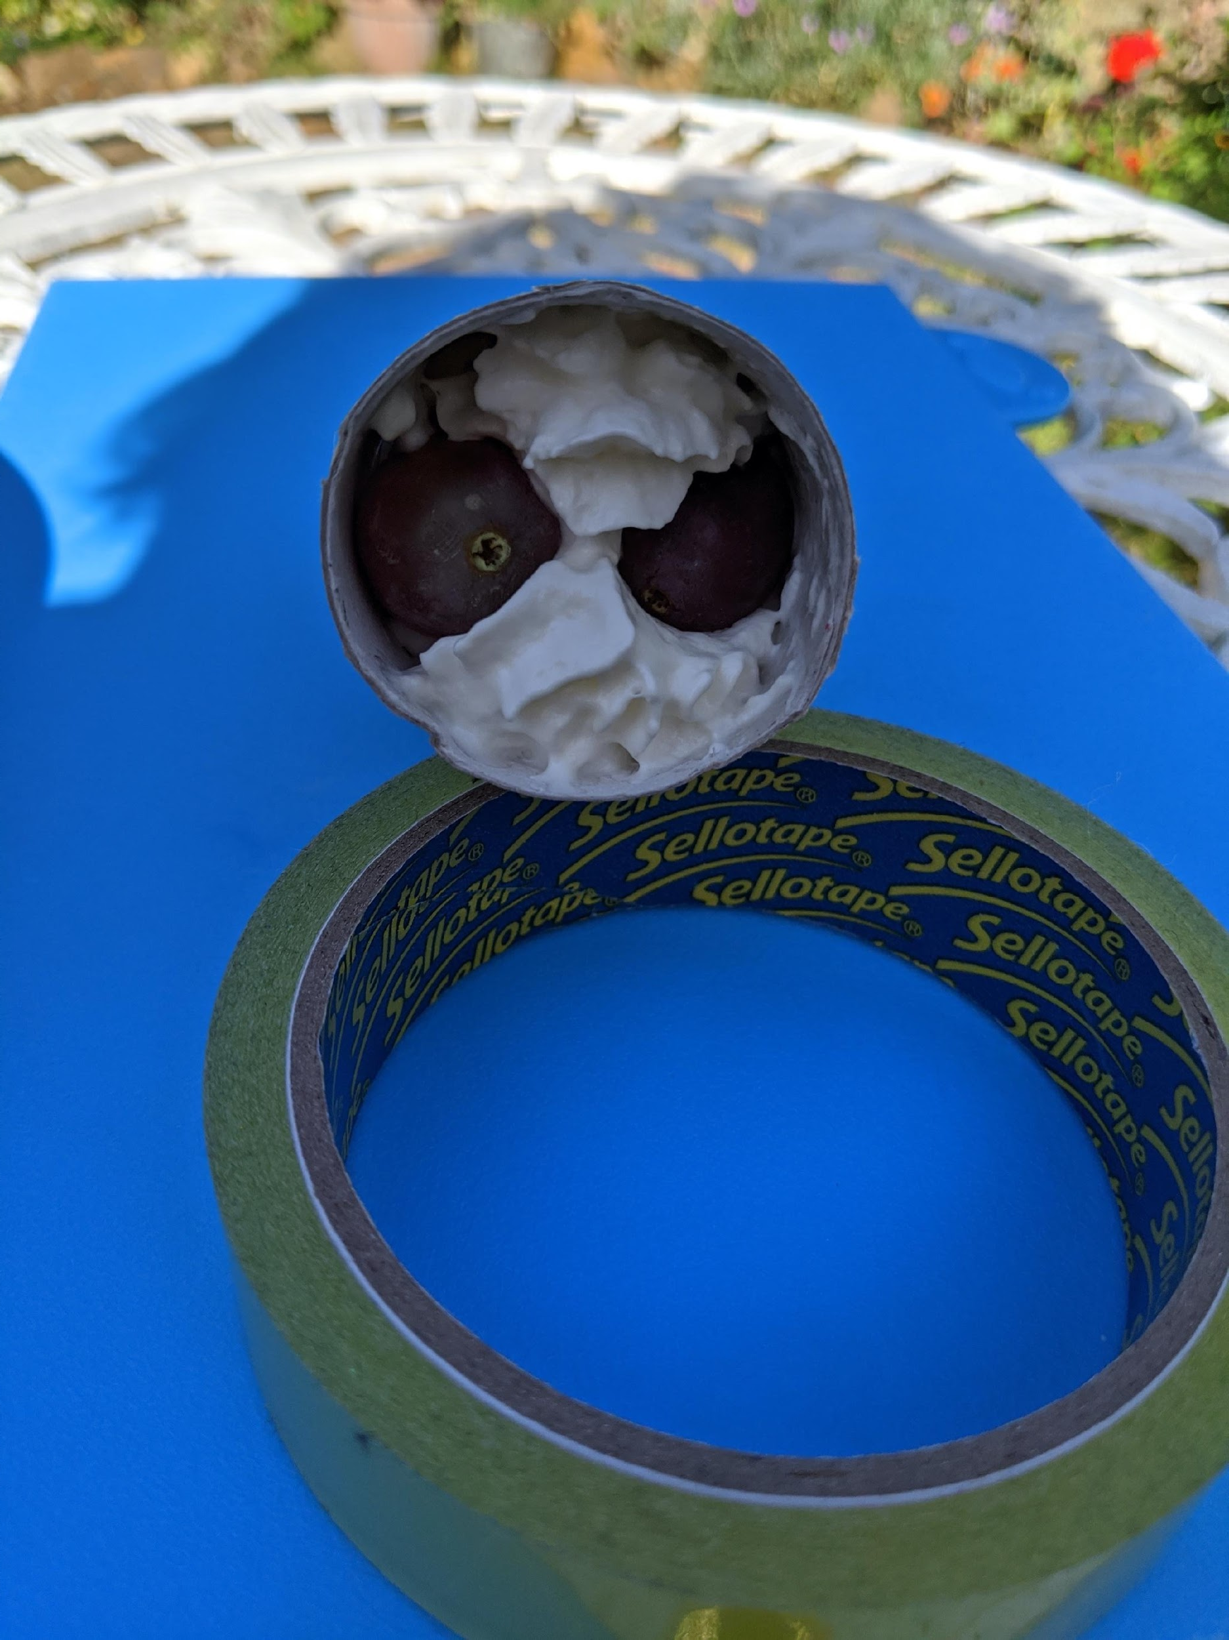
An achy, breaky heart
Next, fill the toilet roll with whipped cream, and try and get the grapes through.
Disaster!
The tube is blocked, and the grapes (blood) can’t flow through. This is essentially what happens during a heart attack, and stops the heart muscle cells from getting oxygen and key nutrients.
Previous slide
Next slide

Slide 22
An achy, breaky heart
Here’s a summary on what we’ve just been through:
Normal
Blood can flow through!
Previous slide
Next slide

Slide 23
An achy, breaky heart
Here’s a summary on what we’ve just been through:
Partly blocked
Plaques reduce the diameter of the vessel, so less blood can flow through.
This can lead to angina – chest pain which comes on with exercise caused by partial blockage of the coronary arteries.
Previous slide
Next slide

Slide 24
An achy, breaky heart
Here’s a summary on what we’ve just been through:
Fully blocked!
The top of the plaque (grey) comes off, and blood cells clump together and clot on top of it. This completely blocks the vessel, so no blood can flow through.
This is what happens in a heart attack, or myocardial infarction.
Previous slide
Next slide

Slide 25
An achy, breaky heart
Here’s a summary on what we’ve just been through:
Partly Blocked
Fully Blocked
Normal
Previous slide
Next slide

Slide 26
An achy, breaky heart
And here’s a useful video which also explains some key signs to look out for and treatments.
Previous slide
Next slide
Notes:
https://www.youtube.com/watch?v=3_PYnWVoUzM

Slide 27
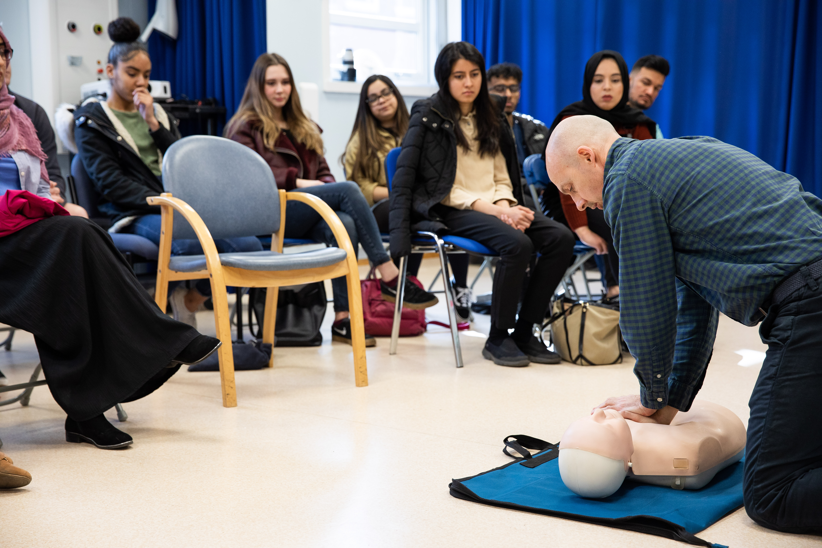
Activity Summary
What we’ve just been through is a small example of some of the things we learn in the first two years of medicine.
In the following years you will learn how to do investigations and clinical skills, including ECGs, and meet patients who’ve suffered from these conditions in a hospital setting during placements.
Previous slide
Next slide

Slide 28
Work Experience
Hopefully you enjoyed that activity and learned something new. Now perhaps you are eager to find out more information or get some work experience?
We know it may be more difficult for you to secure work experience due to Covid19 – Medical Schools are aware of this. The Medical Schools Council have released a guidance document to help.
Previous slide
Next slide

Slide 29
Work Experience
For work experience you could also consider:
Different types of work experience can demonstrate the skills needed for Medicine, especially ‘people-facing’ experience.
Speak to doctors or others in Medicine
Consider volunteering - National Citizen’s Service are running a ‘One Million Hours’ campaign where you can volunteer your time to help your community, or use a website like Do-it to find opportunities near you that can be done at home or socially distanced.
Previous slide
Next slide

Slide 30
Summary Overall
Studying medicine is an exciting process, allowing you to merge your interests in science, practical work and social engagement, ultimately leading to a career where you can make a real difference in your community.
We hope you’ve enjoyed working through this presentation, and are excited about the prospect of studying medicine!
Previous slide
Next slide

Slide 31
Next steps…
To find out more about the course at Sheffield, visit this website.
For tips and advice on applying to medicine, follow our student led group SWAMS here.
Previous slide
End of Session

