Slide 1
1. Electoral Turnout: How Many People Decide to Vote? (Descriptive Statistics)
01
In this workshop we are going to use descriptive statistics to analyse electoral turnout.
Descriptive statistics are used to describe the basic features of the data in a study. They provide simple summaries about the sample and the measures. Together with simple graphics analysis, they form the basis of virtually every quantitative analysis of data.

Slide 2
02
1918-2019: Who was allowed to vote?
In 2018, the UK marked the 100th anniversary of The Representation of the People Act of 1918 that allowed some women, and all men, to vote for the first time.
To understand how many people decide to vote in elections in the UK, let’s look at who has the right to vote:
Before 1918, women did not have the right to vote, and male voters had to be taxpaying householders aged over 21. In 1928, women aged 21 and over were granted the right to vote. In 1969, the voting age was lowered on an equal basis to 18 for both women and men.

Slide 3
03
Let’s keep in mind that now (in 2020), to vote in a general election you must:
be registered to vote
be 18 or over on the day of the election (‘polling day’)
be a British, Irish or qualifying Commonwealth citizen
be resident at an address in the UK (or a British citizen living abroad who has been registered to vote in the UK in the last 15 years)
not be legally excluded from voting

Slide 4
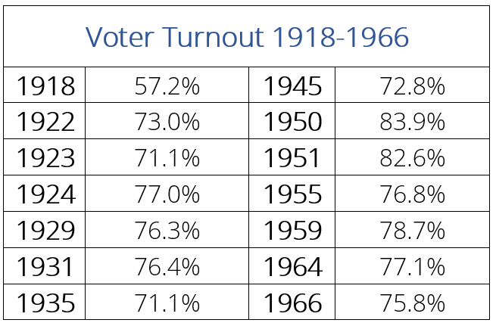
04
Activity 1: Descriptive Statistics
From 1918 to 2019, there were 28 elections. How many people decided to exercise their right to vote?
We are going to start our workshop by looking at the first fifty years, or fourteen elections, to understand how many people (who were eligible to vote) participated in each election.

Slide 5
05
1A: Mean, Median and Mode
Mean, median, and mode are different measures of the center in a numerical data set. They each try to summarize a dataset with a single number to represent a "typical" data point from the dataset.
The Mean is the average number in a dataset. It can be found by adding all the data points together and then dividing by the number of data points.

Slide 6
06
1A: Mean
Let’s do this with our voter turnout numbers. This is what it would look like:
First step - add up all the numbers:
57.2 + 73.0 + 71.1 + 77.0 + 76.3 + 76.4 + 71.1 + 72.8 + 83.9 +
82.6 + 76.8 + 78.7 + 77.1 + 75.8 = 1049.8
We then divide this number by the number of data points. for this set, there are 14 data points.
1049.8 ÷ 14 = 74.99
So the Mean is 74.99%

Slide 7
07
1A: Median
The Median is the middle number in a data set and it can be found by ordering all the data points and finding the one number in the middle. Sometimes there are two middle numbers, and the median would be the mean of those two numbers.

Slide 8
08
1A: Median
Let’s use the same numbers again, starting with putting them in numerical order:
57.2 / 71.1 / 71.1 / 72.8 / 73.0 / 75.8 / 76.3 / 76.4 / 76.8 /
77.0 / 77.1 / 78.7 / 82.6 / 83.9
In this set of numbers, there are two in middle. So we say that the median is the mean (average) of the two:
(76.3 + 76.4) / 2 = 76.35
So the Median is 76.35

Slide 9
09
1A: Mode
The Mode is the most common number in a data set. This is the number that occurs the highest number of times.
Have a look at the numbers again - are there any that occur more than once?
71.1 % occurs twice, so that is the mode.

Slide 10
10
When to use mean, median and mode?
There are different ways to summarise the data that are beneficial to a specific data set.
For example, the mean is more sensitive to extreme outliers and can be pulled in either direction. A good example of this is to think about at house prices that are used to describe a neighbourhood:
If Mark Zuckerberg lived in your neighbourhood, and enlarged the house and expanded into the property around him, then the mean and median home values will look very different because of that house’s affect on the overall property values. Which dispersive statistic do you think would give you a more accurate reflection of the neighbourhood?

Slide 11
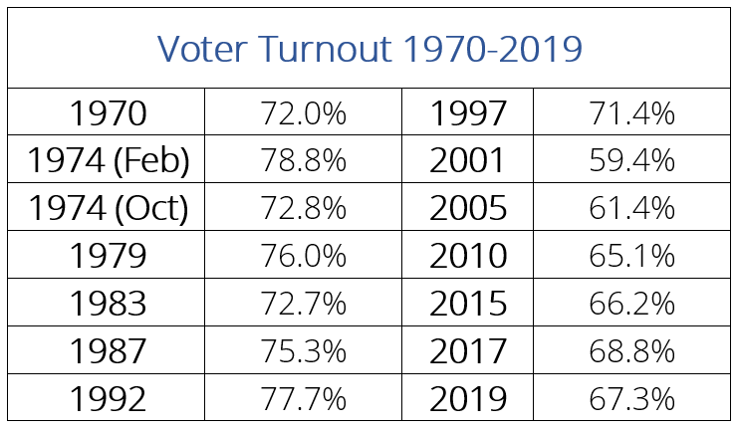
11
1B: Let’s Try it Ourselves
Let’s calculate the mean, mode and median again, this time with the election turnout from the past 50 years:
What is the mean? What is the median? What is the mode?

Slide 12
12
1C: Let's Analyse the full 100 years
Let’s calculate the mean, mode and median for the combined datasets from 1918-2020.
What is the mean? What is the median? What is the mode?

Slide 13
13
Part 2: When was voter turnout the lowest, and when was it the highest?
How can we check that the mean, mode and median that we found above really represent the data? Here we are going to measure the Range to check how spread out our numbers are.
The Range is the difference between the lowest and highest values.
For the percentages from 1918 to 1969, the lowest number is 57.2% and the highest number is 83.9%. The difference between the two is 26.7%.
So the range is 26.7%

Slide 14
14
What is the range from 1970 to 2019?

Slide 15
15
And what is the range for the total numbers from 1918 to 2019?

Slide 16
16
What do you think the range is telling us about electoral turnout for each set of numbers (1918-1966 and 1970-2019)?
Let’s think about how the range is useful - for example, what if the electoral turnout in 1966 was 5%, and in 1924 it was 95%?
The range tells us what the mean, median, and mode don’t: essentially, how spread out our numbers are. Why do you think this is important?

Slide 17
17
Part 3: Final Discussion
After looking at the descriptive statistics (the mean, mode and the median), and a dispersive statistic (the range) here are some questions to contemplate:
3A: What do the different type of statisitcs tell us? And what do they not tell us?
1
What do you think are the positives and negatives of each method?
2
For this data set about electoral turnout over the past 100 years, which statistic (mean, mode, median) do you think worked best?
3
How did these statistics help us understand electoral turnout over the past hundred years?

Slide 18
18
3B: Voter Turnout - How does the UK compare?
In the past, many people have fought for your right to vote (when you turn 18). Many campaigners, such as the women’s suffrage movement or those who took part in the 1819 Peterloo protests and subsequent massacre, gave their lives to win the right to vote.
Through voting for our elected representatives, we get to have a voice in how our country is run.
In the UK, the MPs we elect make decisions about taxes, education, housing, the NHS as well as the environment.
Not everyone who is eligible to vote actually does. There are multiple reasons for this: sometimes they are interested in politics, or do not like any of the candidates, or are worried they are not well enough informed. Some countries have compulsory voting, like Australia and Belgium. And even though voting is mandatory, does not infringe on their rights as they are allowed to submit a blank ballot at a polling station rather than vote for a candidate.
.

Slide 19
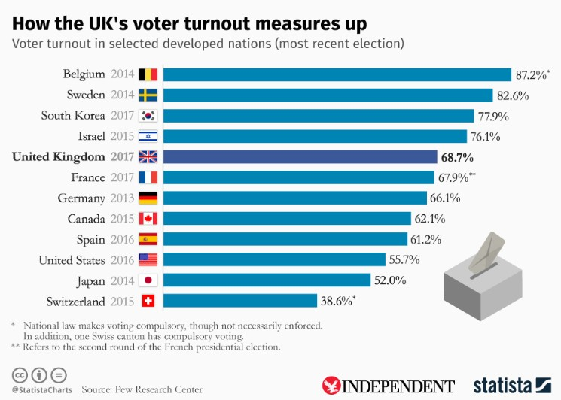
19
So how does the UK compare? The bar graph (a statistical concept we will explore in the next chapter) below will provide some useful information.

Slide 20
20
3C: Here are some more specific questions for discussion:
1
Why do you think people should vote, and are enough people voting?
2
Do you think the criteria for eligibility to vote affect who goes out to vote? What kind of extra data would be helpful in understanding this?
3
How does the UK's voter turnout compare to other countries around the world? Use the graph above to compare. Many countries that do not have a compulsory voting system still get strong turnouts. For example, Sweden had a voter turnout of 82.6% in 2014, South Korea had 77.9% in 2017, Israel had 76.1% in 2015 and New Zealand had 75.7% in 2017.
4
Given the percentage of people who have decided to vote in the last hundred years, do you think there should be compulsory voting in the UK (like in Australia or Belgium)?
5
If the voting age was lowered to 16 years old, do think it would affect the percentage of people who participate in elections?
Why or why not?

