Slide 1



01
6. Media, Bias and Politics (Bias)
When you see data presented to you in the media, it is important to be able to critically examine the statistics for any bias.
Often, headlines will be made for attention-grabbing, and not for accuracy. We see numbers used more and more in the news, and they can be used to persuade you to conduct a certain way. For example, who to vote for in an election or referendum.

Slide 2
02
With the Covid-19 pandemic, there isn’t a day that goes by in the news that we don't see numbers, graphs, and statements about statistics to explain how the UK, and the world, is handling the crisis.
But what do all these numbers really mean? And are they always used objectively?
Today’s activities will help you scrutinize the statistics you see in the media.

Slide 3
What is bias?
03
Sometimes, research is biased when information is presented in a warped way in order to guide someone to reach a desired conclusion.
In statistics, bias occurs when the results differ from the true quantitative parameter being estimated. There are many different types of bias in statistical research.
Examples of different types of biases that we will be exploring today:

Slide 4

04
Selection bias involves choosing individuals selectively over others in a study, and therefore proper randomisation is not achieved. This means that the population sample obtained is not representative of the population intended to be analysed.
Exclusion bias happens when specific individuals are excluded from the population sample of a study.
Observer bias arises when the researcher subconsciously influences research due their own expectations, which can alter how a survey is carried out, or how the results are recorded.

Slide 5
05
Reporting bias is when only certain results are chosen to be included in an analysis, leaving out relevant evidence.
Recall Bias occurs when participants are unable to remember past experiences or events accurately, and memories can be influenced by subsequent experiences and events.

Slide 6

06
Response bias (also known as survey bias) is a general term that describes the different tendencies in participants to answer untruthfully or inaccurately. For example, participants may be reluctant to give truthful answers if they are not deemed socially acceptable. This type of bias frequently happens when participants are asked to self-report (like in structured interviews or surveys) and it can also be the result of poor survey design.

Slide 7
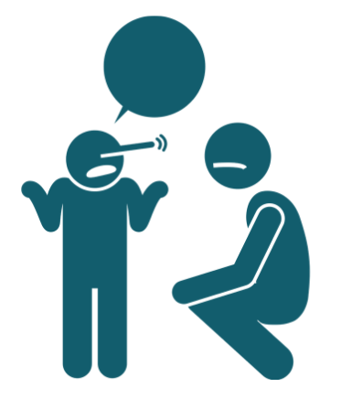
Activity 1: Lying in Statistics
07
Our first activity is going to help you scrutinise the numbers, and statements about them, that you see in the media.
When looking at statistics you should be asking yourself these questions:
When was the data collected? Where did the data come from? What questions were asked and how were participants asked to answer? Is there any information that is missing that could affect the results? Can you think of a way to measure the data in a better way?
In this activity, we are asking you to examine 5 different statements about statistics.

Slide 8
08
For each statement, answer these three questions:
Is there is any bias evident here?
What type(s) of bias?
How would you improve the statement?

Slide 9
09
Researchers surveyed a population sample in Sheffield to find out how the UK would vote if there was a snap election.
Researchers surveyed a random sample of the UK population to find out why they voted the way they did in the 1997 elections.
Researchers collected data on a random sample of individuals from around the UK and found the mean age of Conservative supporters in the UK.

Slide 10
Activity 2: How did we do?
10
Now, let's scrutinise our own work!
What may have been biased about your survey and its results in the last chapter?
How could you make a misleading headline about your research?

Slide 11
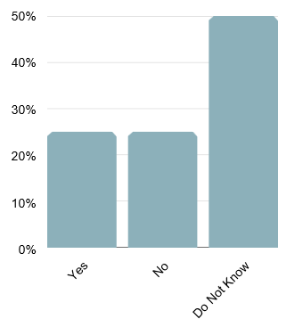
11
For example, I will give you some data with an accompanying headline, and you can tell me what is misleading about the statement and graph about this data (please keep in mind that this data is made up for the purpose of this experiment).
Graph Title: Results show that Only 25% percent of the US will vote for Trump.
Research Question: Will you vote for Donald Trump in the 2020 Election?

Slide 12
12
In the graph above we can see that half the population is undecided, which means that in the end there may be a lot more than 25% of people who vote for Donald Trump.
So now, brainstorm three headlines from your survey that would be misleading, but technically correct:
Next, form small groups of 4 to 5 of your classmates. Share your headlines and see who can work out what may be misleading about your statements. After, share you original data to check if they were right!

Slide 13
Activity 3: The Right Visual
13
In this this activity we are going to explore how statistics can often be presented in skewed ways.
Here are some ways that statistics are visually misrepresented:

Slide 14
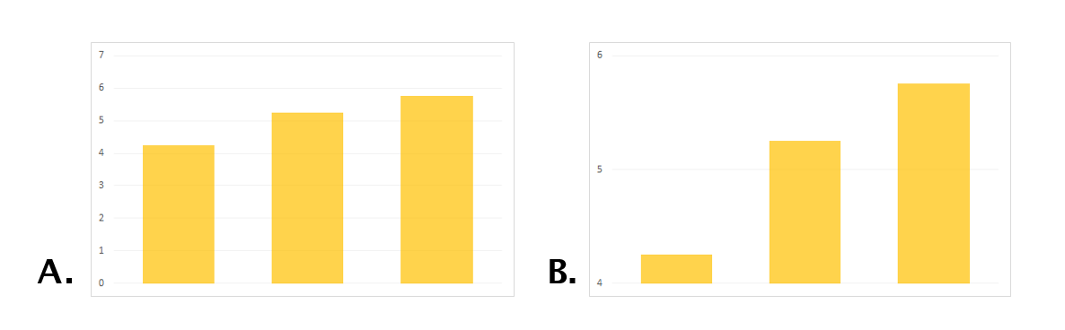
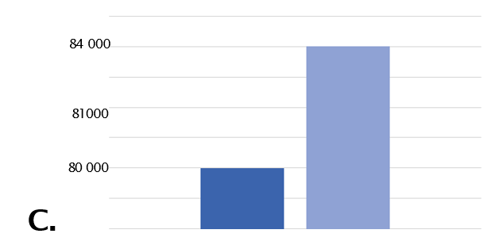
14
Scaling and Axis manipulation is used to alter the way that a scale looks for a graph. This changes the impression of the magnitude of differences:
Here is another example:

Slide 15
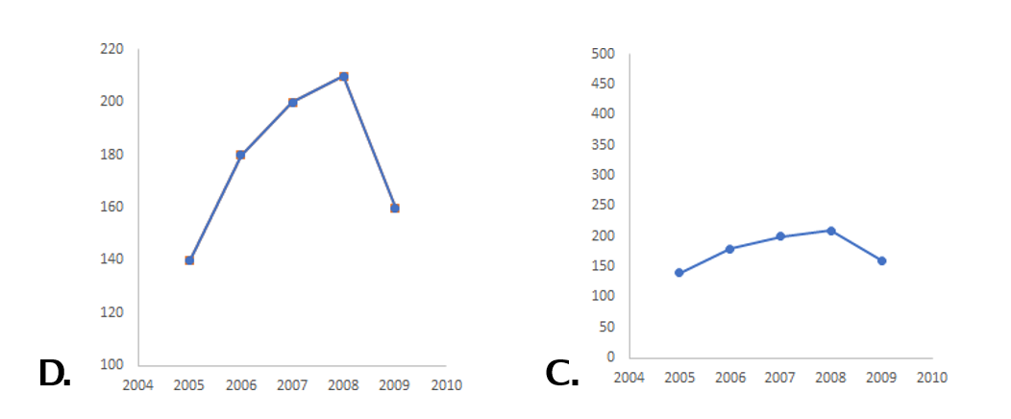
15
Here is an example of the data can be misrepresented in a line graph. Both graphs show the same data but with different scales.
Which one appears more truthful to you? Why?

Slide 16
Activity 4: Can you infer with your data?
16
The reason why we want to have the right type of population sample is because we want to be able to infer our results on the whole population that the sample represents. To infer means 'to deduce', and in survey results this means that we want to be able to draw a conclusion from a sample, that reflects what the population is thinking as a whole.
In order to infer our survey data, our results therefore have to be probable.

Slide 17

17
Probability is the likelihood that an event will occur.
Probability in statistics is what allows us to use an observed sample of data to make inferences about an unobserved population.
An example of probability is a coin toss. When you toss a coin, there is a 50% probability that it will land heads up after you flip it. There is also a 50% probability that it will land tails up. In statistics, we often use decimals to represent probability. So for a coin toss, the probability would be 0.5

Slide 18

18
How does this apply to a population sample? When conducting a survey, you want to think carefully about who your participants should be. For example, just because your research topic is about the elderly, does not mean that you should solely interview people over the age of 65. The results would differ according to who we ask: male or female, young or old, Conservative or Labour supporter.
In order to demonstrate what the population is thinking, we have to survey a sample that is representative of the entire population. That is the only way that we can get the right probability to infer our results on an unobservable population.

Slide 19
19
Think of who you surveyed in Chapter 5 - can you infer statistically from your population sample?
In the survey activity in Chapter 5 we essentially showed the sample as an example of what GCSE students (or your friends and family) are thinking in the UK. This was a non-probability sample: which means that people were selected based on non-random criteria. A form of this is a convenience sample, which when participants are chosen for accessibility and availability - which is what we did!

Slide 20

20
Here are some questions to help you reflect on how your survey could, or could not, be inferred on the UK population as a whole.
Is your population sample biased in any way?
And how would you improve your population sample?
What about the questions you asked? Is there any type of bias that could arise from the wording or type of questions you asked?
In hindsight, is there anything you would change?

