Slide 1
Bolt on or Built in? Challenges for Integrating Wellbeing into Policy
The Carnegie UK Trust work on Wellbeing 2010-2015
Lauren Pennycook

Slide 2
Wellbeing since 1913

Slide 3
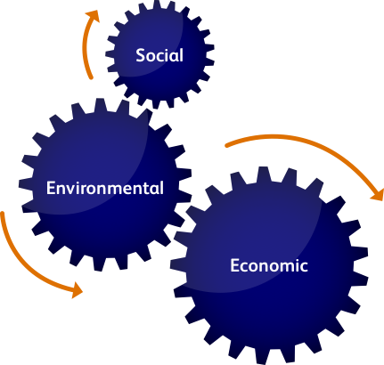
Wellbeing is about far more than happiness

Slide 4
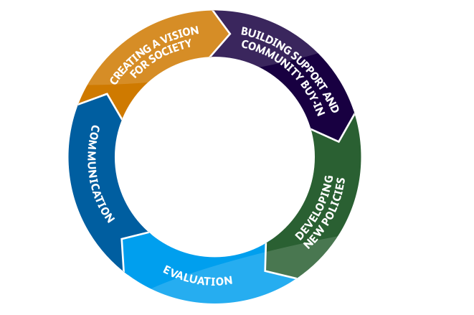
Wellbeing is about more than measurement

Slide 5
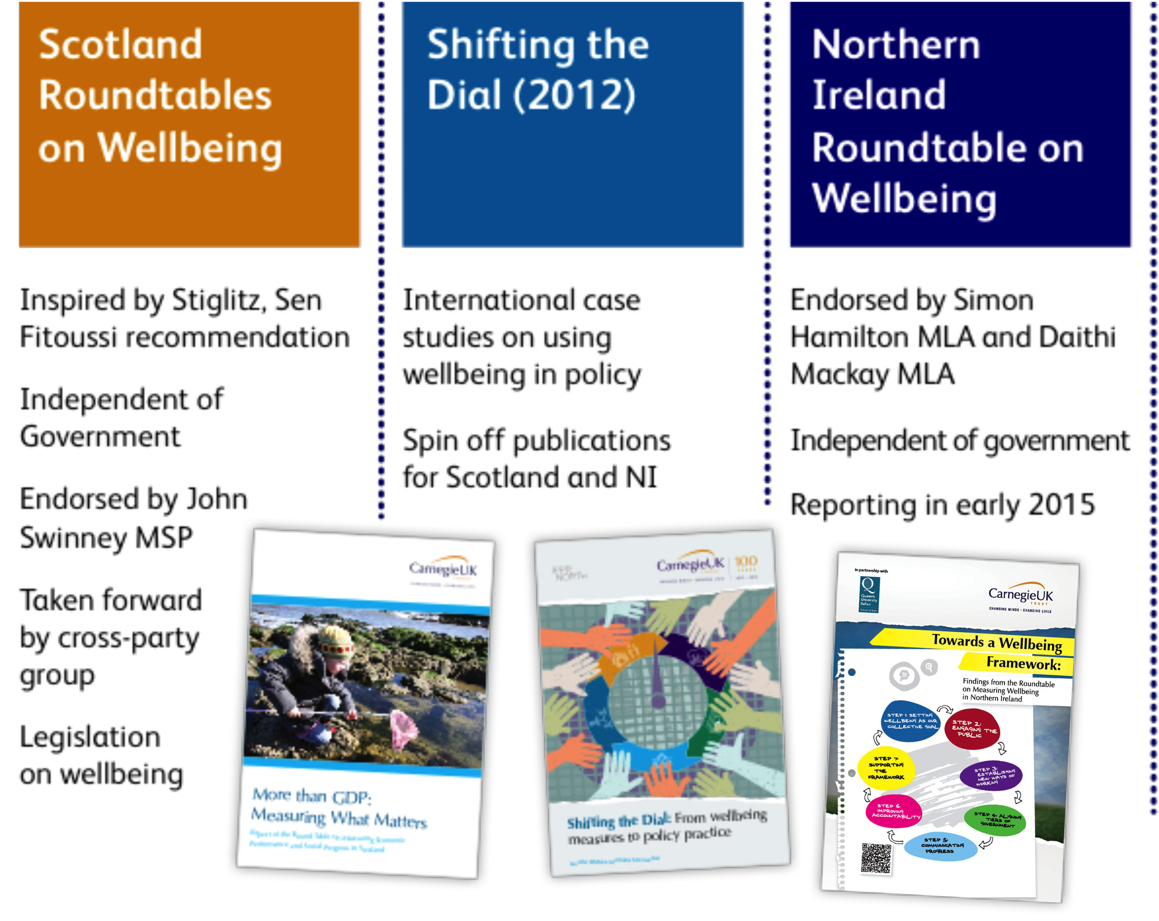

Slide 6
Scottish National Performance Framework

Slide 7
Scotland Roundtable

Slide 8
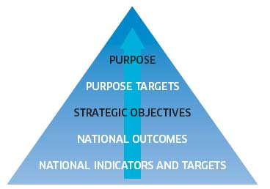
Opportunities: Community Empowerment Bill

Slide 9
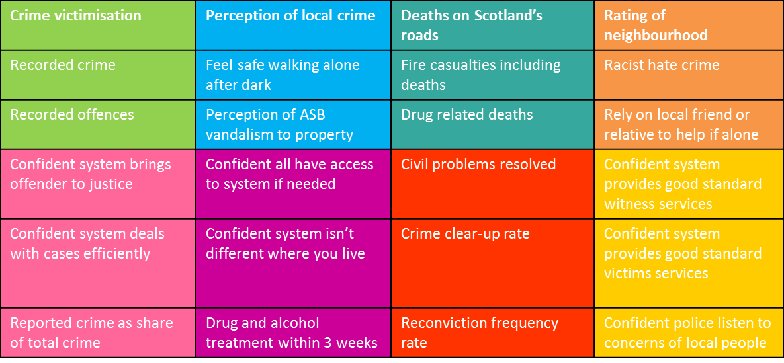
Justice outcomes

Slide 10
Northern Ireland Roundtable

Slide 11
Co-Chaired by Martyn Evans and Aideen McGinley
Representation from political sponsors and cross-sectoral stakeholders
Process
Four Roundtable meetings
Call for evidence
Reporting
Short report with recommendations and clear steps for implementation
Launch hosted by the Minister (12th March)
Study trip to Scotland
Focus groups with the public
Partnership with Queens University Belfast (secretariat)
Background report covering all evidence received
Pre-publication meetings with the Minister and Chair of the Finance Committee
Engagement with Chief Executives Forum and Finance Committee
Membership

Slide 12
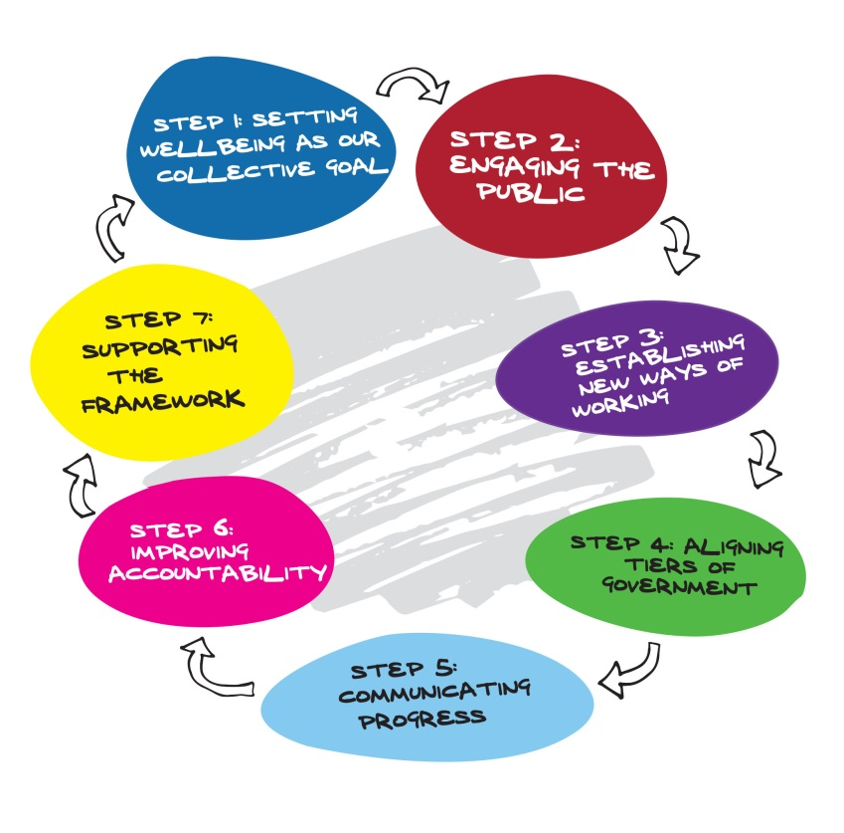
Steps to improving wellbeing in Northern Ireland

Slide 13
Recommendations of the Carnegie Roundtable on Measuring Wellbeing in Northern Ireland
The Northern Ireland Executive should:
Integrate the concept of wellbeing as our collective purpose into its mission statement for all public services as part of the 2016-2021 Programme for Government.
Lead a society-wide conversation on wellbeing which feeds into the development of a Wellbeing Framework to guide the work of the NI Executive.
Agree a set of strategic commitments and outcomes (the Wellbeing Framework) and place this at the core of the 2016-2021 Programme for Government.
Set out, through the future Programmes for Government, the reforms required to achieve the Wellbeing Framework, including a whole-of-government operational culture.
Develop a training and capacity-building programme for all those bodies responsible for implementation.

Slide 14
Recommendations of the Carnegie Roundtable on Measuring Wellbeing in Northern Ireland
The Northern Ireland Executive should:
Embed the Wellbeing Framework by linking it to collaborative budget processes and informing the allocation process.
Work with local government to agree a new relationship to fully integrate and monitor local outcomes within the context of the Wellbeing Framework.
Invest in communicating the Wellbeing Framework and trend data to the public by a range of techniques including data visualisation, live dashboards, social and traditional media.
Lay an annual report before the Northern Ireland Assembly for debate on the progress made by the Programme for Government towards outcomes described in the Wellbeing Framework.
Convene a Standing Advisory Group to provide ongoing technical support, advise on capacity-building activities and provide external review of the implementation of the Wellbeing Framework

Slide 15
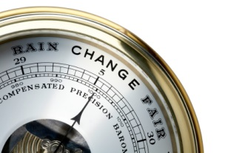
The challenges
Who ‘owns’ wellbeing?
Getting lost in politics
Lack of basic information
Finding an anchor

Slide 16
Contact
laurenp@carnegieuk.org
01383 749795
@CarnegieUKTrust
@NIwellbeing #NIwellbeing

