Slide 1
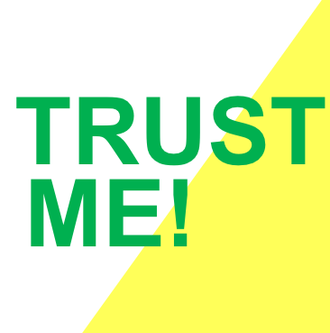
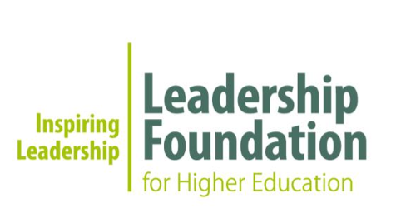
++ Behaviours that build and break trust in doctoral supervision relationships.
Dr Kay Guccione
Researcher Mentoring & Coaching
k.guccione@sheffield.ac.uk | @kayguccione | @predoctorbility

Slide 2
why did I do this work?
++ impact of supervision
on progress
“I’m terrified of being asked how it’s going – I have no idea how it works, I’m lost and it’s scary, so I avoid contact.”
Unspoken rules
Role boundaries blurry
Unclear end goals
Original contribution?
Project management

Slide 3
why did I do this work?
++ how best to help
students progress
“I’ve tried hands on, I’ve tried hands off, I just don’t know what they need, and they’ve stopped responding to emails.”
Chase/quarry effect
What works for me
Silence is golden
More reporting?
I don’t know either

Slide 4
both sides
++ insecurities = vulnerabilities
Trust as a
workplace
phenomenon can be defined as 'willingness to accept uncertainly and make oneself vulnerable in the face of insecurity'
(Hope-Hailey et al., 2012)

Slide 5
transitions are hard
++ the life and times
of supervision
Doctoral development is continual identity reappraisal in response to new learning, changing priorities, and working relationships
(Gardner, 2008).
2. Rapid identity shifts create feelings of confusion, conflict, and evokes an emotional response
(Eraut, 2004).
3. Making sense of developmental experiences can be supported by good professional relationships
(Clegg, 2008).
4. Doctoral transition difficulties that go unresolved, are sustained and mediated by the relationship with the supervisor (McAlpine et al, 2012).

Slide 6
testing times for HE
++ support for supervisor development
Emotionally competent leadership, as well as
technical and intellectual mentorship is required of academic leaders, who must establish good rapport and ‘high-quality’ student-supervisor relationships (Jairam and Kahl,
2012).

Slide 7
TRUST ME!
++ does more trust = quality?
1. what are the vulnerabilities that exist within doctoral student-supervisor relationships
2. how is trust built, how is it eroded, how is it broken?

Slide 8
Critical Appreciative Inquiry approach (Cockell & McArthur-Blair, 2012)
++ research study design
completion
literature
heavy on student demographics: M/F, FT/PT, nationality, discipline, age, work experience etc
external impact
factors
Phenomenon:
facilitate discussions of common experiences of enablers and disablers of doctoral
progression though a social/relational
lens. Appreciative enquiry.
prelim interviews (5)
group interviews (54)
3rd year (or PT☰) PGRs
15% non-STEM
Interpretive analysis
PLUS: supervisor data
PLUS: blog data
(Latona &
Browne, 2001)

Slide 9
students
++ 1. what are the vulnerabilities
http://predoctorbility.co.uk/willingness-to-accept-uncertainly-and-make-oneself-vulnerable
Unclear expectations
Learning involves not knowing
Research is all about the unknown
Define doctorateness? Define OC? Define critical?
Academic rudeness
‘Fine’ is not the same as good
All or nothing stakes
Absent/changing ECR colleagues
Tied to one person (grant exacerbates)
No-one really wants to help (status quo)
Non-responsive supervisors
Conflicting agendas (grants/publishing)

Slide 10
supervisors
++ 1. what are the vulnerabilities
http://predoctorbility.co.uk/supervisor-uncertainty-and-vulnerability
Recruitment practices (culture)
People management is difficult – unsupported
Accountable for funding (reputation)
Data integrity (reputation)
Complicated processes and checkpoints
Supervision is not talked about
No prizes for good supervision
Supervisory team ‘mentoring’ backfires

Slide 11
change over time
++ 2. trust building / erosion / breaking
1. assumed trust: derived from the supervisor’s institutional affiliation, research status, or prior experience e.g. Masters supervisor. Implicit trust (Frowe, 2005).
2. building trust: knowledge and guidance, openness, disclosure and finding common ground; having the student’s best interests at heart; inclusion and giving credit where due; socialising, and professional integrity. 4 domains of trust: Competence, Integrity, Benevolence, and Predictability (Dietz & Den Hartog, 2006). Give trust, get trust. Being trusted raises self-esteem, personal worthiness, and job satisfaction (Van Maele & Van Houtte, 2012).

Slide 12
change over time
++ 2. trust building / erosion / breaking
3. eroding trust: predictability: expectations vs reality (e.g. unavailability of supervisor, lack of specialist expertise); insecurity about progress, standards and achievements. Benevolence and integrity blaming (e.g. for failed experiments); experienced unfairness (favouring students on ‘productive’ projects); ‘checking/snooping’ activities. Sanctions or penalties increases mis-trust (Groundwater-Smith & Sachs, 2002).
4. breaking trust: breaking confidences, consulting third parties; acute incidents related to the ‘competitive’ nature of research or the ‘high expectations’ on research careers e.g. research integrity issues related to publication, public criticism, or appropriate credit for intellectual contribution.

Slide 13
impact
++ so far…
completion
literature
heavy on student demographics: M/F, FT/PT, nationality, discipline, age, work experience etc
Trust is build by creating certainty from uncertainty piecemeal over time…
Vulnerability is inherent in the processes of research…
external impact
factors
Where trust is not present, a student is more likely to isolate themselves. Isolation = delay (Gardner, 2008).
Supervisors can help students build security, by providing safe spaces to test their abilities…
(Latona &
Browne, 2001)

Slide 14
++ further thoughts,
anonymous stories

Slide 15
thanks!
++ acknowledgements
Leadership Foundation for Higher Education
Universities of Glasgow, Oxford, Leeds
Prof. Jerry Wellington

Slide 16
reading
++ references
Clegg, S. (2008). Academic identities under threat? British Educational Research Journal, 34(3), 329–345.
Cockell, J and McArthur-Blair, J (2012). Appreciative inquiry in higher education: A transformative force. San Francisco: Jossey-Bass.
Dietz, G., & Hartog, D. N. D. (2006). Measuring trust inside organisations. Personnel Review, 35(5), 557–588.
Eraut, M. (2004). Informal learning in the workplace. Studies in Continuing Education, 26(2), 247–273.
Frowe, I. (2005). Professional trust. British Journal of Educational Studies, 53(1), 34–53.
Gardner, S. K. (2008). Fitting the Mold of Graduate School: A Qualitative Study of Socialization in Doctoral Education. Innovative Higher Education, 33(2), 125–138.
Groundwater-Smith, S., & Sachs, J. (2002). The activist professional and the reinstatement of trust. Cambridge Journal of Education, 32(3), 341–358.
Hope-Hailey, P. V., Searle, D. R., & Dietz, D. G. (2012). Where has all the trust gone? (pp. 1–99). CIPD.
Hughes, C. (2004). The supervisor's influence on workplace learning. Studies in Continuing Education, 26(2), 275–287.
Jairam, D., & Kahl, D. H., Jr. (2012). Navigating the doctoral experience: The role of social support in successful degree completion. International Journal of Doctoral Studies.
Maele, V. D., & Houtte, M. V. (2012). The role of teacher and faculty trust in forming teachers’ job satisfaction: Do years of experience make a difference? Teaching and Teacher Education. 28, 879-889.
McAlpine, L., Paulson, J., Gonsalves, A., & Jazvac-Martek, M. (2012). “Untold” doctoral stories: can we move beyond cultural narratives of neglect? Higher Education Research & Development, 31(4), 511–523.

