Slide 1
The University of Sheffield Hedgehog Friendly Campus
Gracie Adams

Slide 2
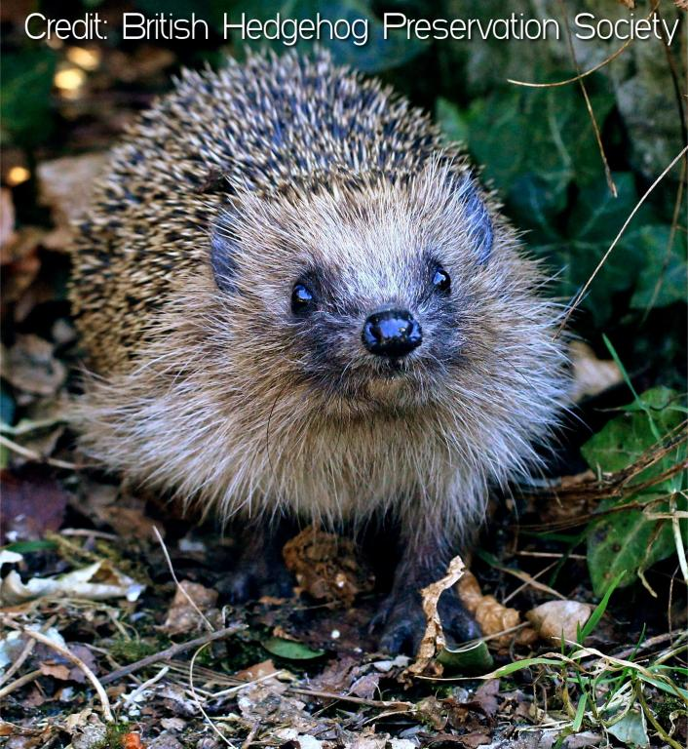
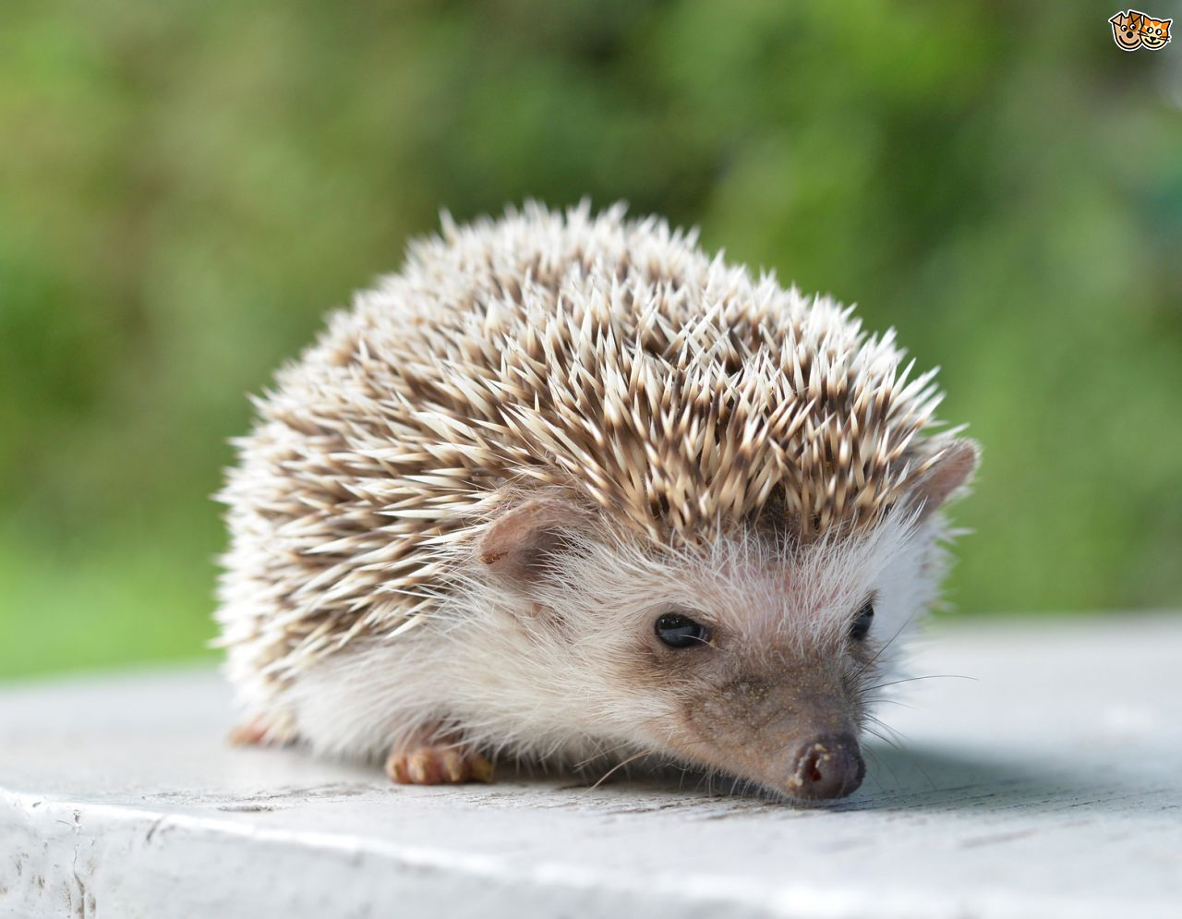
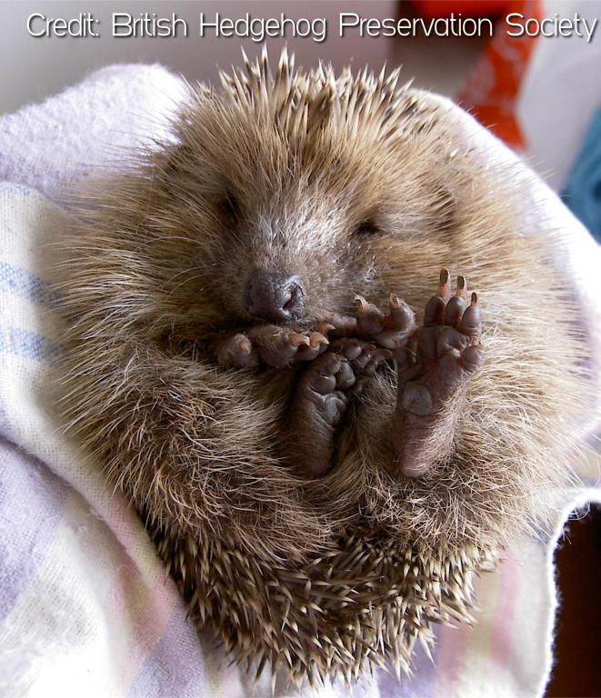
European Hedgehogs
European hedgehogs are vulnerable to extinction in the UK
Threats:
Loss of habitat
Declining food sources
Agriculture/traffic accidents
Indicator species
Conservation helps other animals too
Notes:
Recent state of hedgehogs report shows conservation efforts are working in towns and cities, but we still have a long way to go
Human causes, it’s up to us to help them
Show how soil invertebrates are doing etc
General biodiversity

Slide 3
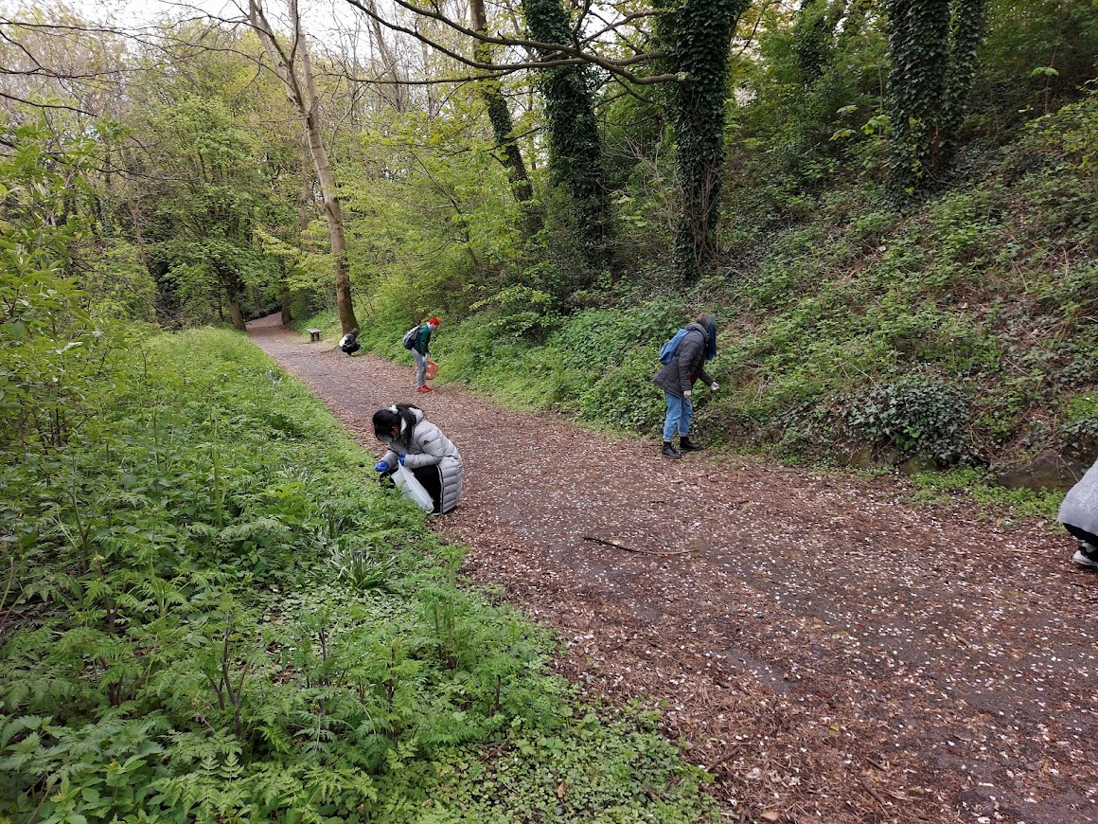
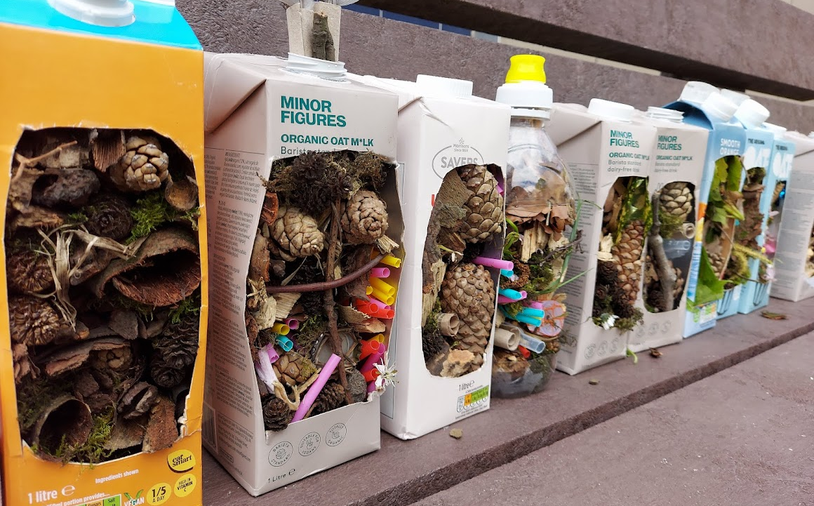
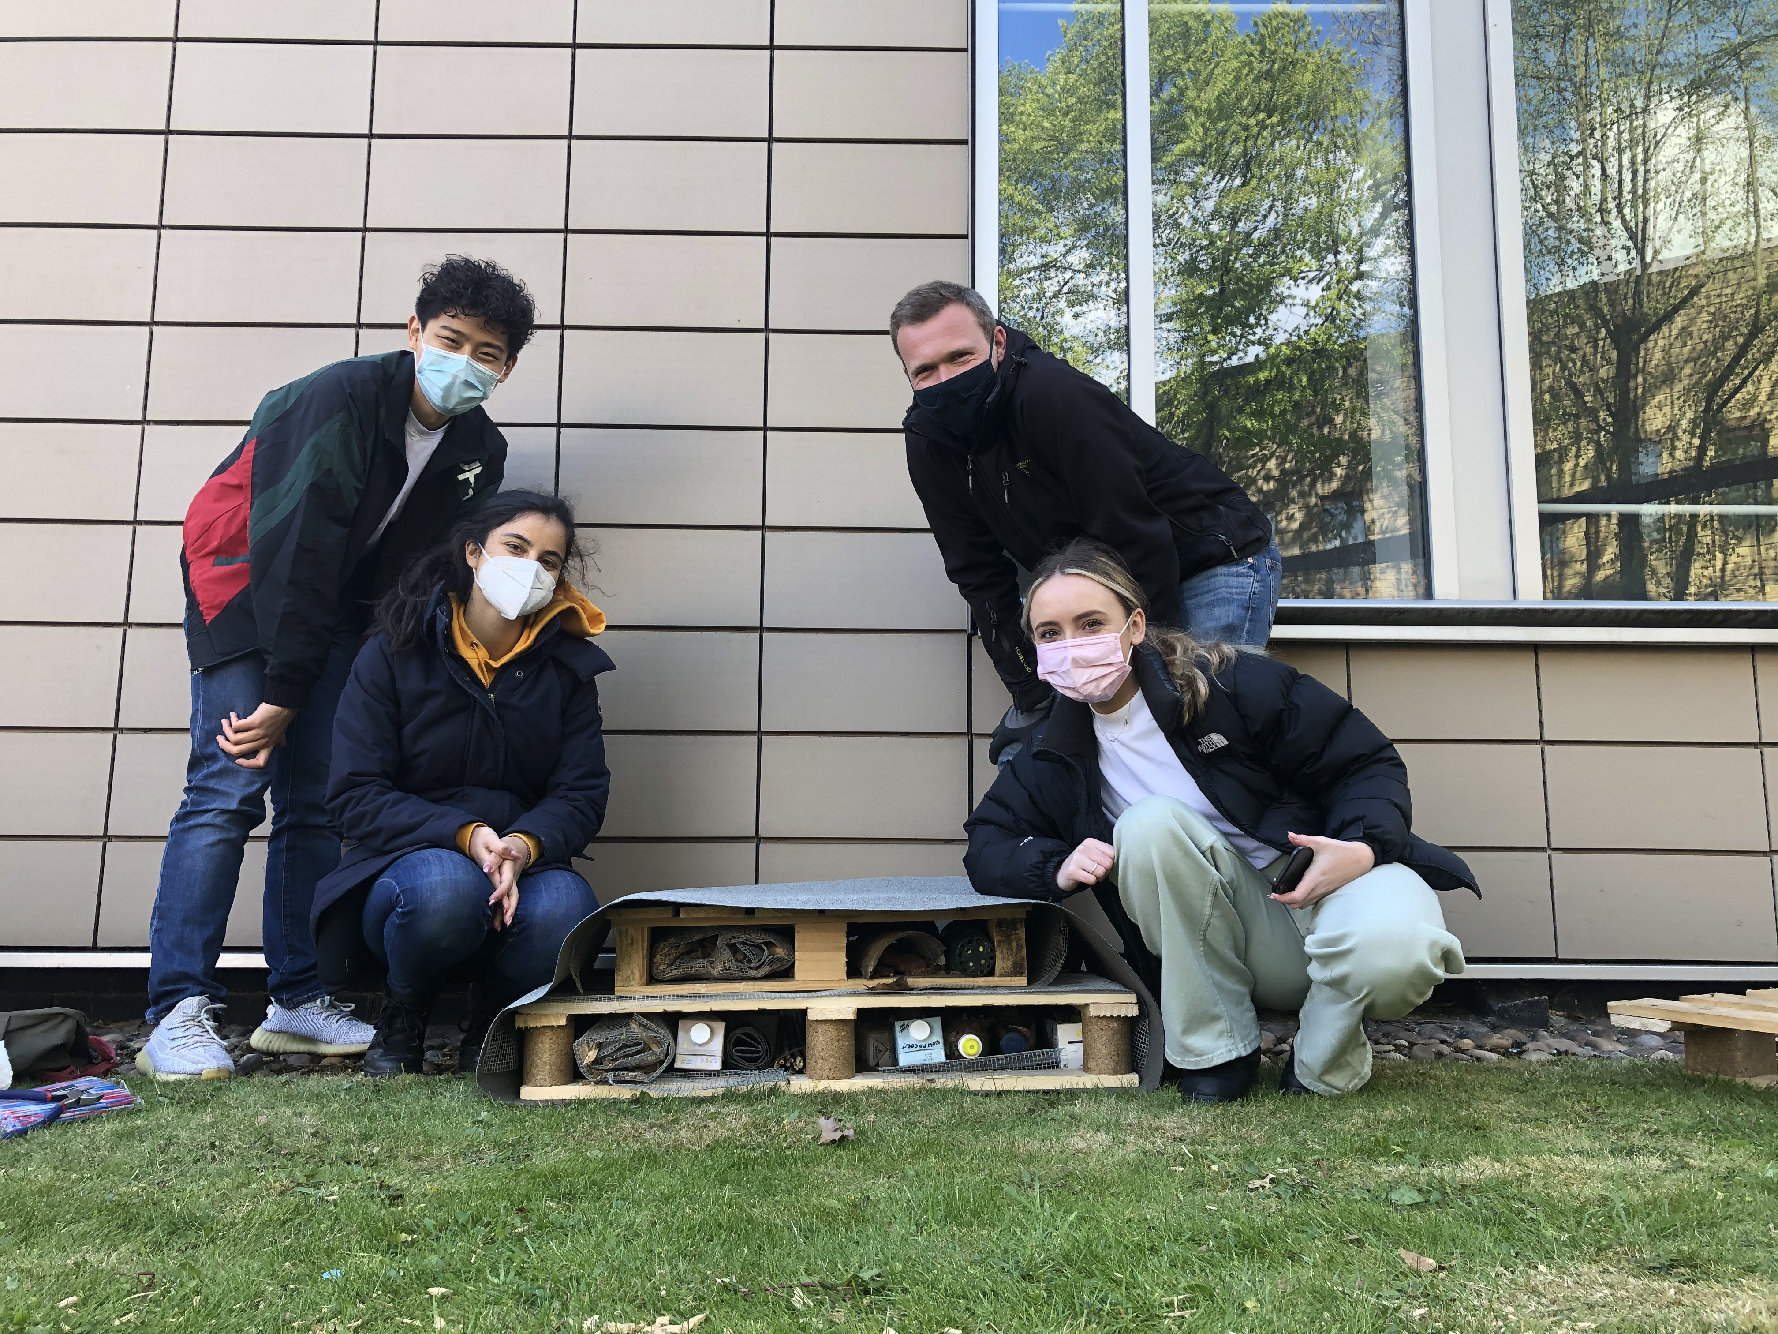
What We Do – On the Ground
Hedgehog surveys
Connect up greenspaces (where appropriate!)
Training estates and landscaping teams
Hedgehog houses and signs
Ramps in and out of ponds
Wildlife friendly plants, logpiles and less managed areas
Litter picks
Workshops - survey tunnels, bug hotels
Notes:
1. Informs us where hedgehogs are/aren’t
Liaise with estates to make improvements
Add to Big Hedgehog Map
2. Intern to work on this before and getting another one
Don’t send hedgehogs towards main roads (near Hickes)
3. Signs of hedgehogs, strimmer stickers
4. 4 more hedgehog houses and 10 road signs
5. Hedgehogs great swimmers but need to get out
6. Encourage insects hedgehogs eat
7. Litter harmful – get stuck or ingest cigarette butts etc
8. Students and staff able to be independent

Slide 4
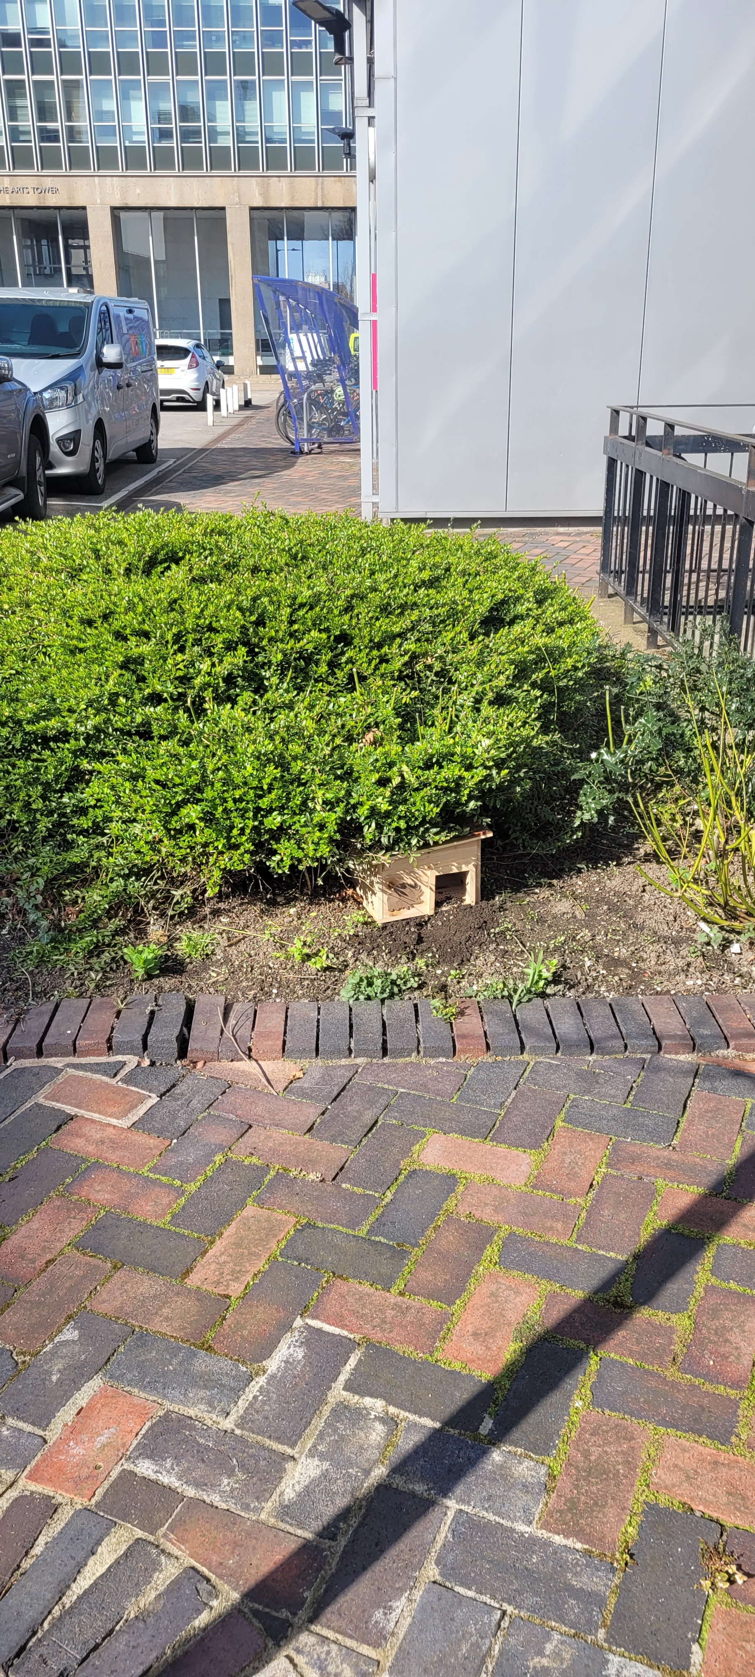
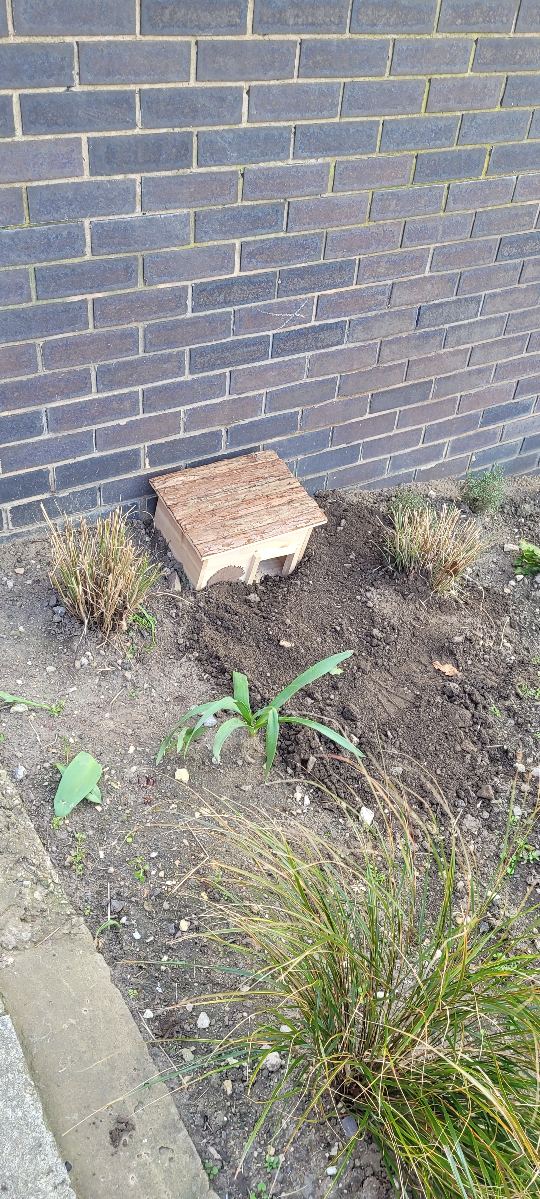
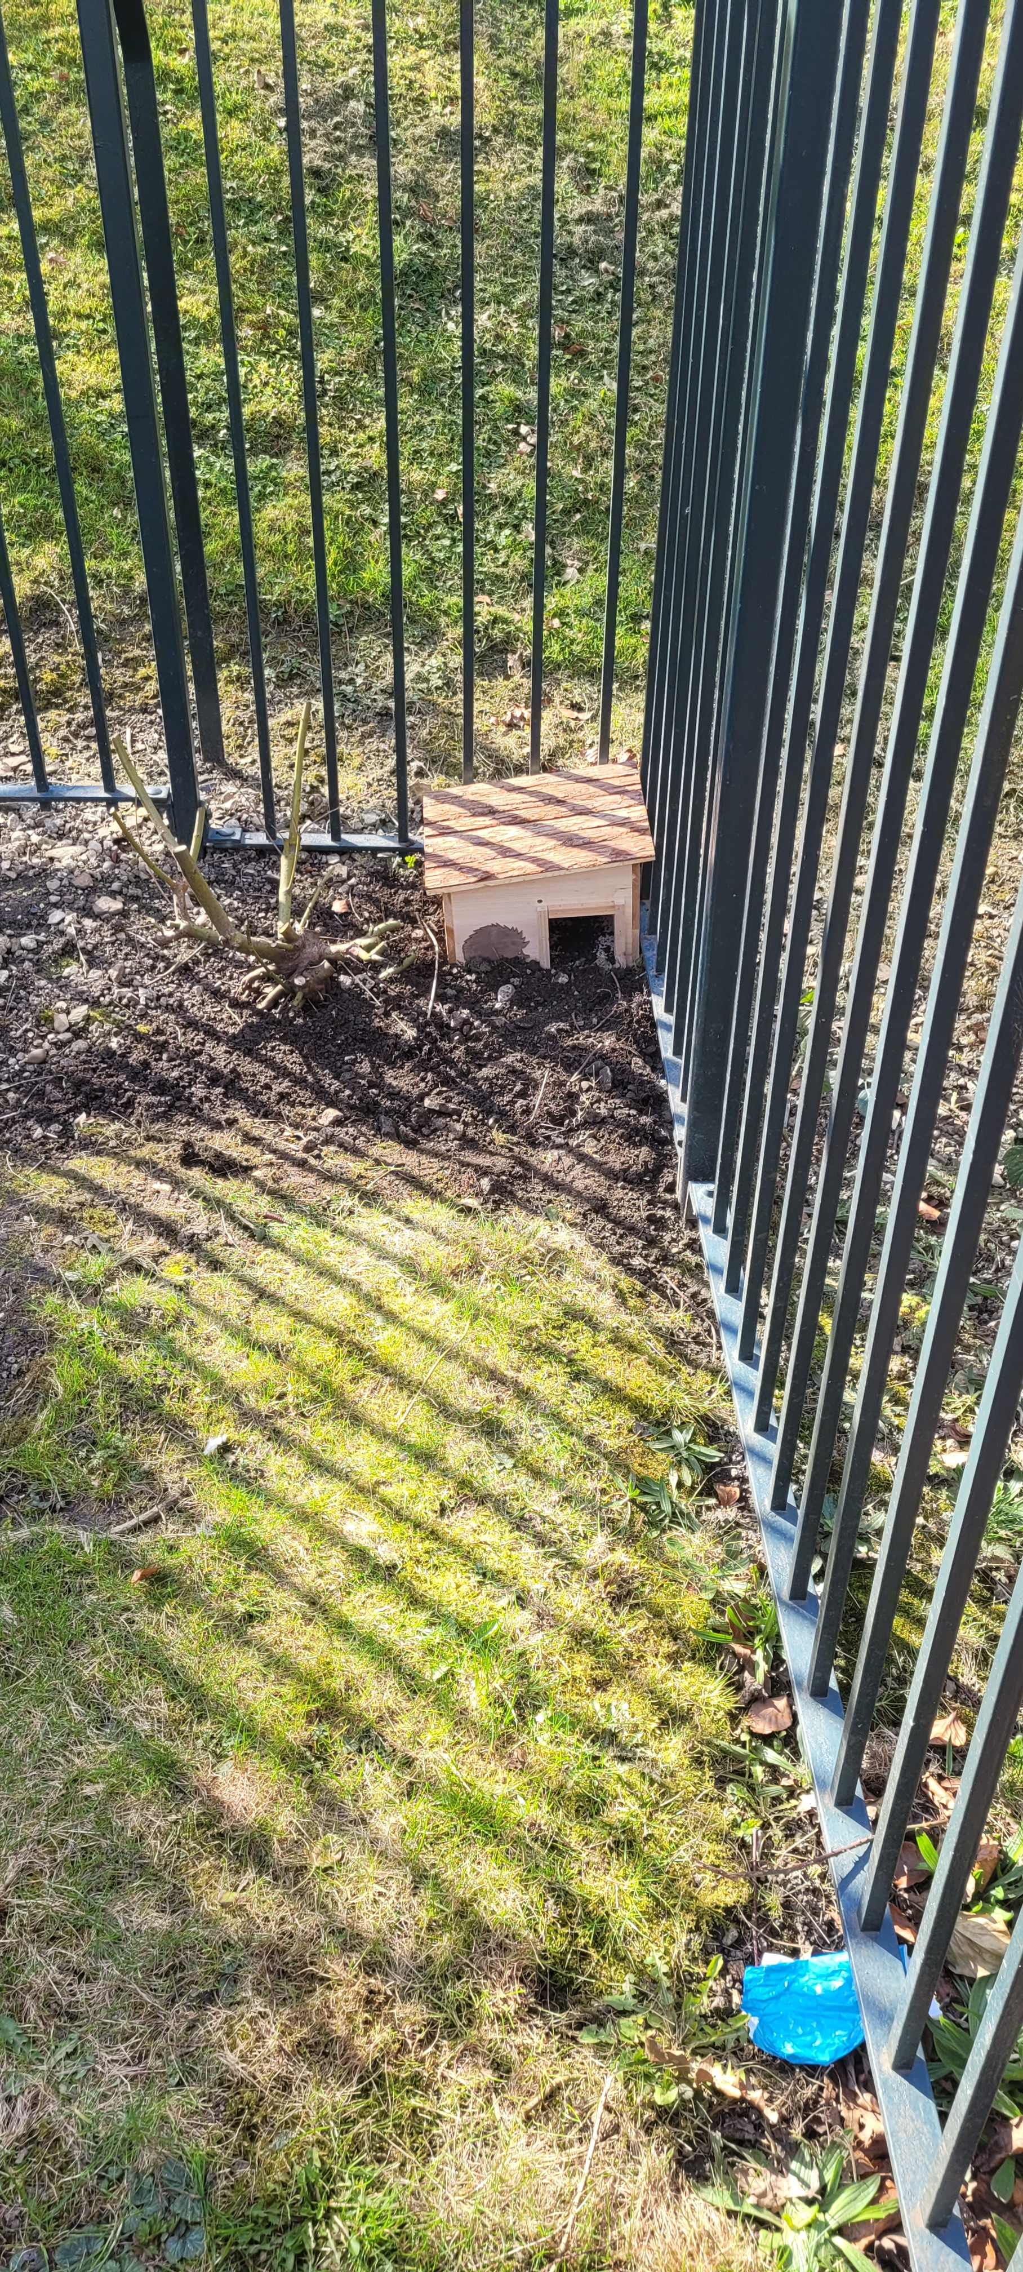
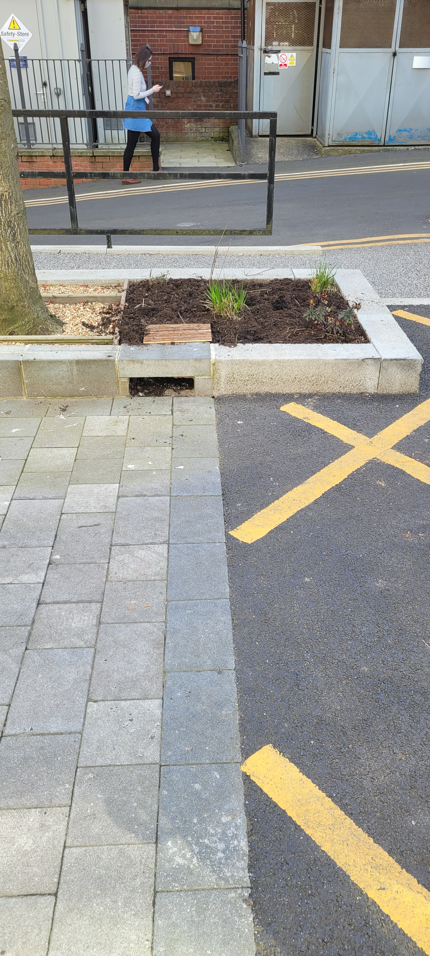
Landscaping Team
Created their own toolbox talk for landscapes staff
Newly installed 4 hedgehog boxes in safe areas
Planting specific species to attract insects for hedgehogs
Ensuring shrub area protected
Installing signs on roads/in areas with high footfall
Promoting hedgehog habitat in green corridors
Storyboarding their work
Biodiversity Action Plan
Notes:
Exemplifies what can be achieved when you get enthusiastic people on board and show people that we can help hedgehogs with our changes
Enthusiastic about training and maintaining training for staff
Ordered and installed 4 new boxes in safe areas where hedgehogs roam
Specific planting along Western bank to attract insects and provide food for hedgehogs
Protecting a shrub area outside our Dainton building that provides cover and habitat for hedgehogs
Installed signs on roads but also in areas of high footfall for awareness
Promotion of hedgehog and wildlife friendly habitat throughout greenspaces across uni
Storyboarding their work across campus
Hedgehogs in the new BAP

Slide 5
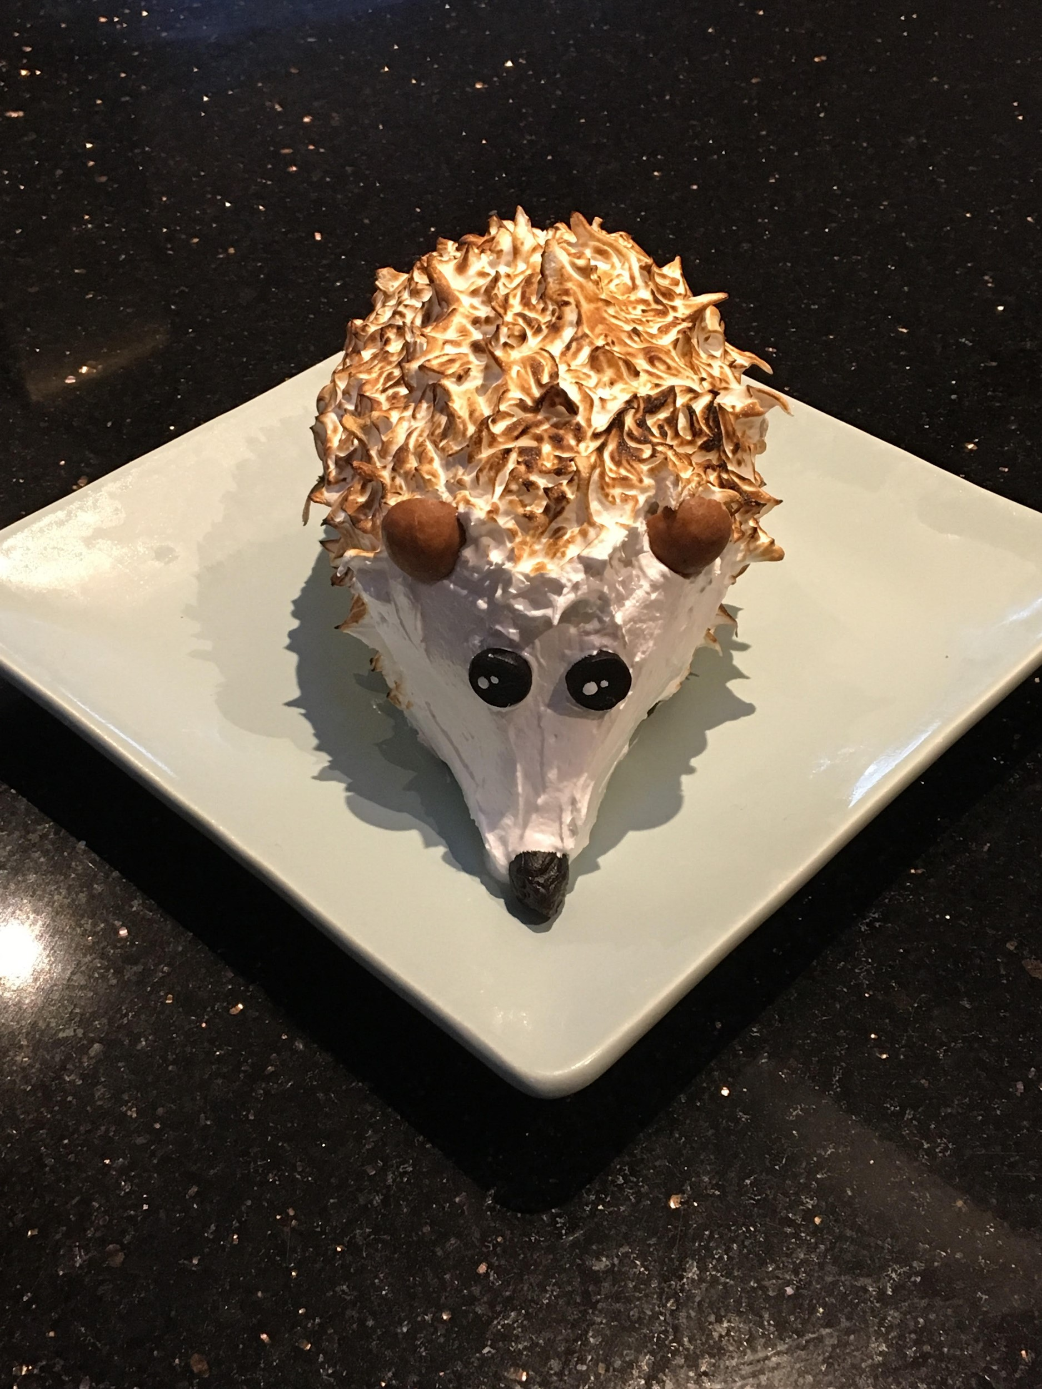
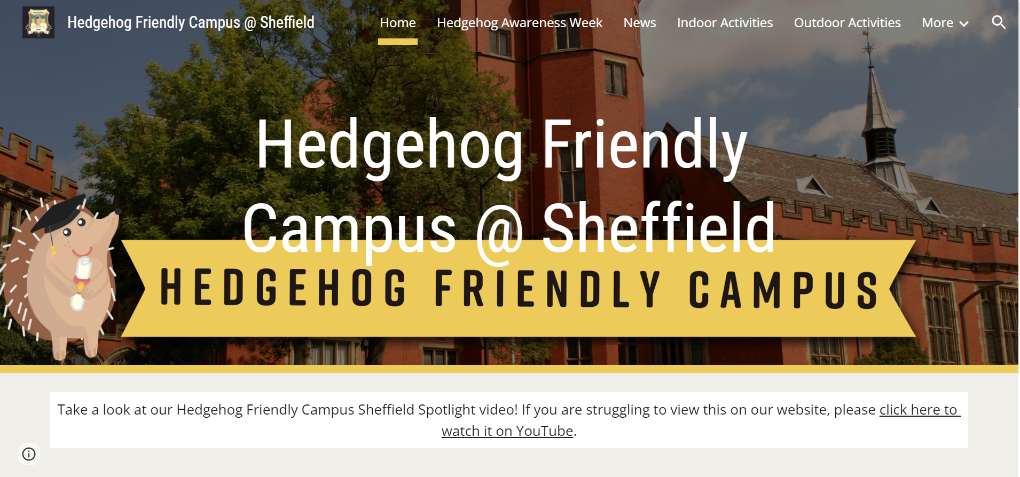
What We Do – Awareness
Fundraising for BHPS
Uni of Sheffield HFC Website
Public engagement
Hedgehog Awareness Week
Notes:
Fundraising campaign last HAW
Website full of indoor and outdoor activities and advice
Outreach events such as this
HAW first week of may

Slide 6
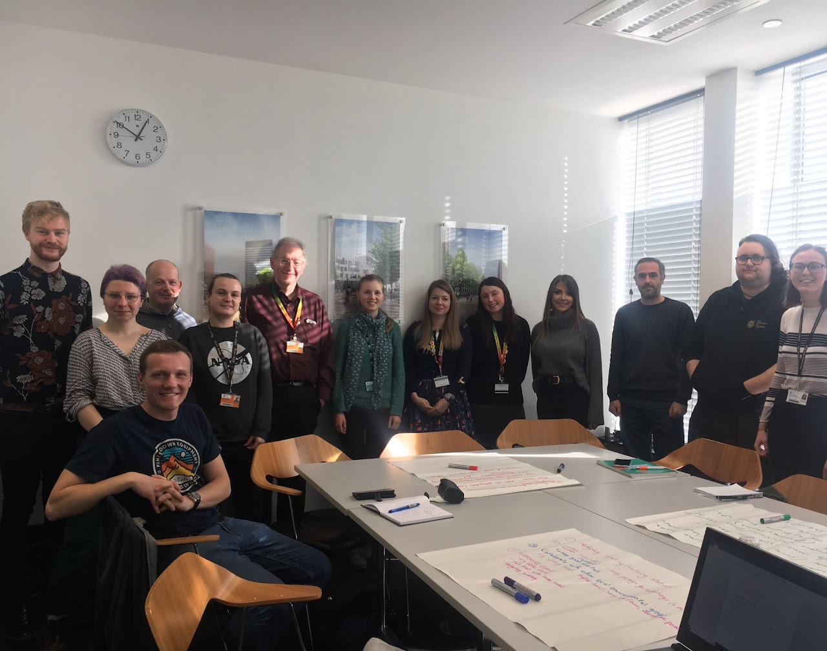
https://sites.google.com/sheffield.ac.uk/hedgehog-friendly-campus
g.adams@sheffield.ac.uk
Sign up today!

