Slide 1
Turn it up to
save energy
Charlotte Winnert – Environment & IMS Manager
Louis Garnham – Environmental Assistant

Slide 2
Contents
Context and background
University of Sheffield: environmental impact and net zero carbon goals
Understanding carbon emissions
The environmental impact of our research
Investigating the environmental impact of ULT freezers
https://www.sheffield.ac.uk/sustainability

Slide 3
The scale of our environmental impact
https://www.sheffield.ac.uk/sustainability
Notes:
121,000?

Slide 4
The scale of our environmental impact
In 2018/19 our activities were responsible for an estimated 121,000 tonnes of carbon emissions…
… while the average UK household is estimated
to be responsible for 8 tonnes of carbon annually
https://www.sheffield.ac.uk/sustainability
Notes:
121,000?

Slide 5
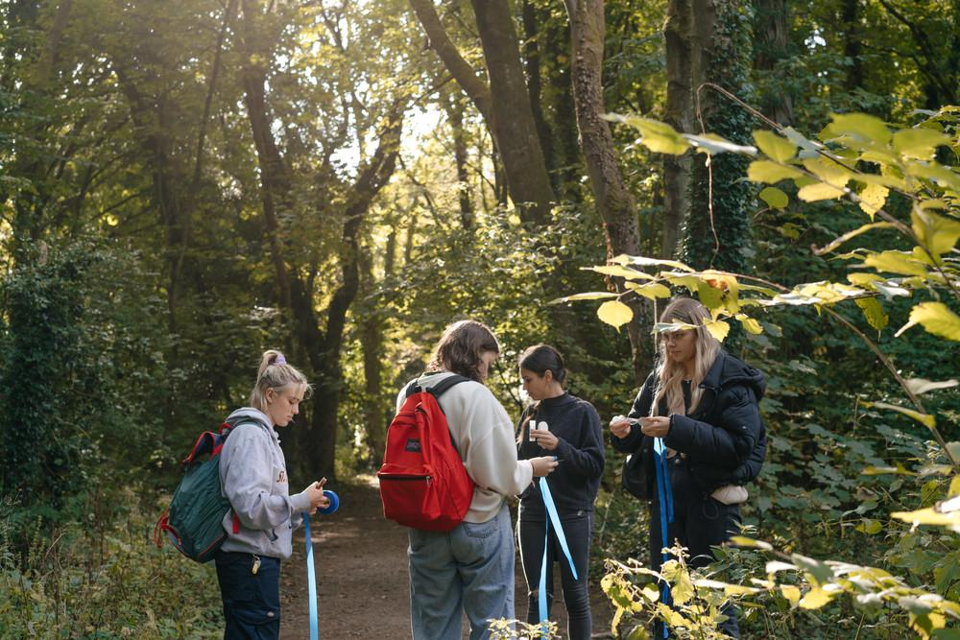
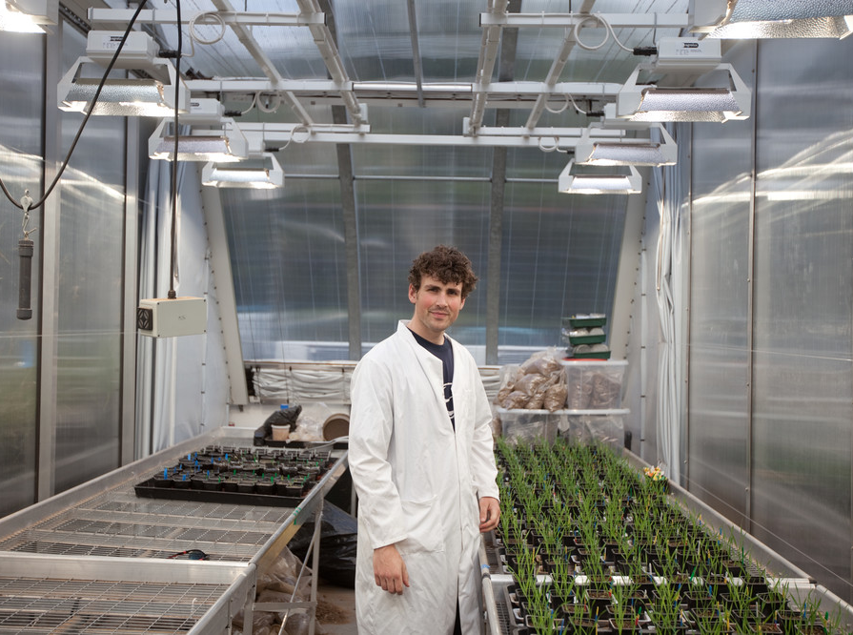
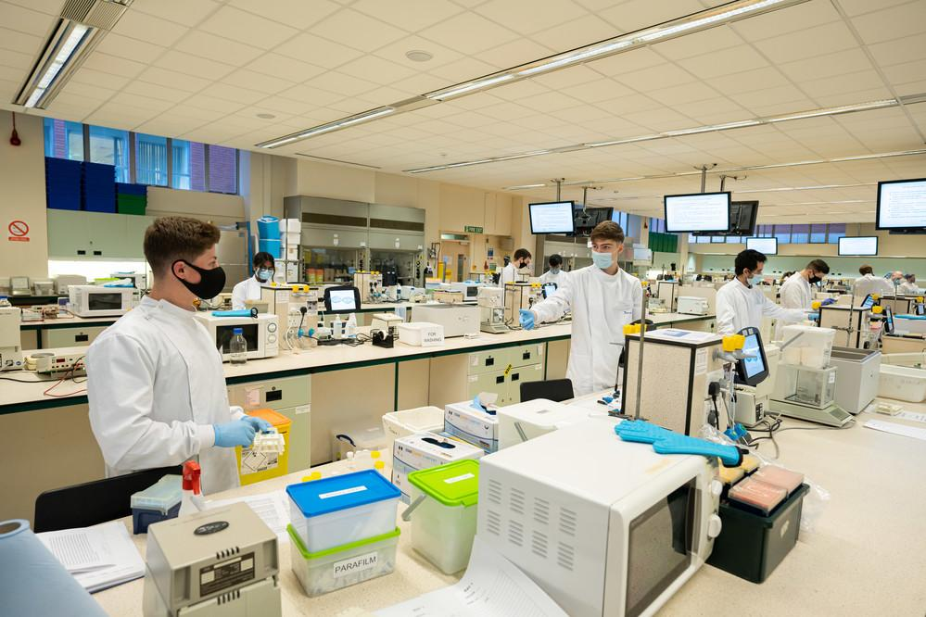
Our commitments
The University aims to become one of the most sustainable research-intensive universities in the country and we will align our research, teaching and campus to ensure sustainable practice across everything we do.
We are committed to becoming net carbon neutral on campus by 2030 and across all activities by 2038.
https://www.sheffield.ac.uk/sustainability
Notes:
121,000?

Slide 6
Understanding carbon emissions
Types of carbon emissions:
Scope 1 – direct emissions from our owned or controlled sources
→ e.g., boilers and vehicles
Scope 2 – indirect emissions from purchased energy
→ e.g., heating and cooling buildings, running equipment
Scope 3 – Indirect emissions from an organisation’s supply chain
→ e.g., the manufacture, shipping, and disposal of all materials & resources
Becoming net carbon neutral requires reducing emissions across all scopes.
https://www.sheffield.ac.uk/sustainability

Slide 7
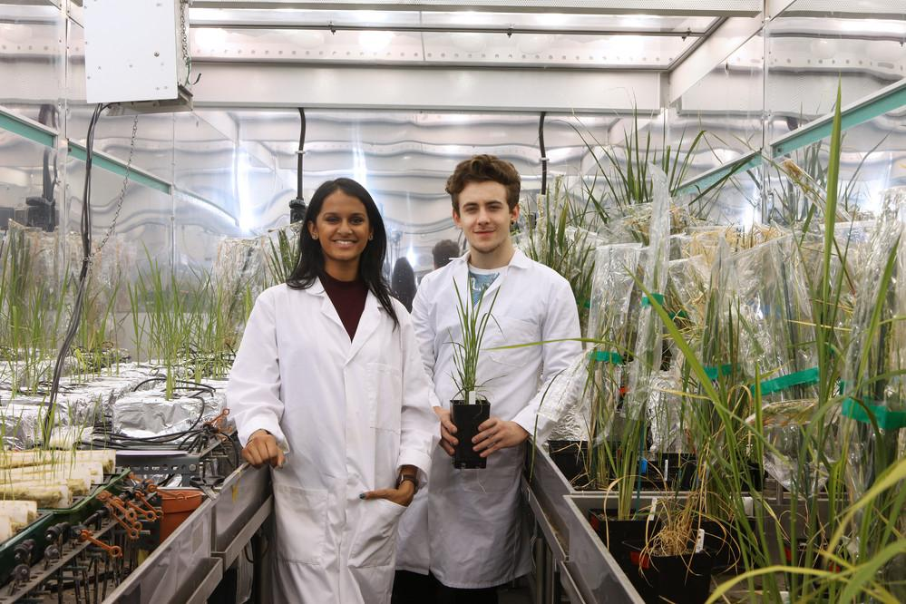
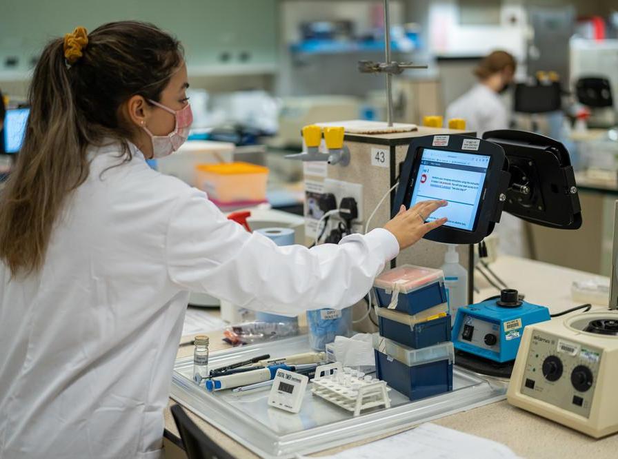
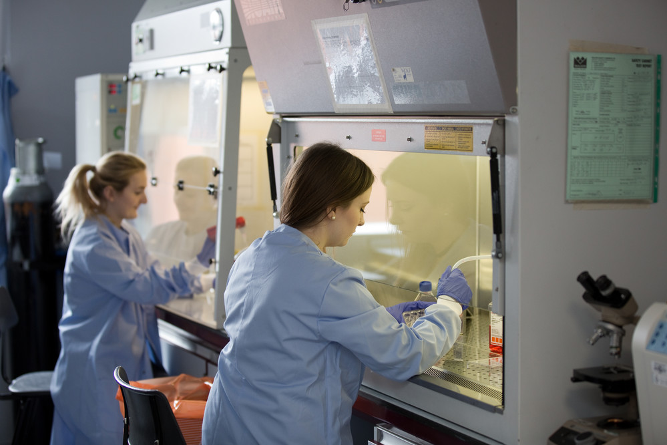
The impact of our research
https://www.sheffield.ac.uk/sustainability

Slide 8
The impact of our research
Estimated costs & carbon emissions from our research (2018/19)
Area | Costs | Estimated gross tonnes CO₂e | Emission category
Consumables & materials | £22,900,000 | 59,105 | Scope 3
Energy | £2,300,000 | 4,100 | Scopes 1 & 2
Water | £450,000 | 17 | Scope 3
Waste disposal | £75,000 | 29 | Scope 3
Total | £25,725,000 | 63,251
In 2018/19 our institutional carbon emissions totalled 121,182 tonnes CO2e.
Our scientific research was responsible for just under 50% of these emissions whilst occupying just 7% of our floor space.
https://www.sheffield.ac.uk/sustainability
Notes:
121,000?

Slide 9
The impact of our research
Estimated costs & carbon emissions from our research (2018/19)
Area | Costs | Estimated gross tonnes CO₂e | Emission category
Consumables & materials | £22,900,000 | 59,105 | Scope 3
Energy | £2,300,000 | 4,100 | Scopes 1 & 2
Water | £450,000 | 17 | Scope 3
Waste disposal | £75,000 | 29 | Scope 3
Total | £25,725,000 | 63,251
In 2018/19 our institutional carbon emissions totalled 121,182 tonnes CO2e.
Our scientific research was responsible for just under 50% of these emissions whilst occupying just 7% of our floor space.
https://www.sheffield.ac.uk/sustainability
Notes:
121,000?

Slide 10
The impact of our research
Estimated costs & carbon emissions from our research (2018/19)
Area | Costs | Estimated gross tonnes CO₂e | Emission category
Consumables & materials | £22,900,000 | 59,105 | Scope 3
Energy | £2,300,000 | 4,100 | Scopes 1 & 2
Water | £450,000 | 17 | Scope 3
Waste disposal | £75,000 | 29 | Scope 3
Total | £25,725,000 | 63,251
Decarbonisation Strategy (2023), core principle #3 → “Demand reduction lessens the burden”
https://www.sheffield.ac.uk/sustainability
Notes:
121,000?

Slide 11
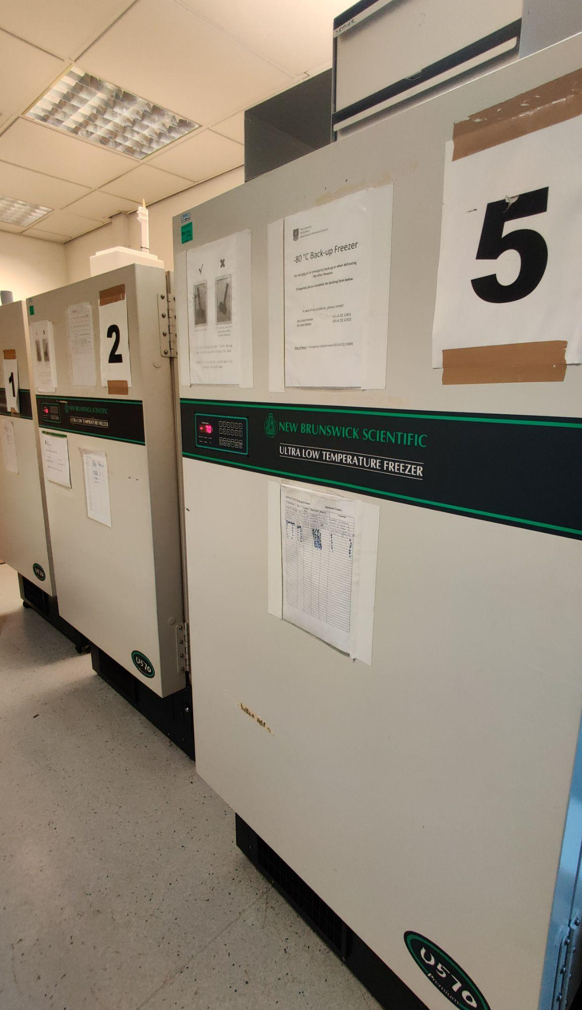
Ultra-low temperature freezers
ULT freezers are energy intensive!
New: 7 kWh/day =
Up to ~35 kWh/day - range of factors, primarily age
Nearly 200 at Uni of Sheffield
Large impact - but how large? How to reduce impact? What £/CO₂ savings can be made?
https://www.sheffield.ac.uk/sustainability

Slide 12
Project approach
School of Biosciences: ~85 ULT freezers
How are they used?
User requirements
Energy consumption
How to reduce energy consumption → environmental impact?
Answers from conversations, freezer audits, energy monitoring
https://www.sheffield.ac.uk/sustainability

Slide 13
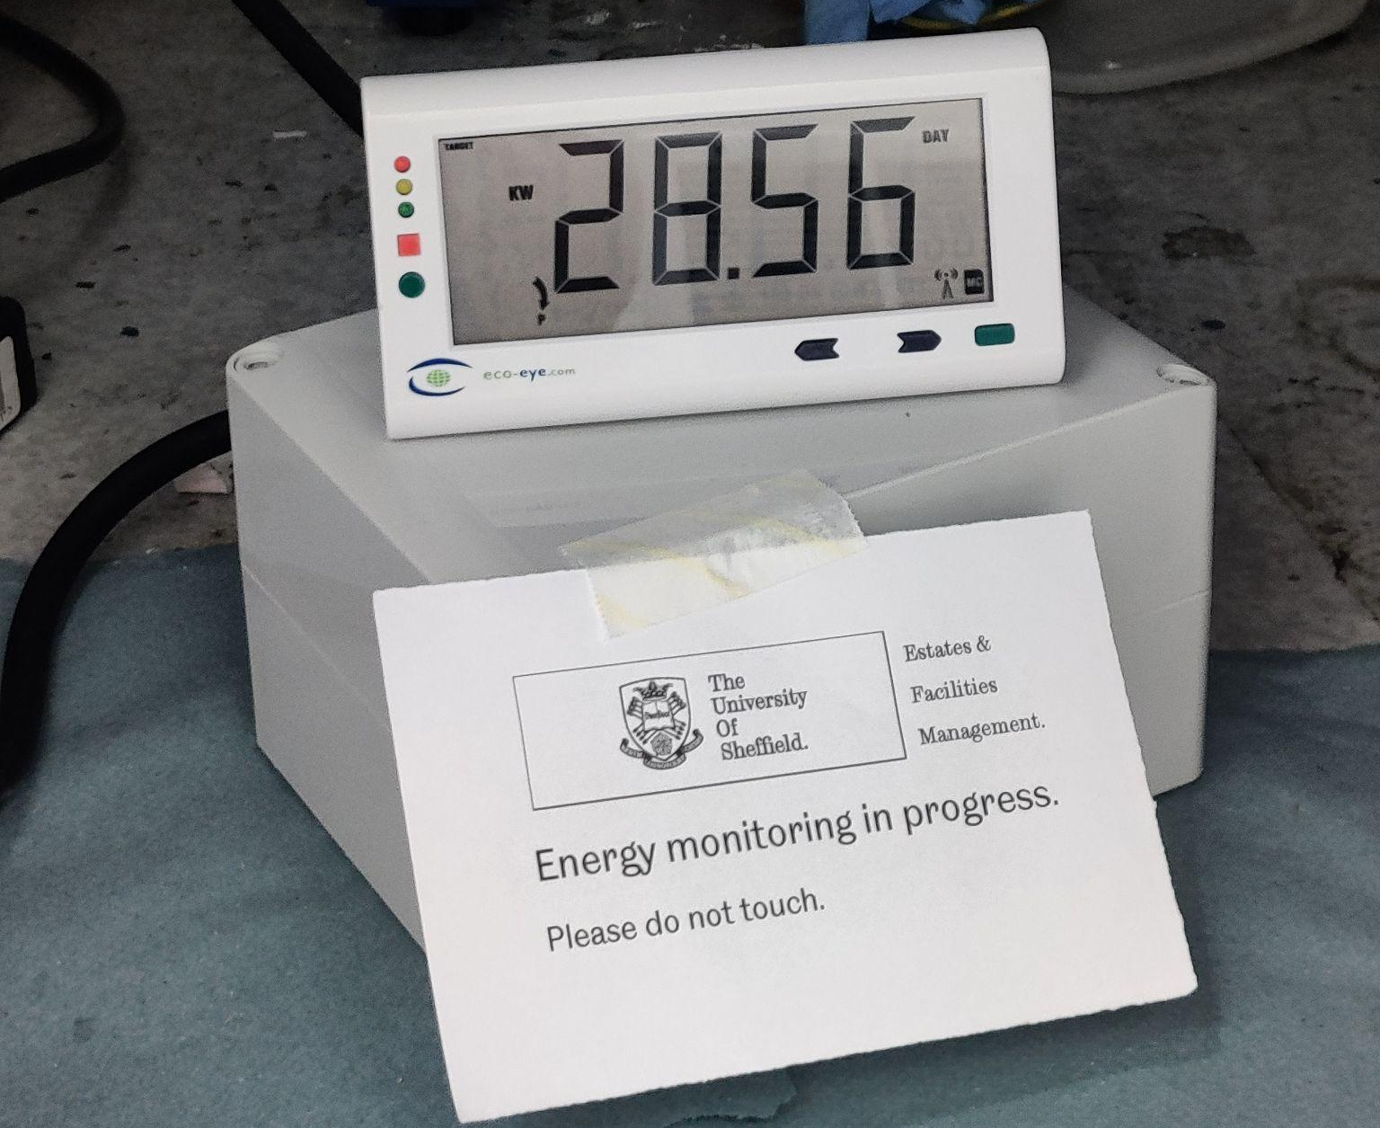
Findings
Avg energy consumption 12–20 kWh/day /unit
Excluding extra heat load on air conditioning!
Opportunities to reduce energy consumption by 30+% whilst reducing risks in research
Energy (year) | Gross emissions | £ 2023/24
372,000–620,000 kWh | 72–120 tCO₂e | £113,900–£189,800
https://www.sheffield.ac.uk/sustainability

Slide 14
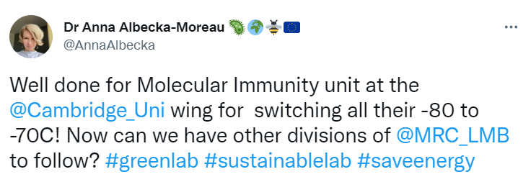
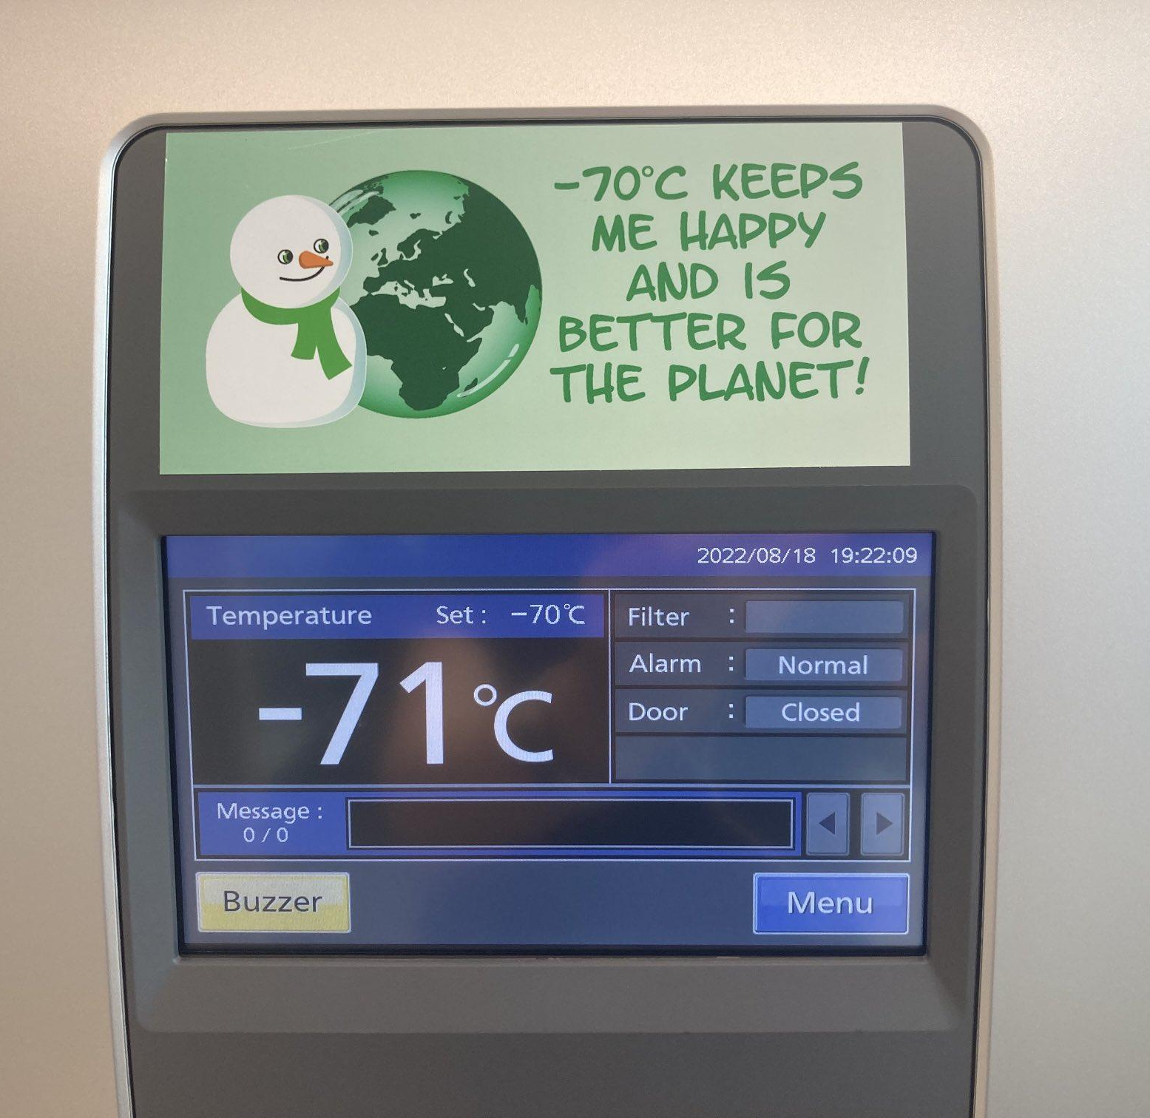
Findings and recommendations: set temperature
Currently: ~90% freezers at -80°C, handful at -70°C
-80° → -70° energy saving 15-40%
-80° → -60° energy saving 40+% (backups)
-70°C is big topic in sustainable science
online database of samples being stored at -70
institutions below running many/all freezers at -70
Roslin Institute: long term study of sample preservation
Action | Energy (year) | Gross emissions | £ 2023/24
53 freezers (70%) to -70°C | 62,000 kWh | 12 tonnes CO₂e | £18,900
All 8 backups to -60°C | 16,000 kWh | 3 tonnes CO₂e | £4,900
Credit: Anna Albecka-Moreau, Twitter

Slide 15
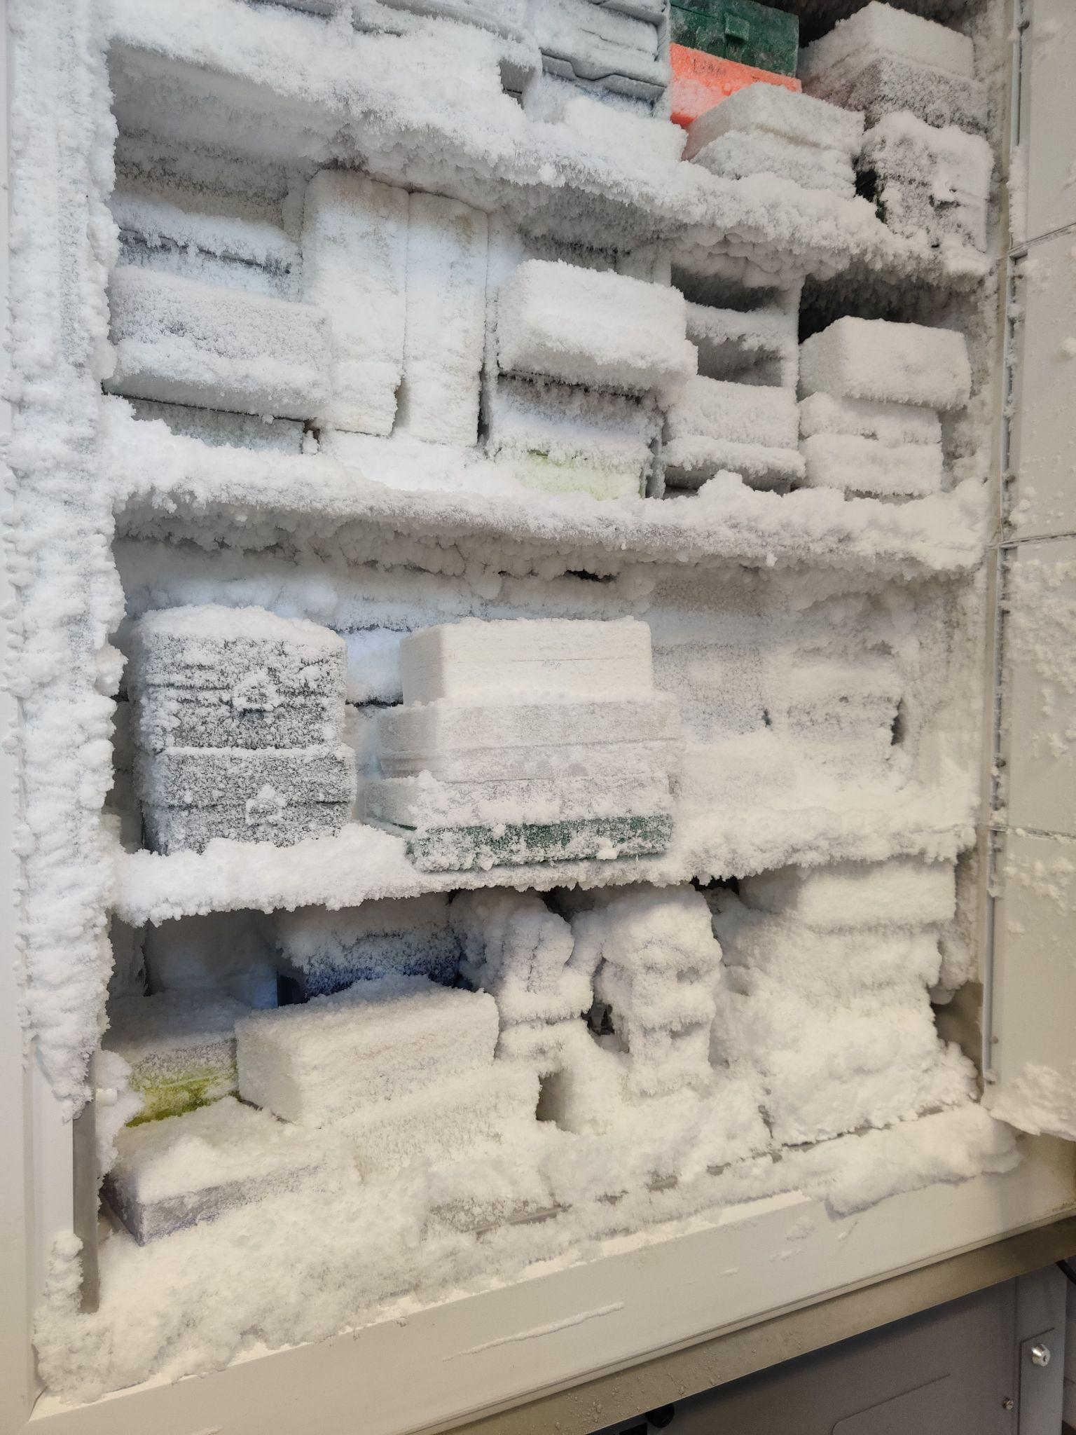
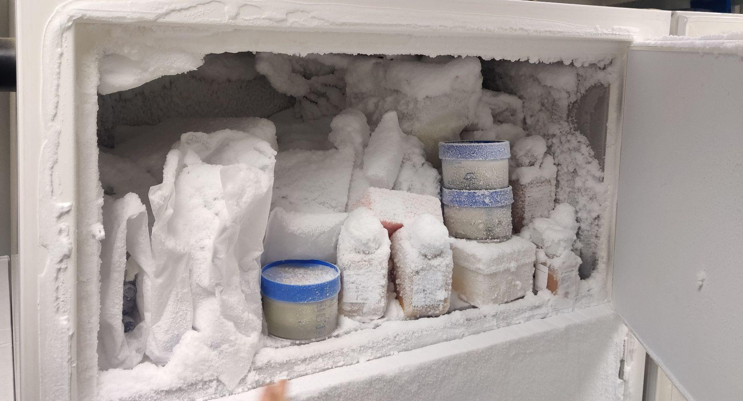
Findings and recommendations: organisation & housekeeping
Lack of / poor inventory
harder to find samples
door open longer → temp fluctuations
→ buildup of snow and ice
→ compressor wear & tear
→ door not closing properly
Not using racks
these aid organisation and protects samples from temp fluctuations
Dust and ice
compressor overworked, high energy consumption, wear & tear
Action: implement better organisation and preventative maintenance
→ inventories, racks, clearouts, de-icing, filter cleaning
Direct savings not easy to quantify - but actions still helpful
https://www.sheffield.ac.uk/sustainability

Slide 16
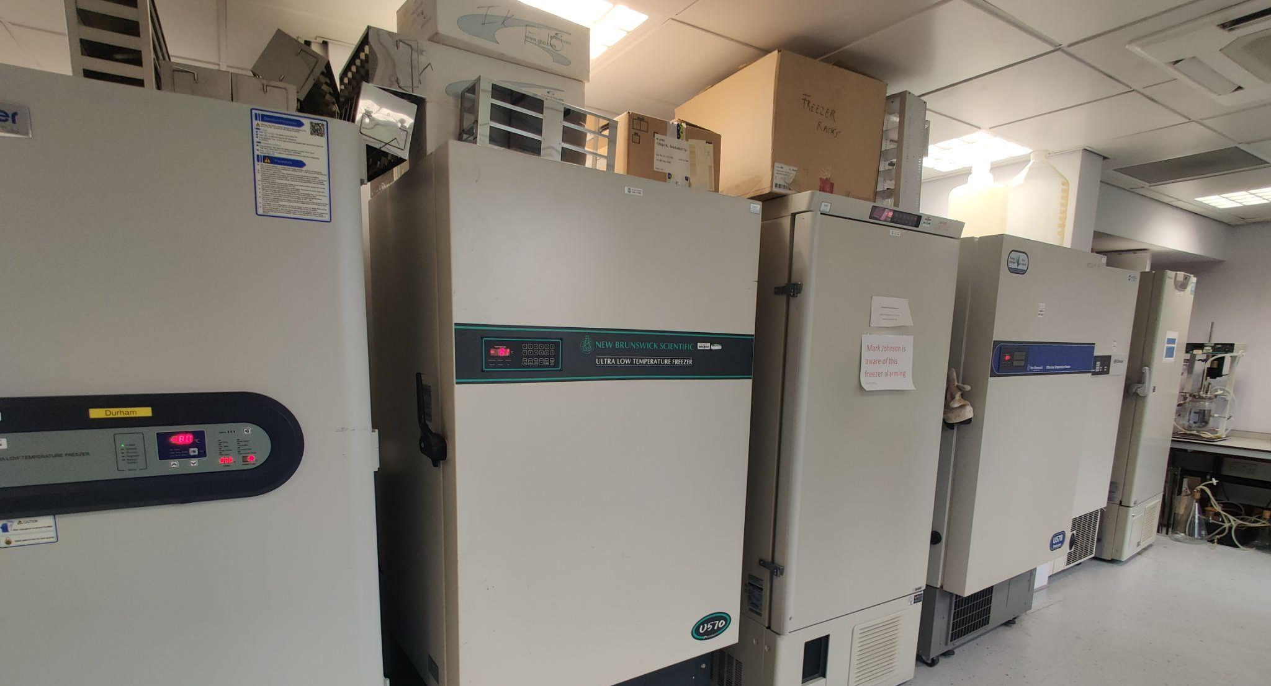
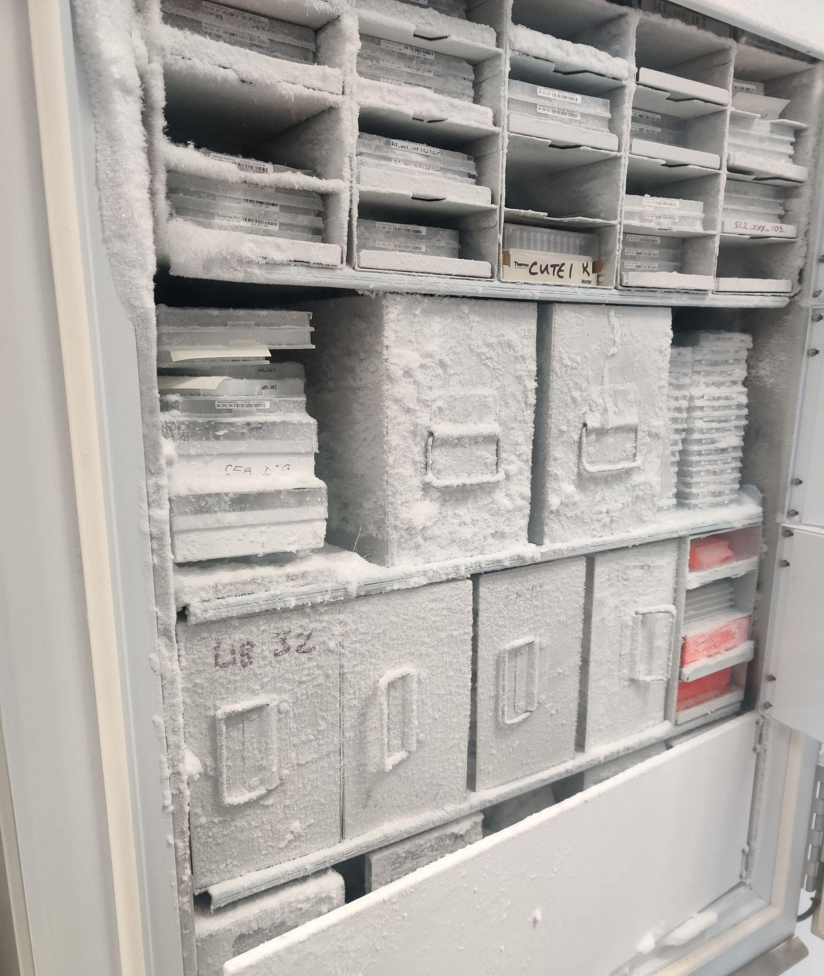
Findings and recommendations: consolidation
Currently: most freezers not full, not shared
Free up more space with clearouts and better organisation
Consolidate into fewer units, turn old freezers off (standby)
Action | Energy (year) | Gross emissions | £ 2023/24
Switch off 5 old freezers (25 kWh/d) | 45,600 kWh | 8.8 tonnes CO₂e | £14,000
https://www.sheffield.ac.uk/sustainability

Slide 17
Summary
Uni of Sheffield: net carbon neutral by 2030 for scopes 1 & 2; all scopes by 2038
Scientific research: ~50% of campus emissions, 7% of floor space
environmental impact of research must be addressed
We all need to contribute to help reach net zero
Decarbonisation strategy → reduce energy demand
Ultralow freezers - found opportunities to reduce energy use and provide benefits to users
Have a look at your labs!
https://www.sheffield.ac.uk/sustainability

