Slide 1
Facility Led Funding of Capital Equipment
Darren Robinson – Wolfson Light Microscopy Facility Manager

Slide 2
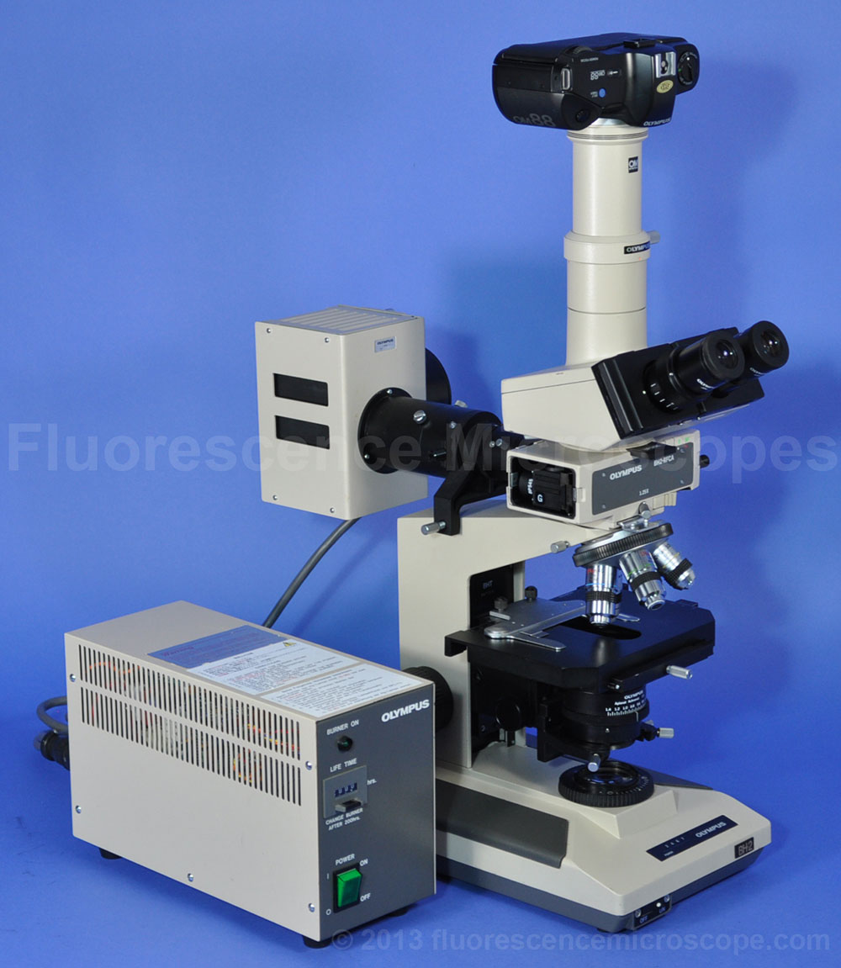
1998
2023
£12k
£555k

Slide 3
Technical Support
Technical support and technicians are vital to academic research
Expertise and knowledge of current instrumentation are important at all stages of the procurement process
System Identification
System specification
Available companies
Alignment of technology with users needs
Requirements for estates and IT
System management
All of the above feed into the procurement process
Facility managers can lead capital equipment grant applications

Slide 4
Internal Processes – Internal Sifting and CRAG
Equipment pipeline – If it’s not on it will not be considered
Matched funding – Both MRC and BBSRC will now fund up to 100% of costs
Estates and IT – Space, load, vibration, utilities, access, storage, networking
Business case – Cost recovery mechanism, staffing, servicing…
Demonstrate need (TEAG) for the applicant(s), the wider University, and possibly the UK – Collaborative bids and cross faculty applications will be viewed more favourably
Arrange demonstrations of the requested equipment and obtain pilot data – Can take months to organise as many demo systems are overseas
Speak to lots of companies to get a full picture of what is out there

Slide 5
Application Process
Description of the department in which it will be installed
Institutional support – How will the long-term running of the system be supported?
Technical Justification – Why do you need this particular system?
Scientific Case – What will it be used for and who will benefit?
System specification and quotes – What components will the system comprise, and how much are you asking for? Service contracts?
Environmental Impact – What will you do with old equipment?
IT and Infrastructure – What will you do with the data? Where will it go?
Procurement – What mechanism will you use to purchase the system, e.g. tender, mini-tender or a university procurement framework?
CV’s and References – Worst job of the lot!
Home office licences – Do you have or will you need home office licences, i.e. intravital work, whole animal imaging, etc.

Slide 6
Summary
Grant applications for equipment can and should be led by facility managers
The process should be a collaboration between facilities and researchers
Co-applications between facility managers and researchers are ideal

