Slide 1
Electrical Safety
Construction of Experimental
Equipment

Slide 2
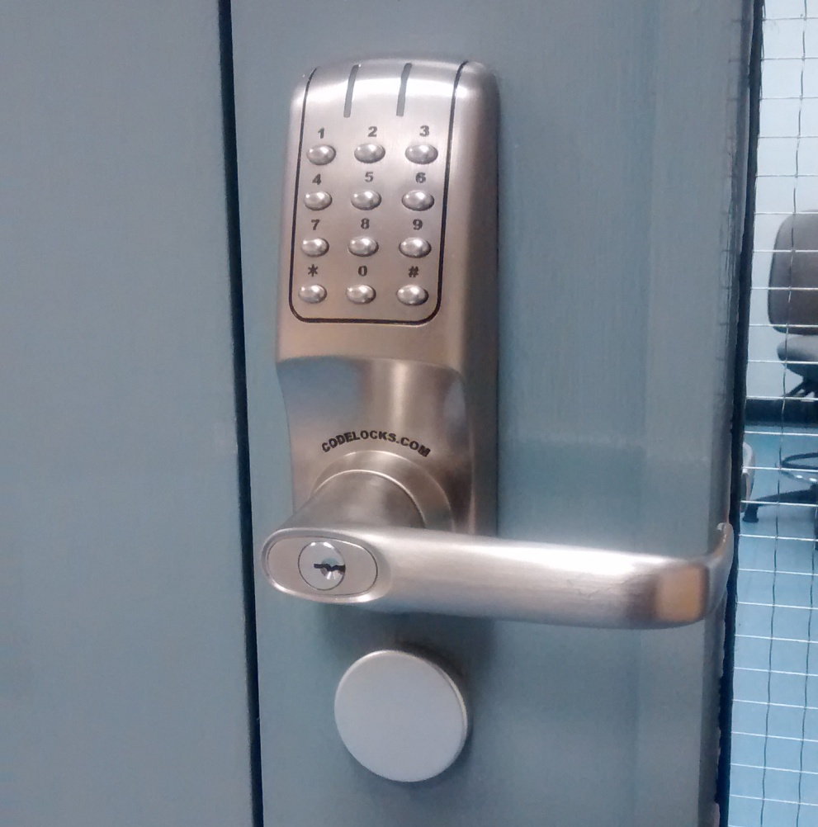
Accessing the Laboratories
To work in the EMD laboratories you must undertake lab safety induction training.

Slide 3
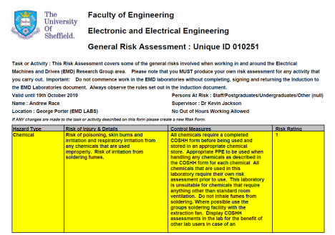
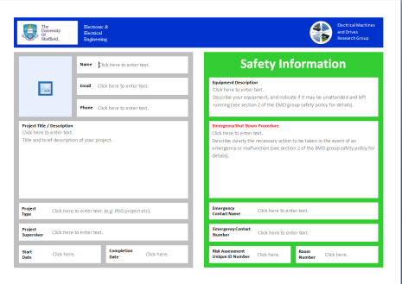
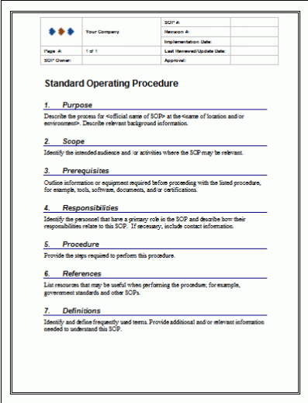
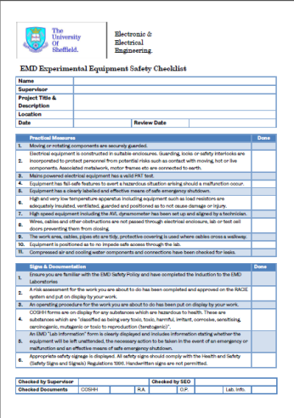
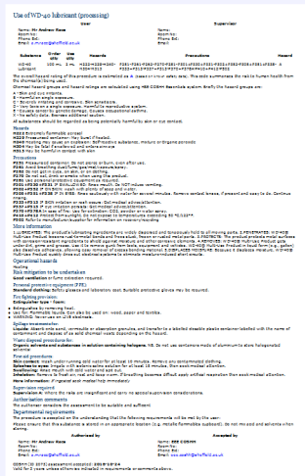
Safety Documents
General
Risk
Assessment
Information & Shutdown
Procedure
Operating
Procedure
Check
List
COSHH
Form
Ensure relevant safety documentation is in place. An EMD Lab Information sign must be clearly visible and indicate the necessary action to be taken in the event of an emergency or malfunction. You may require a COSHH form.

Slide 4

Help and Advice
Type of work | Contact name
Electronic systems | Mr Ian Wraith
Electrical and energy storage systems, high voltage apparatus | Mr Andy Race
Electrical machines & rotating apparatus | Mr Andy Race
Mechanical systems and materials, woodworking | Mr Karl Rotchell
Hydraulic & pneumatic supplies/services | Mr Karl Rotchell
Gases | Mr Paul Haines
?  
A list of staff available to give advice on the safe construction of equipment and apparatus is given in the Departmental web pages. Ask if you’re unsure.
http://hercules.shef.ac.uk/eee/local/safety/construction.html
Notes:
Type of work
Contact name
Electronic systems
Mr Ian Wraith
Electrical and energy storage systems, high voltage apparatus
Mr Andy Race
Electrical machines & rotating apparatus
Mr Richard Garraway
Mr Andy Race
Mechanical systems and materials, woodworking
Mr Wayne Frankish
Lasers and optics
Dr Rick Smith
X-ray radiation
Prof Mark Hopkinson
Microwave radiation
Dr Jon Rigelsford
Hydraulic & pneumatic supplies/services
Mr Wayne Frankish
Gases
Mr Dave Morris

Slide 5
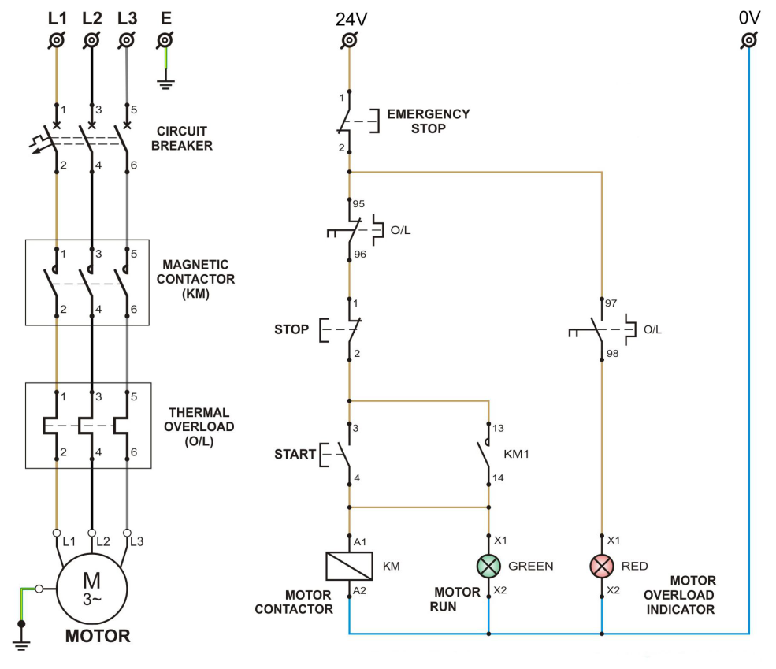
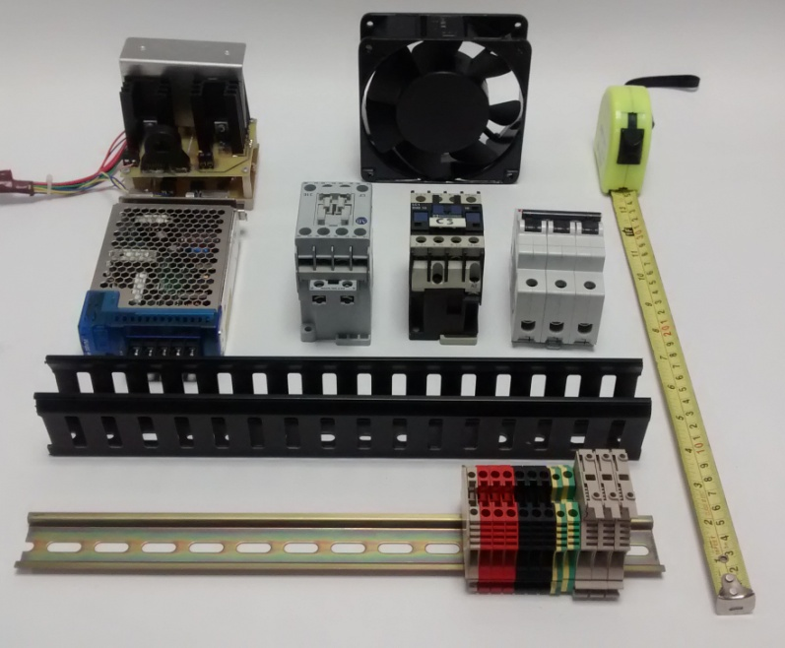
Plan Your Work
Develop a schematic diagram. Calculate the physical size of your project from the components you plan to use.
If your circuit includes capacitors incorporate a discharge circuit in your design.

Slide 6
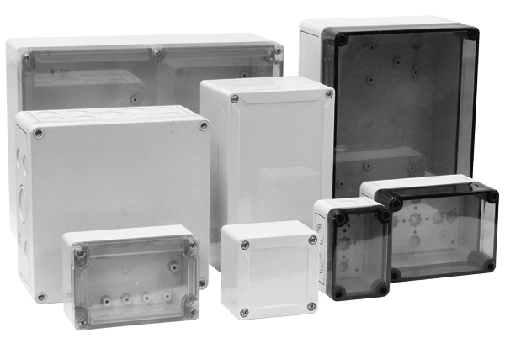



Enclosures
All electrical equipment, especially equipment operating at over 50V should be constructed in a appropriate enclosure. This is to protect the equipment from damage and to protect personnel from contact with it.
Allow plenty of space for future development and for heat dissipation.

Slide 7
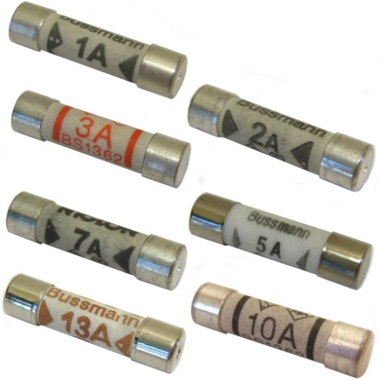

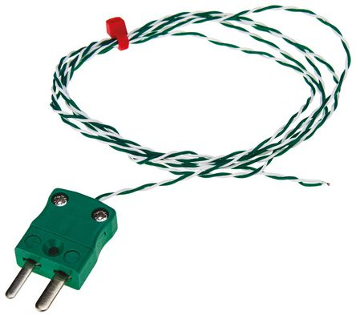
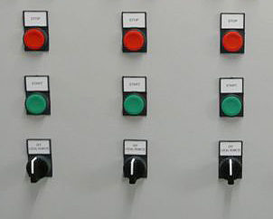
Fail Safe Features
Fuses
Circuit
Breakers
Over Temperature
Protection
Indicator
Lamps
Equipment must incorporate fail-safe features to avert a hazardous situation from arising should a malfunction occur.
Fit indicator lamps to show what’s happening.

Slide 8
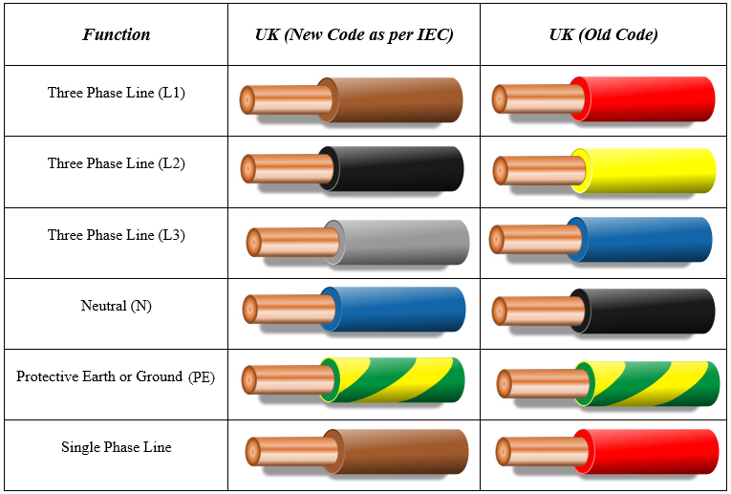
Wires
Use the current EU wire colours when building new equipment and use sizes appropriate for the current they will carry.

Slide 9
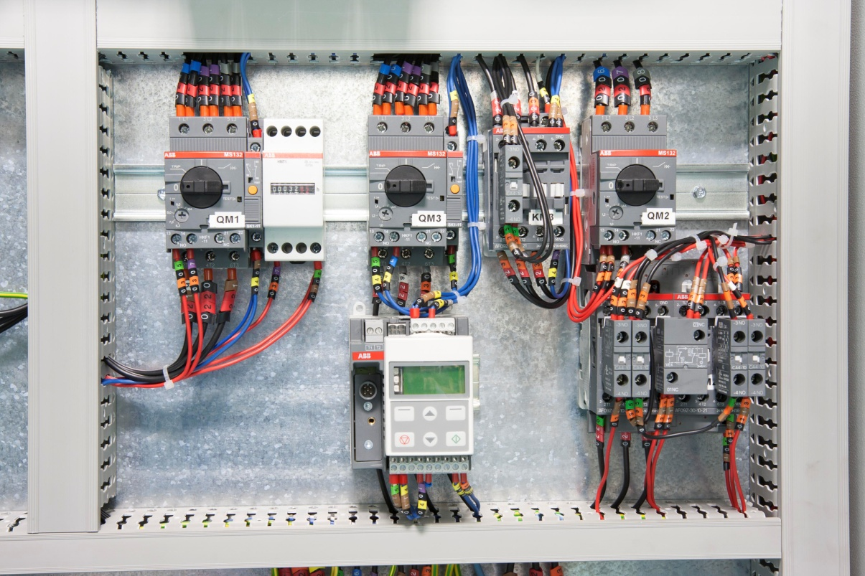
Wiring
Use slotted trunking when possible, this protects the internal wiring makes it easier to obtain a safe & tidy job . Number the wires and components to correspond to you diagram. Terminate the wires with crimp terminals.

Slide 10
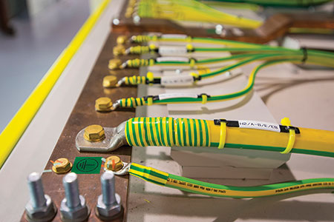
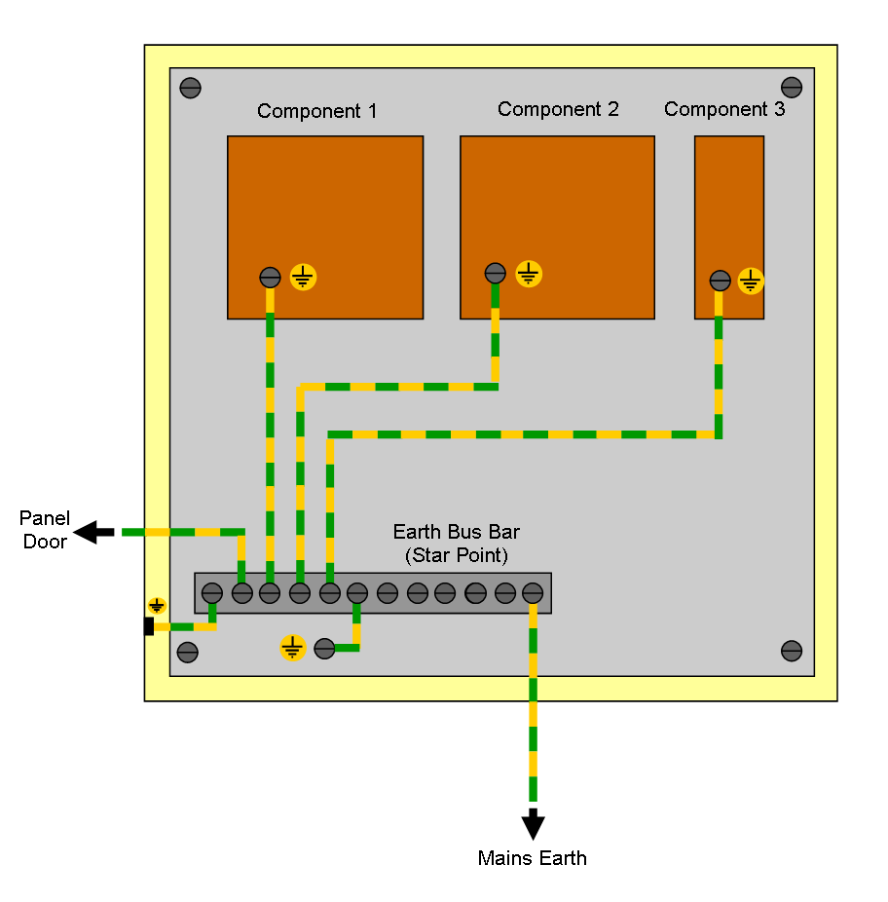
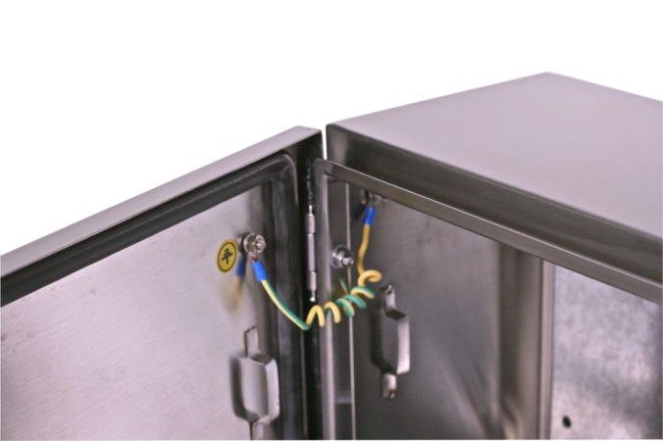
Earthing
If the equipment is connected to the mains electricity supply the enclosure and any other associated metalwork should be connected to earth.

Slide 11
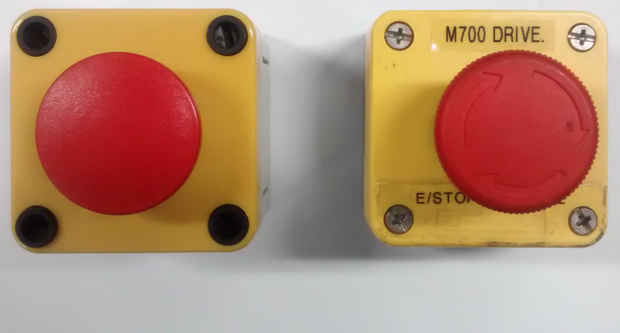


Emergency Shutdown
Basic Emergency Stop Circuit
Start
Switch (NO)
Emergency
Stop Switch (NC)
Emergency
Stop Relay

R1

Emergency
Stop Relay Contacts (NO)
R1/1
Emergency
Stop Relay Contacts (NO)
Mains Contactor
R1/2
C1
Emergency
Stop Relay
Mains Contactor
24V
0V
Electrical equipment should have a clearly labelled and effective means of safe emergency shutdown.
Emergency stop push buttons should be latching and the emergency stop circuit should be 12V or 24V. Test emergency stop push buttons periodically.

Slide 12
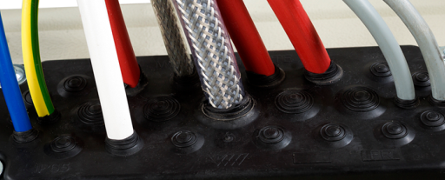
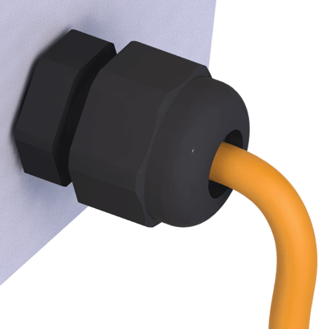

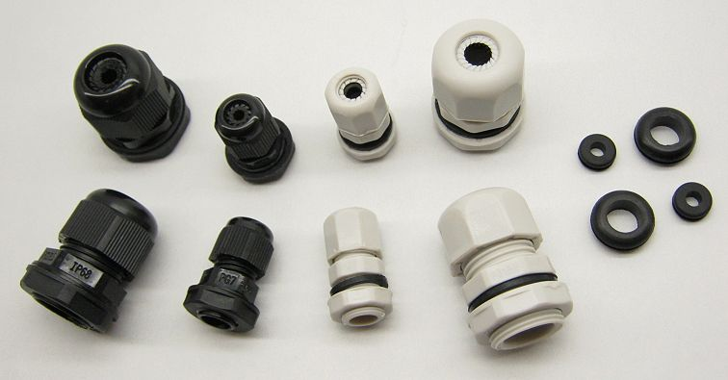
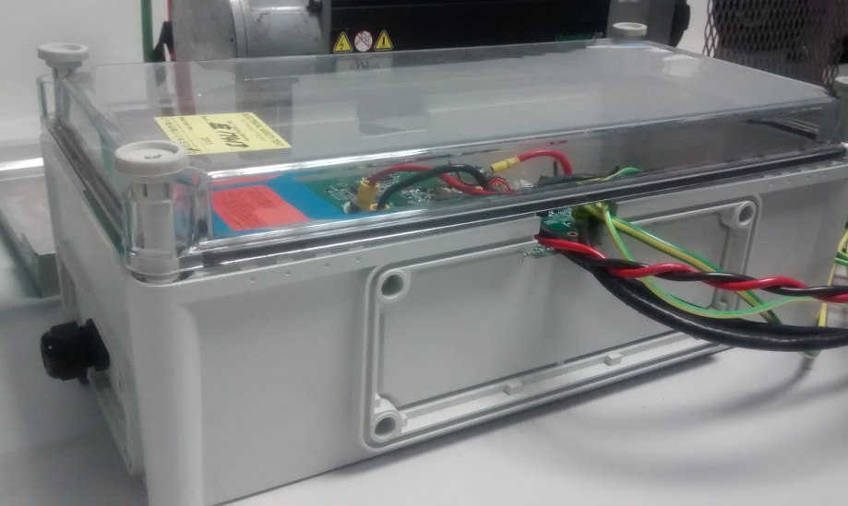
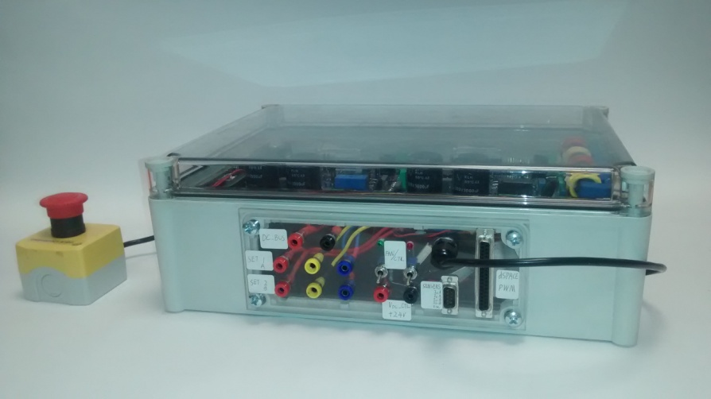
Cables
Wires, cables and other obstructions should not be passed through the enclosure door. Use grommets, glands, cut-outs and sockets. Cut outs should not allow finger access. Fit sockets for points which require regular testing. Cables should be protected by appropriately rated fuses or circuit breakers.

Slide 13
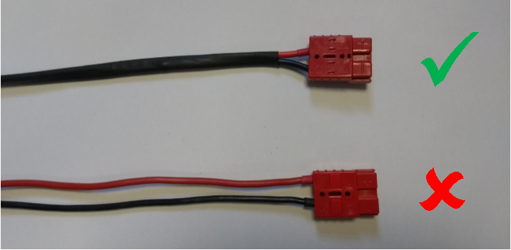
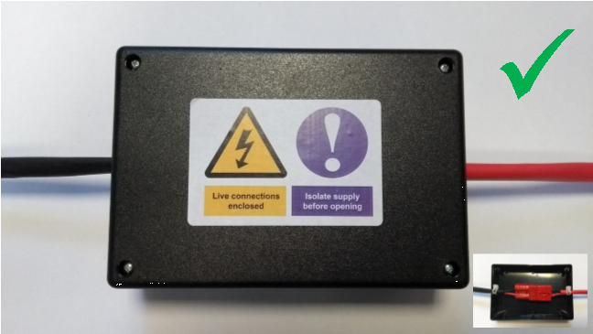
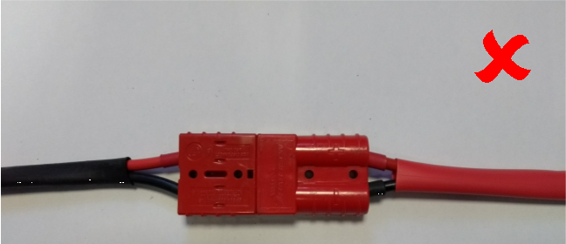
DC Cables & Connectors
DC power cables should be double insulated. Suitable sleeving is available in the EEE stores.
Anderson style connectors should be enclosed before switching on the power. This is to prevent accidental contact should they be pulled apart with the power switched on.
Suitable enclosures are available from RS, Rapid and Onecall.
Andy Race has the stick-on safety labels.

Slide 14
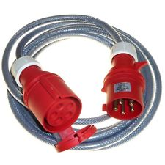
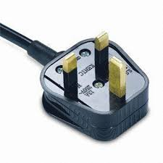
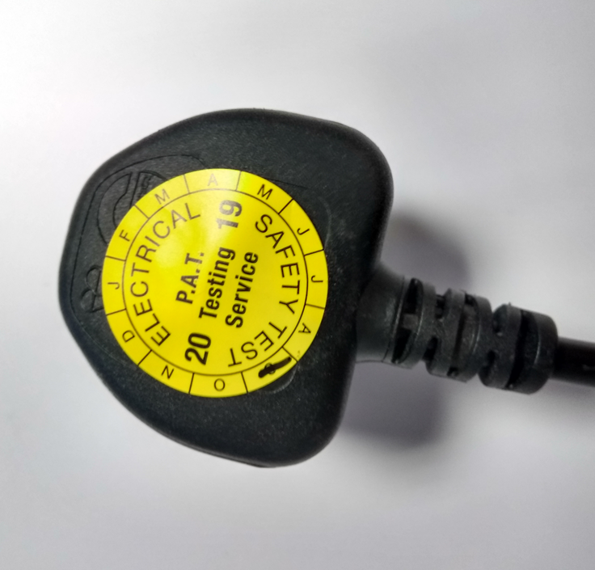
Mains Cables & Connectors
All mains cables must be installed and tested by a member of the technical staff.
Three-phase flexible cables should be SY type. It is flexible, has a galvanised steel wire braid and a transparent outer sheath so that damage can easily be seen.
All cable assemblies must be tested and labelled before use.

Slide 15
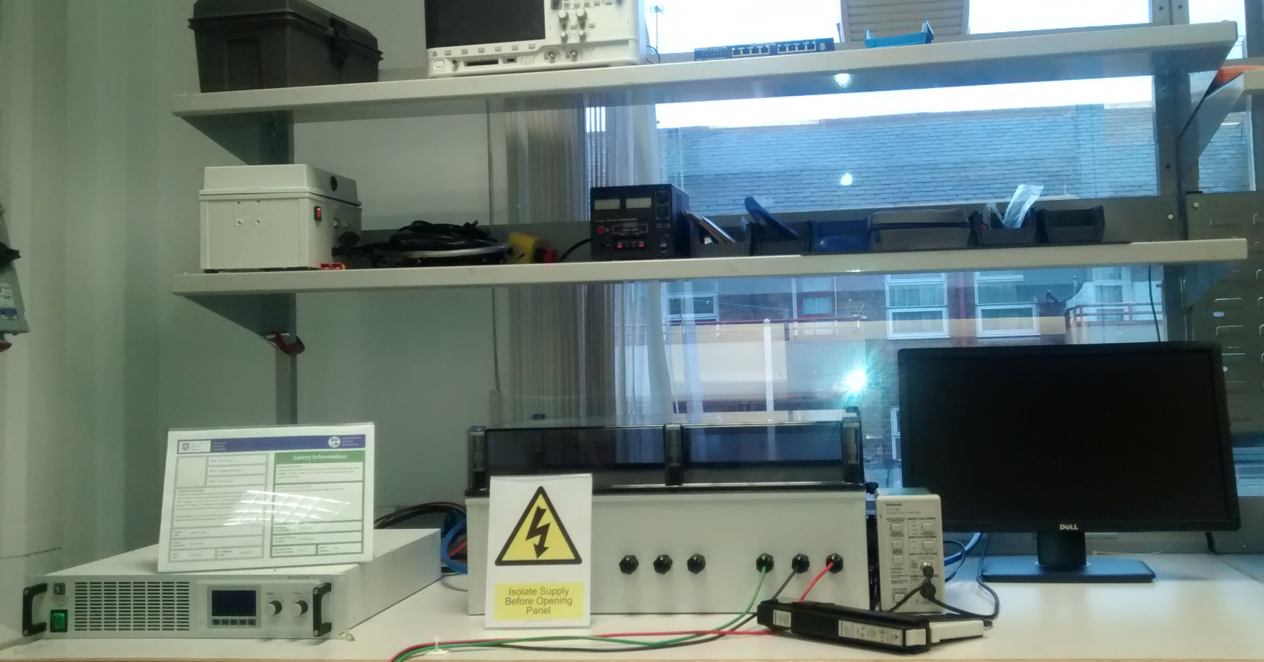
Workspace
Ensure you have space to safely carry out your planned work.
Keep your workspace tidy at all times.

Slide 16
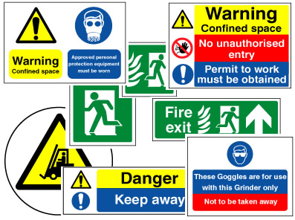
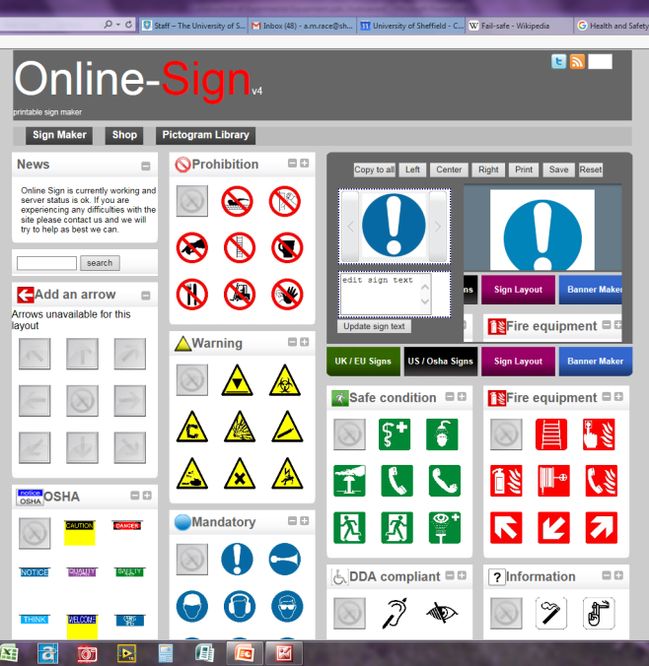
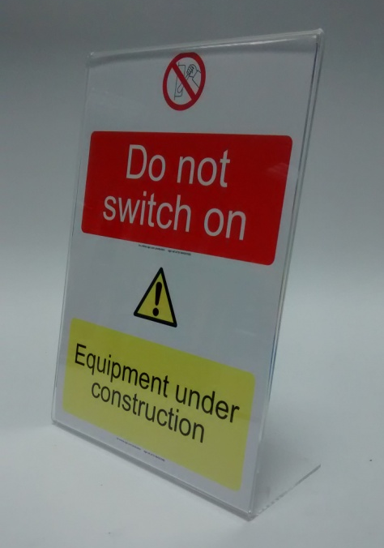
Safety Signs
Safety signs should comply with the Health and Safety (Safety Signs and Signals) Regulations 1996. You can print your own signs on:
http://www.online-sign.com/
Andy Race has a stock of desk top holders

Slide 17
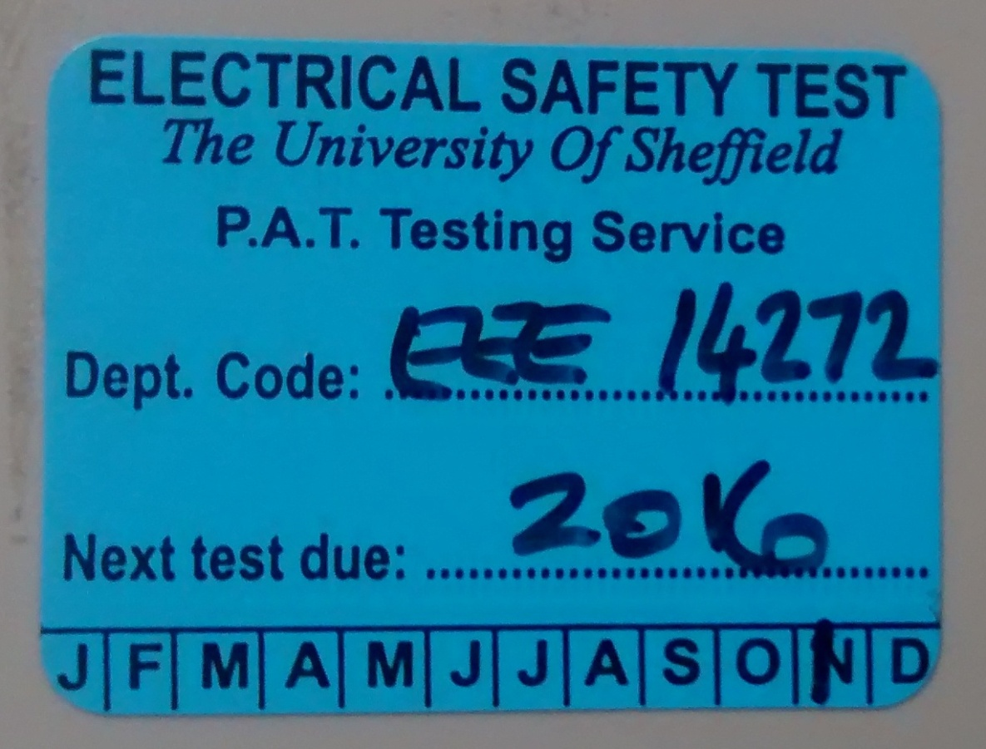
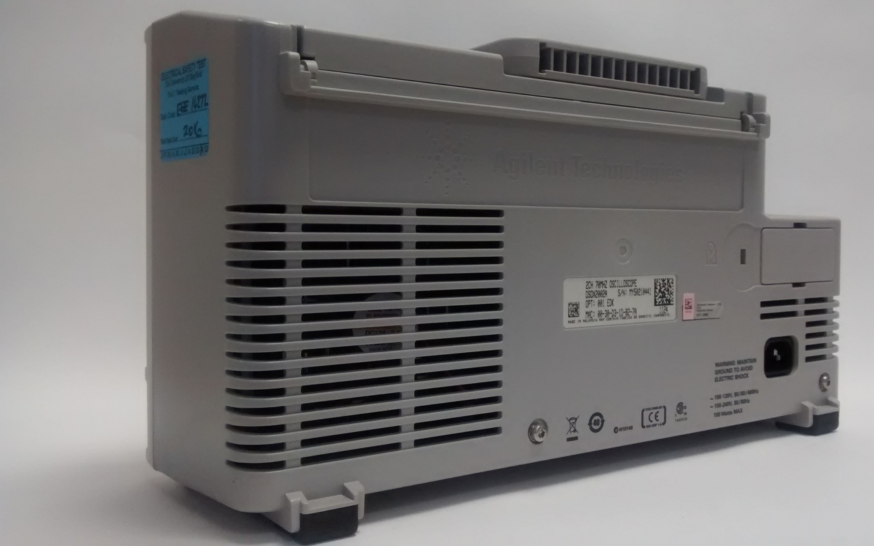
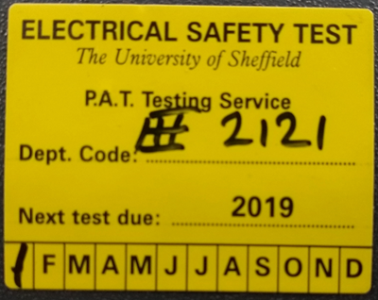
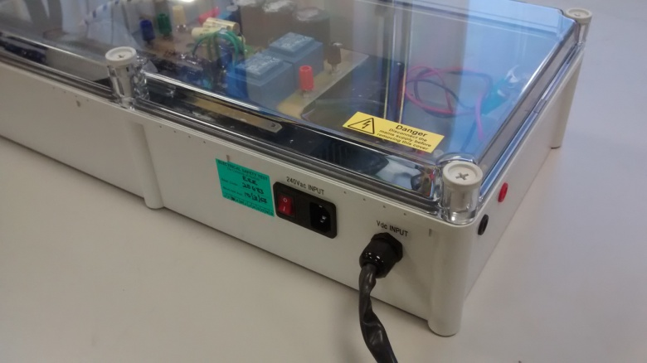
PAT Testing

Authorised PAT Testers
Ian Wraith
Tom Templeman
Fahmi Mohammad

Mains powered electrical equipment, either constructed or purchased pass a PAT test before it can be connected to the mains electricity supply.
It is your responsibility to check that it has been tested and the test date has not expired. Contact an authorised PAT tester if a PAT test is required.

Slide 18
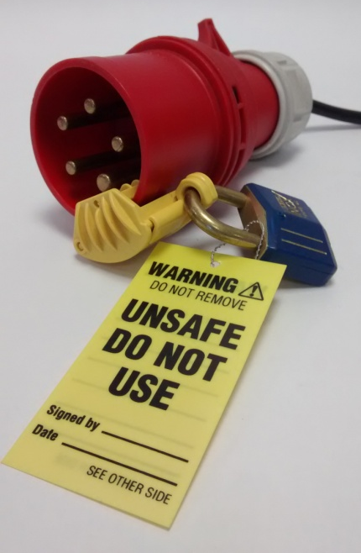
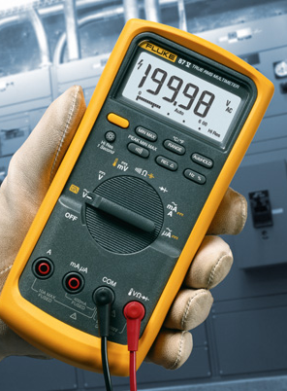
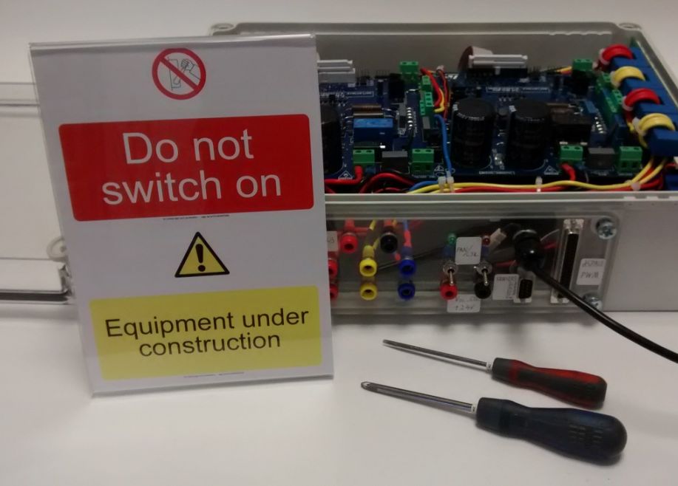
Working on Equipment
Disconnect external power supplies before commencing work. Take measures to prevent accidental reconnection, lock off and display signs. Test the power is off and any capacitors are discharged.

Slide 19
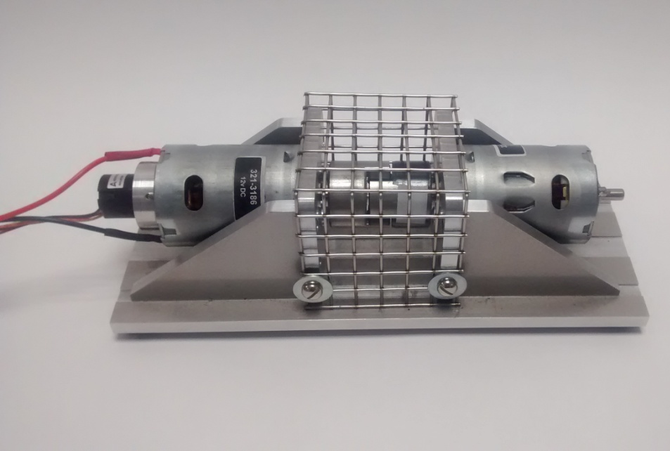
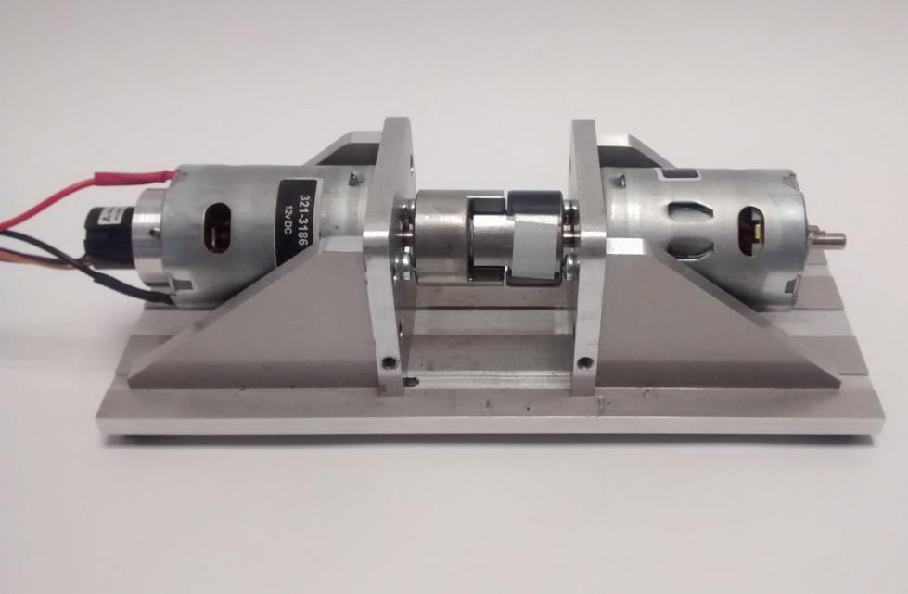
Machine Guards


Moving or rotating components should be securely guarded to prevent accidental contact occurring while in motion.

Slide 20
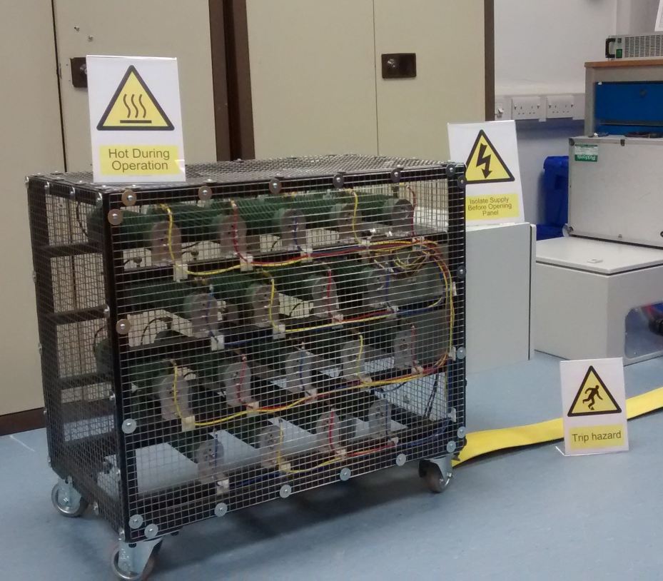
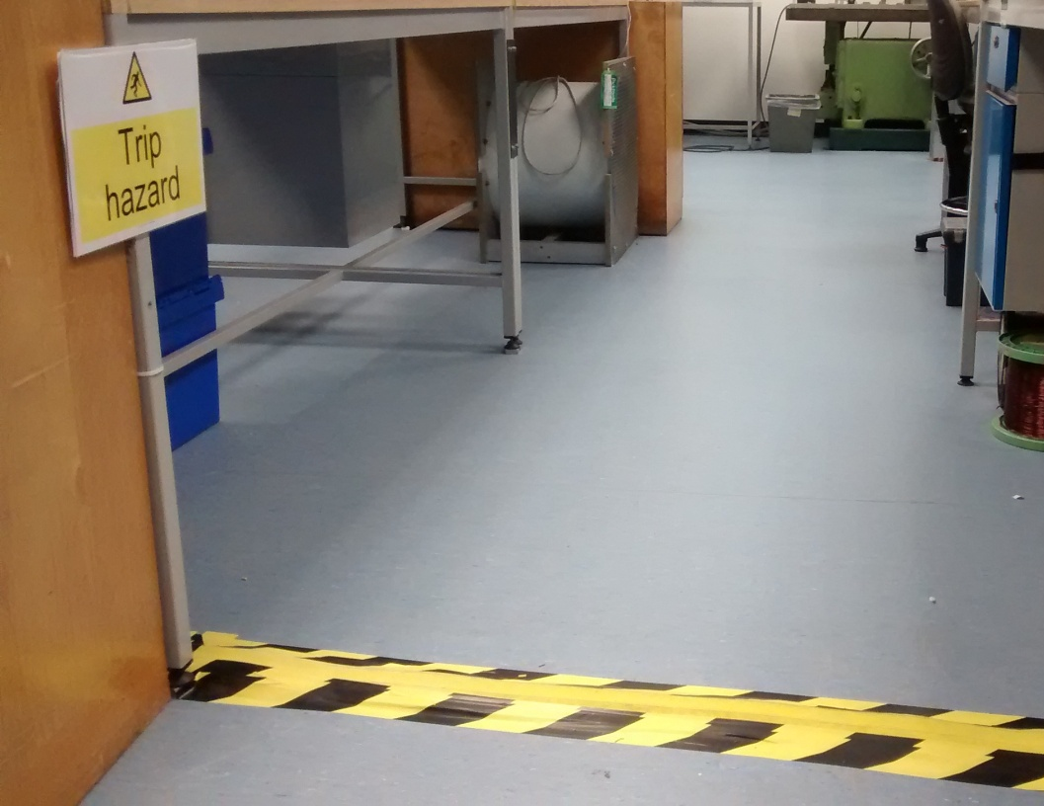
Installing Other Equipment in the Lab
Equipment that you install in the lab should be positioned as to no impede safe access.
Heat generating equipment should be adequately ventilated and positioned as to not cause damage to anything nearby.
Appropriate signage should be displayed.
Cables should be kept tidy and protective covering should be fitted where they cross any walkway.

Slide 21
Any Questions?

