Slide 1
Narrative and metaphor:
The potential impact on graphic medicine on patient emotions
Sarah McNicol
ESRI, Manchester
Metropolitan University
March 2014

Slide 2
Bibliotherapy
Long established (at least WW1)
Research evidence to support
Books on Prescription/Information Prescriptions = self-help books
Creative/imaginative bibliotherapy = reading fiction , reading groups and creative writing
Notes:
Most of us recognize the power of therapeutic reading. We find ourselves
entering the world described in the pages of a good book or appearing in the
scenes of a good movie, and we become involved with the characters. We feel
happy or sad, we cry with the character who suffers, we want the good ones to
cope and the bad ones to be punished; we really care. We usually end up gaining
new insights and ideas for our own lives as well. Just reading high-quality
literature, then, is a healing process that can enrich our selves. (Bibliotherapy as a Method of Treatment
Zipora Shechtman)

Slide 3
Why are comics different?
Sequential art
Dual visual and linguistic codes
Demand more active engagement: ‘silent accomplice’
Personalising
Non-threatening
Garfield, Jim Davis

Slide 4
Comics and health: a typical study
Improving schoolchildren's knowledge of methods for the prevention and management of low back pain: a cluster randomized controlled trial.
Results showed the comic slightly improves children's knowledge of appropriate methods for the prevention and management of LBP, and the effect remains significant 3 months after intervention.
Factual knowledge, but not social/psychological impacts
Kovacs F, Oliver-Frontera M, Plana M, et al. Improving schoolchildren’s knowledge of methods for the prevention and management of low back pain: a cluster randomized controlled trial. Spine 2011;36(8):E505–12
Teachers in the intervention group gave the schoolchildren a ‘Comic Book of the Back’, No intervention was carried out in the control group.
8 year-old children were given a questionnaire on LBP prevention and management at baseline, and 15 and 98 days later.
A stratified random sample of 12 schools, randomized to an intervention and a control group

Slide 5
The value of narrative
Companionship
Empathy: understanding motives, emotions, perspectives and consequences:
“Sometimes fiction can be better than non-fiction because you get more emotions and opinions, not just facts.”
More enjoyable!
McNicol S. Teenagers, reading and censorship: Teenagers’ views on censorship in libraries. 2006.http://www.ebase.bcu.ac.uk/docs/censorship-teenage-focus-groupsreport.pdf

Slide 6
The challenges of narrative
Dissonance between own story and that of the character
‘plurality of messages’ – individual responses and alternative interpretations

Slide 7
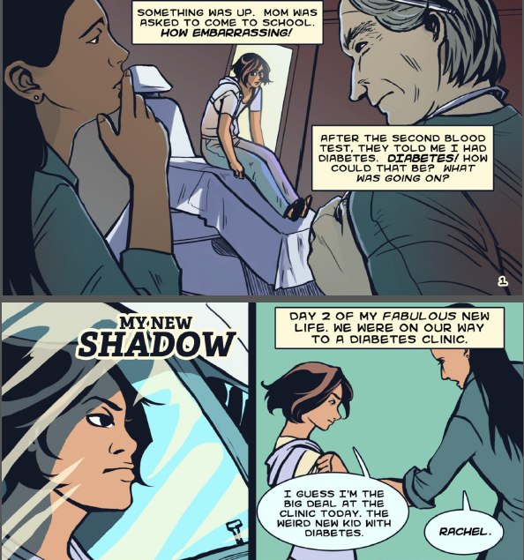
Fears & anxieties
Learning About Diabetes. My New Shadow 2012. http://www.learningaboutdiabetes.org/comic/MyNewShadow_fullcomic.pdf

Slide 8
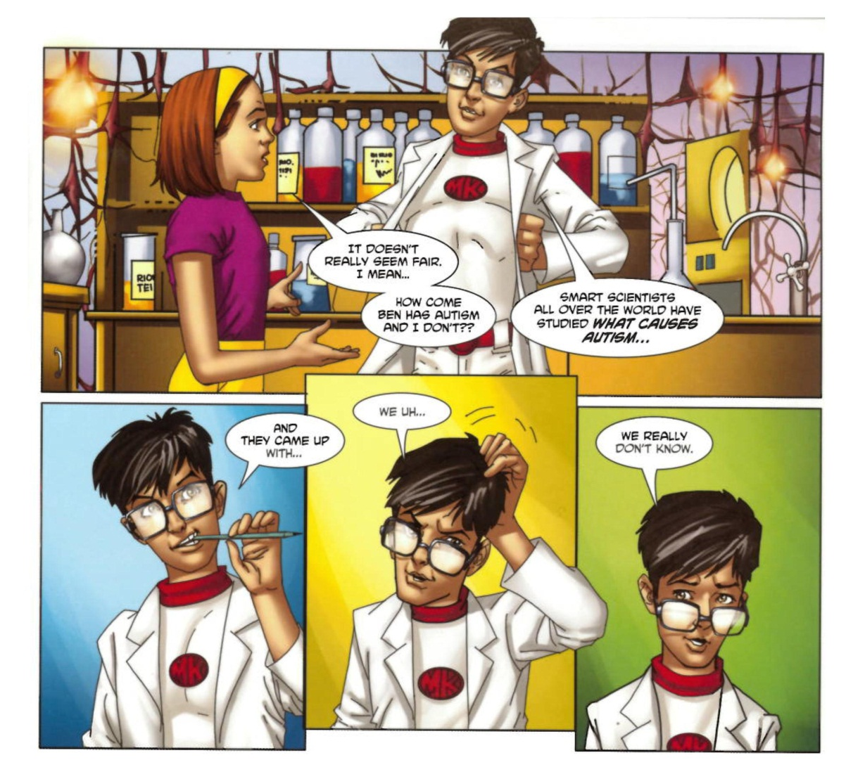
Relationships with medical professionals
What’s Up with Ben? Medikidz Explain Autism

Slide 9
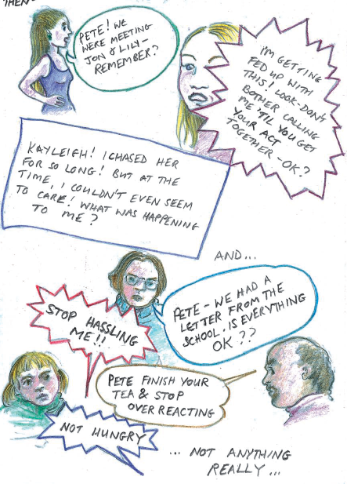
Relationships with family & friends
My Name is Pete, Mind, 2007, http://www.mind.org.uk/media/46845/my_name_is_pete.pdf

Slide 10
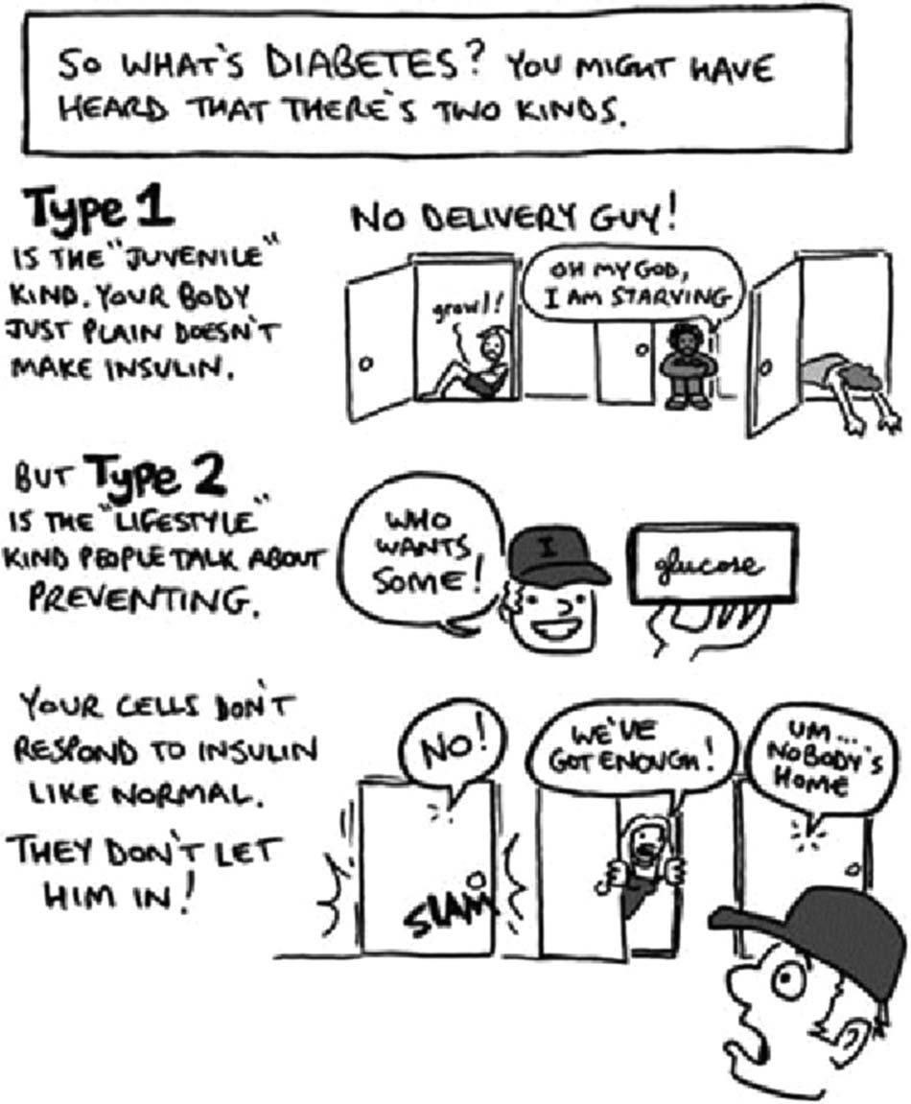
The value of metaphor
Familiar and understandable
Memorable
Diabetes is after your Dick! (Cathy Leamy).

Slide 11
The challenges of metaphor
Problematic metaphors: eg war, contamination, criminal activity, alien invasion
“Military metaphors contribute to the stigmatizing of certain illnesses and, by extension, those who are ill” (Susan Sontag, AIDS and its Metaphors, 1990)
Children’s understanding of metaphor depends on world experience and semantic ability
Norbury, C.F. The relationship between theory of mind and metaphor: Evidence from children with language impairment and autistic spectrum disorder. British Journal of Developmental Psychology (2005), 23, 383–399

Slide 12
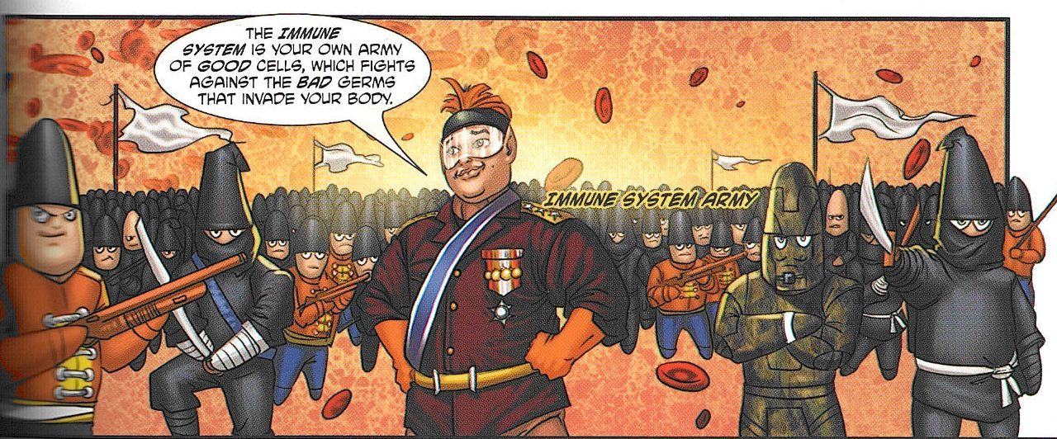
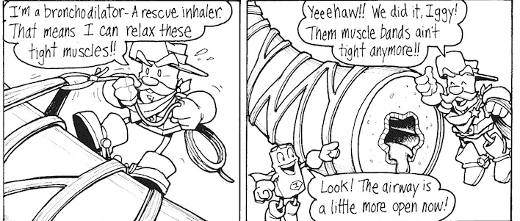
Examples of metaphor
What’s up with Paulina, Medikidz explain food allergies
Iggy and the Inhalers, http://iggyandtheinhalers.com/comics.php

Slide 13

Comics and games/play
Appealing
Active engagement
Encouarge empathy
Different interpretations/creativity

Slide 14
Future plans…
Small scale empirical research project
Young adults with health condition themselves or a family member
Different styles of comics

Slide 15
Sarah McNicol s.mcnicol@mmu.ac.uk
Humanising illness: presenting health information in educational comics, Medical Humanities, 2014. doi: 10.1136/medhum-2013-010469

