Slide 1
The New Zealand Living Standards Framework and Wellbeing Budget
Dr Tony Burton
Visiting Fellow, NZWRI, Auckland University of Technology
June 2019

Slide 2
What we are trying to achieve?
Two questions I get asked about NZ Treasury work on wellbeing:
What difference will it make?
What will I do differently?
Notes:
Key themes:
Use data and indicators
Evidence that is coherent across government
Intergenerational wellbeing
Allow Treasury to do its job better

Slide 3
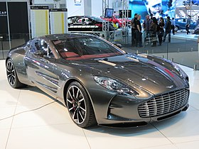
The state of wellbeing policy
What we have...
… what we need.
Notes:
Aston Martin 177 - to be admired like a work of art on the wall, not a practical car for getting from A to B.

Slide 4
What makes the System of National Accounts so successful?
They were developed with specific policy problems in mind
They are detailed (720 pages plus background and technical documents).
Standards are created by a clearly technical process run by a credible international organisation.
They have become boring!
Part of the institutional framework
“Apolitical”
Notes:
Key themes:
Use data and indicators
Evidence that is coherent across government
Intergenerational wellbeing
Allow Treasury to do its job better

Slide 5
New Zealand Treasury had FOUR attempts
Attempt 1: 2002 Heckman's Life cycle approach
Review of overseas academic literature on child development.
Problem: Overly abstract, with little New Zealand policy relevance and no engagement with public or implementation agencies
Attempt 2a: 2011 Build on the OECD approach
Interpretation of Sen, Stiglitz and Fitoussi 2009 for New Zealand
Problem: Low capability and immature international context
Attempt 3: 2012 The pentagon
High level objectives based on tax review
Problem: See below
Attempt 2b: 2017 Build on the OECD approach
Build on range of work inspired by the OECD
Problem: We are still finding out (review in 2021)
Notes:
Key themes:
Use data and indicators
Evidence that is coherent across government
Intergenerational wellbeing
Allow Treasury to do its job better

Slide 6
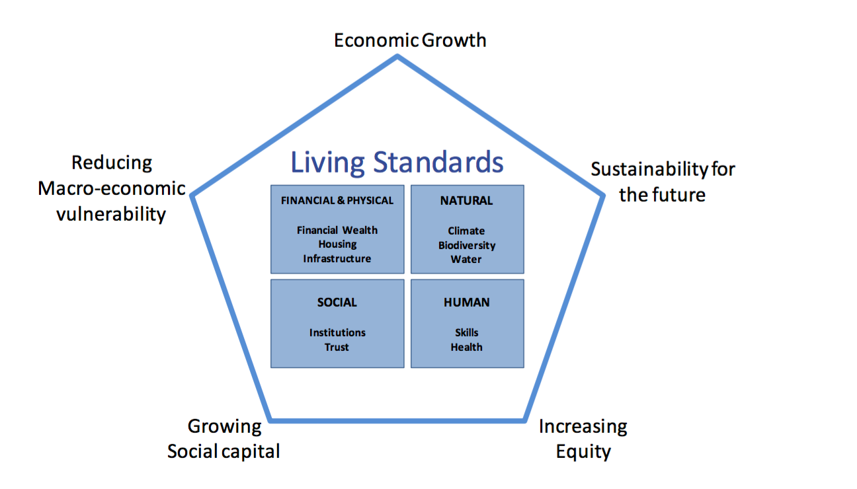
New Zealand Treasury had several attempts
Attempt 3: 2012 The pentagon
Based on a very successful analysis for a tax review
Notes:
Key themes:
Use data and indicators
Evidence that is coherent across government
Intergenerational wellbeing
Allow Treasury to do its job better

Slide 7
New Zealand Treasury had several attempts
Problems with the pentagon
Mis-alignment with agency role and purpose
Confusion between political and civil service (institutional) objectives
Unclear alignment with evidence
Lack of clarity about the elements of the framework.
Disengaged from New Zealand policy debate
Notes:
Key themes:
Use data and indicators
Evidence that is coherent across government
Intergenerational wellbeing
Allow Treasury to do its job better

Slide 8
What we did differently
Building credibility, including:
Engage with the public, test ideas and incorporate feedback
Actively draw critics into the process (including those who believe GDP is sufficient, critics from a gender and culture perspective, and environmentalists).
Identify where work had been done and build on it
Be upfront about the gaps and open about what we did not know
Link our work to someone’s day job.
Initially this was to Treasury’s long term fiscal modelling, but after the change of government it was to the budget.
Clear that the problem we are dealing with is efficiency of what government does and improving how well agencies work together
Notes:
Key themes:
Use data and indicators
Evidence that is coherent across government
Intergenerational wellbeing
Allow Treasury to do its job better

Slide 9
Sorting out what we are doing
Worldview | Overarching philosophical approach that motivates our work
Elements | Conceptual elements of the wellbeing framework derived from the worldview
Indicators | What we measure to assess wellbeing
Data | The technical definition and dataset for indicators
Notes:
Key themes:
Use data and indicators
Evidence that is coherent across government
Intergenerational wellbeing
Allow Treasury to do its job better

Slide 10
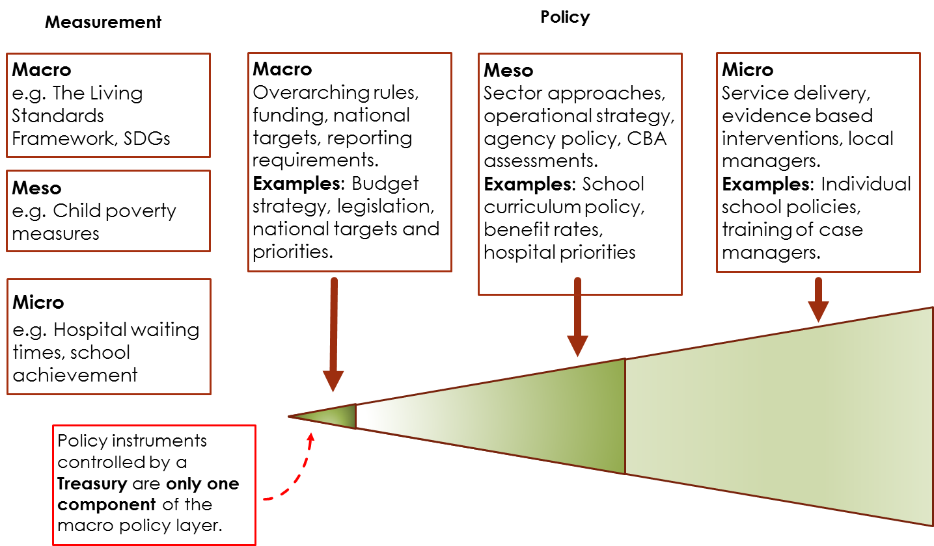
Sorting out what we are not doing
Notes:
The Treasury work is a small, but crucial part of the picture. The data links it all together, but we need:
Agencies to use their expertise
This is about overall management, particularly of the finances, not Treasury doing the work

Slide 11
What we are trying to achieve?
“[We are] using a Living Standards Framework built off real data with concrete indicators across the range of measures … I am producing a [Wellbeing Budget] that will have indicators across all of those areas and we are actually using the evidence base to decide what to invest in for our long term intergenerational benefit.”
Hon. Grant Robertson New Zealand Minister of Finance
Notes:
Key themes:
Use data and indicators
Evidence that is coherent across government
Intergenerational wellbeing
Allow Treasury to do its job better

Slide 12
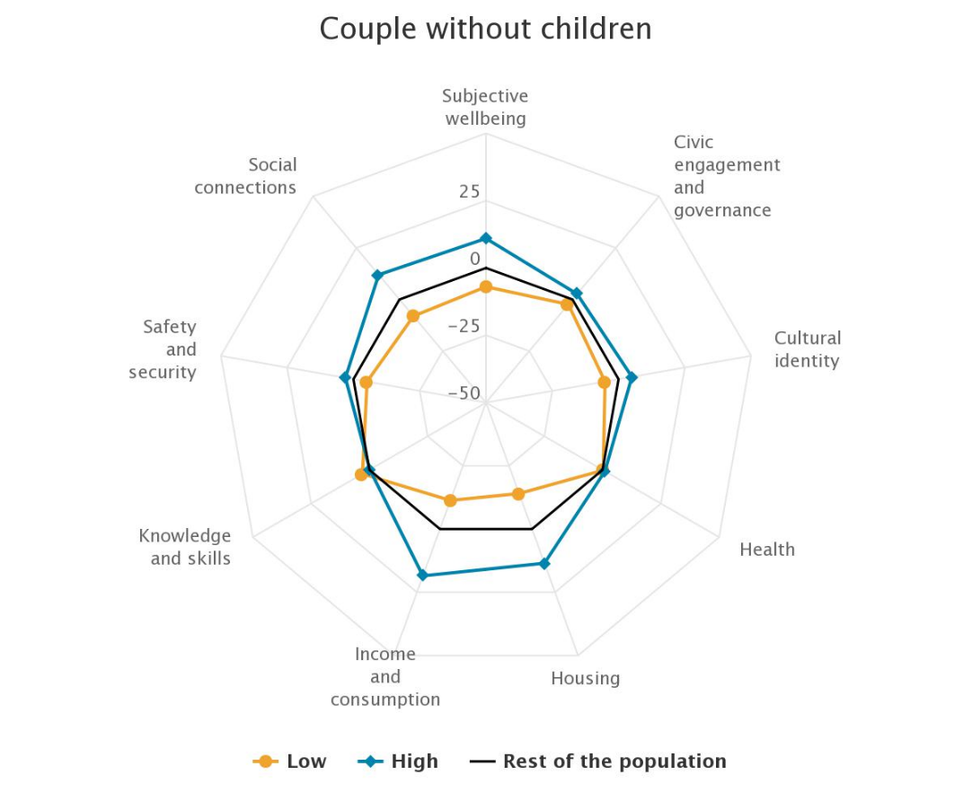
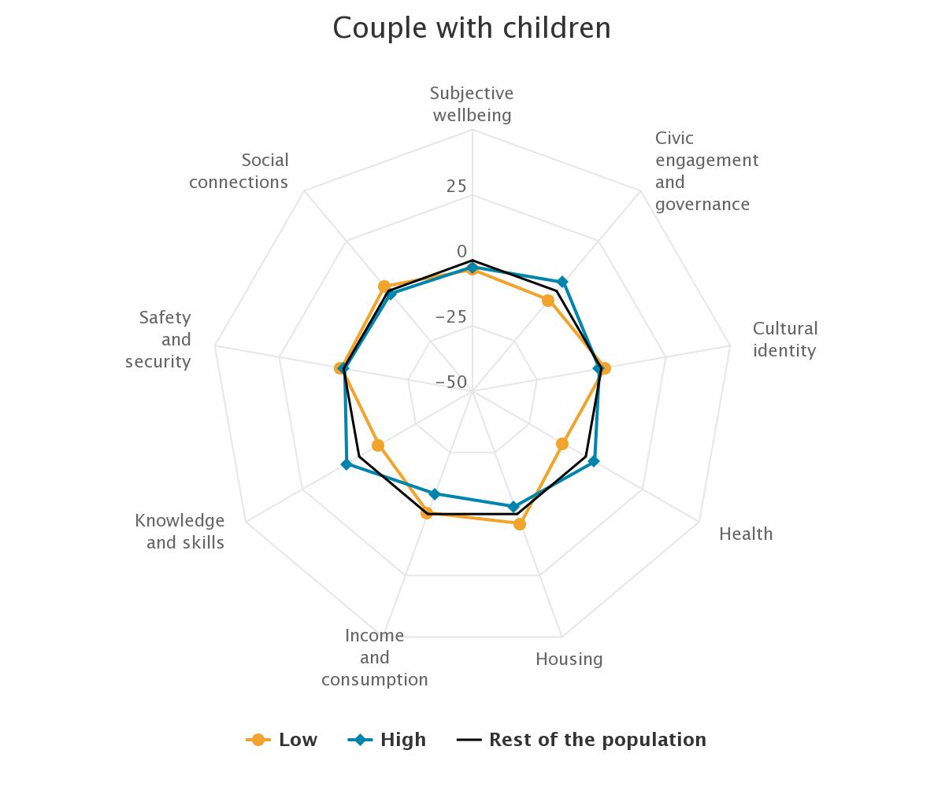
Living Standards: The LSF dashboard
Notes:
Can get complicated, but look at the whole first:
Blue more likely to have high wellbeing
Orange more likely to have low wellbeing
Obvious is material wellbeing
Less obvious is social connections

Slide 13
The LSF: What is it?
A framework, aimed at improving the quality of the Treasury’s policy advice
The LSF draws on OECD analysis and amends it for NZ (cultural identity)
The starting point is three questions:
What are current outcomes?
Will these outcomes be sustained or improved?
How resilient is the system?
Notes:
We have two further dimensions that need more work:
International connections
Overlaps and what brings work together

Slide 14
Living Standards: Current wellbeing
Civic engagement and governance Voter turnout Proportion of the population reporting discrimination | Housing Rooms per person Housing cost overburden Housing quality | Safety Intentional homicide rate per 100,000 Self-reported victimisation Feelings of safety
Cultural identity Having a strong sense of identity, belonging, and ability to be oneself, and the existence value of cultural tāonga | Knowledge and skills Educational attainment of the adult population (upper secondary) Educational attainment of the adult population (tertiary) Cognitive skills at age 15 | Social connections Social network support Loneliness Time spent in positive social activities
Environment Air quality (PM10) Air quality (PM2.5) Satisfaction with water quality Natural space footprint within a 1km radius of dwelling | Income and consumption People's disposable income from all sources, how much people spend and the material possessions they have | Subjective wellbeing Overall life satisfaction and sense of meaning and self
Health Life expectancy at birth Self-reported health status Limitations in daily activities Proportion of the population with poor mental health | Jobs and earnings Unemployment rate Employment ate Median hourly earnings Work accidents rate Job strain | Time use The quality and quantity of people's leisure and recreation time (i.e. people's free time where they are not working or doing chores)
Notes:
Based on OECD with input from consultation
Same idea a s capitals
DATA IS AN ISSUE
The indicators are descendants of work by the 1988 Royal Commission and the Social Report

Slide 15
Living Standards: Capitals
Notes:
This is a way of organising indicators and concepts (like the national accounts), not real entities

Slide 16
Informing Government priorities
MEASUREMENT
DATA
AGENCY FRAMEWORKS AND REPORTING
INFORMATION, ANALYSIS, ADVICE
MINISTERIAL DECISIONS AND
PRIORITIES
Child Poverty measures
Child Poverty Unit, DPMC
Cabinet and
Cabinet
Committees
Government
priority setting
and value
judgements
Budget Strategy
Strategic Policy
Regulation
Child and Youth Wellbeing Outcomes Framework
Child Wellbeing Unit, DPMC
Indicators
Aotearoa
New Zealand
(IANZ)
Stats NZ
IANZ will
be a key
data source
but agencies
will also use
other data
sources
Environmental Report
Ministry for Environment & Stats NZ
Social Report
Ministry of Social Development
LSF
The Treasury
Other agency frameworks

Slide 17
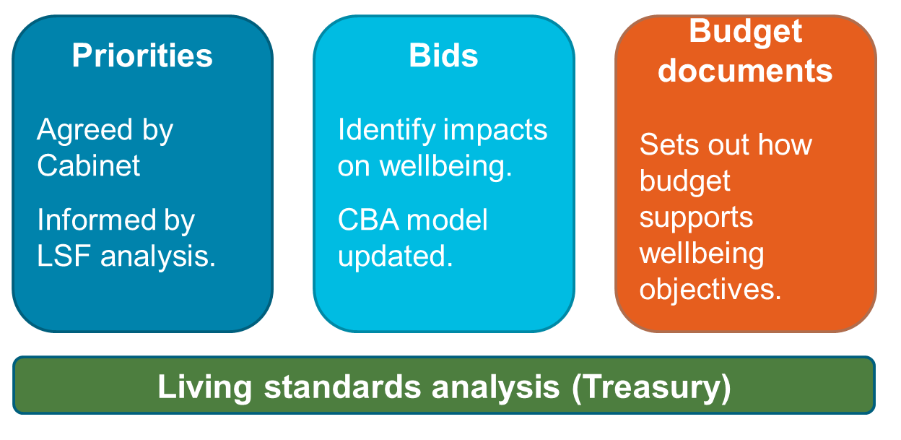
The Wellbeing Budget 2019
Five priorities for 2019:
a sustainable and low-emissions economy
supporting digital participation
lifting Māori and Pacific incomes, skills, opportunities
reducing child poverty and family violence, improving child wellbeing,
supporting mental wellbeing

Slide 18
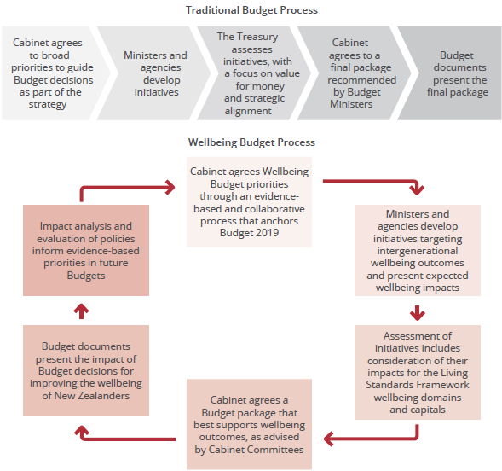
What will we do differently?

Slide 19
Risks
Overselling of current state of knowledge
Capability: Wellbeing approach is harder because it is about a wider range of government activity. The public service needs wider functional numeracy.
Multiple interpretations of wellbeing: some of these could not plausibly be subjects of government action.
Service line agencies see wellbeing as justifying what they currently do. Most work on wellbeing is about agencies doing something different. This is an unresolved tension.
Credible international leadership is needed to move beyond domestic political agendas.
Notes:
Key themes:
Use data and indicators
Evidence that is coherent across government
Intergenerational wellbeing
Allow Treasury to do its job better

Slide 20
Next steps for wellbeing
Develop the technical background
A theory driven and detailed equivalent to the SNA
Improve statistical indicators so they are policy relevant
Content development
Time use
Culture
Those excluded: children, non-citizens and citizens abroad
Process
- An international body to provide technical leadership, independent of domestic political pressures
Notes:
Key themes:
Use data and indicators
Evidence that is coherent across government
Intergenerational wellbeing
Allow Treasury to do its job better

Slide 21
SOME EXTRA SLIDES

Slide 22
LSF v Wellbeing Budget
Living Standards Framework | Wellbeing Budget
Tool developed by the Treasury | Policy decisions made by Ministers
The Treasury aims to provide broadly-focused advice to help governments make decisions that improve wellbeing | The Government allocates resources in its Budget using evidence from the Treasury’s LSF and other sources
The LSF: is an enduring framework feeds into the Treasury’s advice illustrates trade-offs between policy options helps the Government decide its policy priorities | The Wellbeing Budget: Sets out the Government’s spending priorities Uses indicators to make decisions (and, over time, measure their impact) Requires departments/agencies to work together to deliver wellbeing objectives

Slide 23
New Zealand Treasury had several attempts
Attempt 1: 2002 Heckman's Life cycle approach
“a review of the literature on how the process and experiences of childhood have a later impact on well-being; how child development and outcomes are influenced by individual, family and communal factors and how risk and resilience can be used to indicate that an individual is at increased or decreased risk of negative outcomes. ”
Problem:
Essentially a review of overseas academic literature on child development.
Overly abstract framework with little New Zealand policy relevance.
No engagement with public or implementation agencies
Notes:
Key themes:
Use data and indicators
Evidence that is coherent across government
Intergenerational wellbeing
Allow Treasury to do its job better

Slide 24
New Zealand Treasury had several attempts
Attempt 2a: 2011 Build on the OECD approach
“Ultimately, decisions about acceptable levels of factors within the Framework, distributional choices, and trade-offs between competing goods are ethical and political in nature and are therefore not amenable to definitive policy solutions. However, highlighting these choices and tradeoffs will help ensure Treasury’s advice is robust and that governments’ decisions are well-informed. ” (emphasis added)
Problem:
Organisational capability
International context was immature
Notes:
Key themes:
Use data and indicators
Evidence that is coherent across government
Intergenerational wellbeing
Allow Treasury to do its job better

Slide 25
New Zealand Treasury had several attempts
Attempt 2b: 2017 Build on the OECD approach
“The Treasury LSF is a way to support government agencies to be more cohesive so public policy on wellbeing, spending and other government interventions is aligned to improving intergenerational wellbeing … Our approach is unapologetically pragmatic: ... the Treasury's work on the LSF is focused on a wellbeing approach that can improve the quality of policy advice and government services.”
Notes:
Key themes:
Use data and indicators
Evidence that is coherent across government
Intergenerational wellbeing
Allow Treasury to do its job better

Slide 26
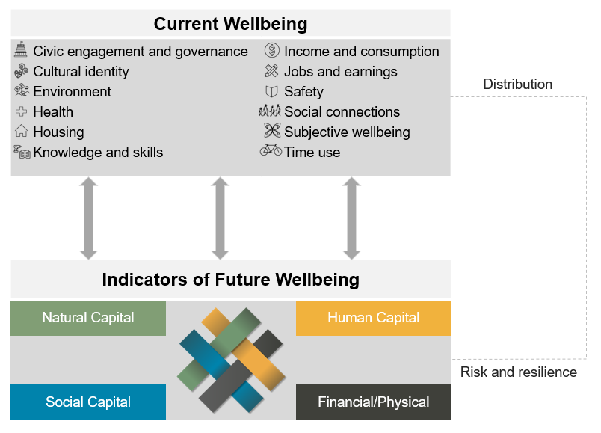
The Framework: Bringing it together
Notes:
The three elements of the LSF. Talk about each of these in turn.
Current wellbeing – domains based on OECD Better Life Index (with some slight adjustments) and the inclusion of ‘cultural identity’ to recognise NZ’s unique culture, including the Treaty of Waitangi and our bi-cultural country, and our multi-cultural society
Future wellbeing – these are the four capitals we have chosen, there are others in the literature including cultural capital, but we wanted to ensure culture and Te Ao Maori are part of the all the capitals and the whole LSF. The capitals are the stocks that generate the flows of current wellbeing.
Risk and resilience – economic shocks, domestic and foreign (EQ, GFC) but also emerging threats such as rising sea levels and climate change

