Slide 1
www.sheffield.ac.uk/english
Interpreting Shakespeare’s ‘When my love swears that she is made of truth’

Slide 2
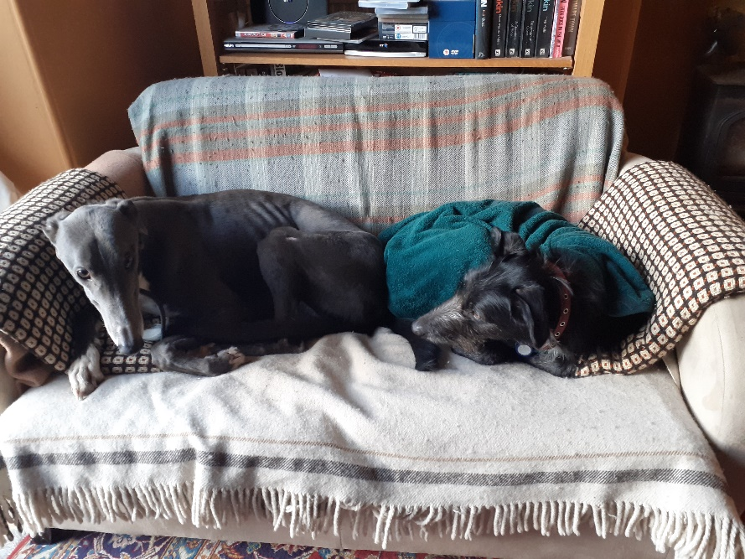
www.sheffield.ac.uk/english
Professor Cathy Shrank: c.shrank@sheffield.ac.uk
+ canine associates (apologies for any barking during the recording)

Slide 3
Structure: 3 quatrains (4-line rhyming units) + rhyming couplet
www.sheffield.ac.uk/english
When my love swears that she is made of truth,
I do believe her, though I know she lies,
That she might think me some untutored youth,
4 Unlearned in the world’s false subtleties.
Thus vainly thinking that she thinks me young,
Although she knows my days are past the best,
Simply I credit her false-speaking tongue;
8 On both sides thus is simple truth suppressed.
But wherefore says she not she is unjust?
And wherefore say not I that I am old?
O love’s best habit is in seeming trust,
12 And age in love loves not to have years told.
Therefore I lie with her, and she with me,
And in our faults by lies we flattered be.

Slide 4
Structure: 3 quatrains (4-line rhyming units) + rhyming couplet
www.sheffield.ac.uk/english
When my love swears that she is made of truth,
I do believe her, though I know she lies,
That she might think me some untutored youth,
4 Unlearned in the world’s false subtleties.
Thus vainly thinking that she thinks me young,
Although she knows my days are past the best,
Simply I credit her false-speaking tongue;
8 On both sides thus is simple truth suppressed.
But wherefore says she not she is unjust?
And wherefore say not I that I am old?
O love’s best habit is in seeming trust,
12 And age in love loves not to have years told.
Therefore I lie with her, and she with me,
And in our faults by lies we flattered be.

Slide 5
Structure: 3 quatrains (4-line rhyming units) + rhyming couplet
www.sheffield.ac.uk/english
When my love swears that she is made of truth,
I do believe her, though I know she lies,
That she might think me some untutored youth,
4 Unlearned in the world’s false subtleties.
Thus vainly thinking that she thinks me young,
Although she knows my days are past the best,
Simply I credit her false-speaking tongue;
8 On both sides thus is simple truth suppressed.
But wherefore says she not she is unjust?
And wherefore say not I that I am old?
O love’s best habit is in seeming trust,
12 And age in love loves not to have years told.
Therefore I lie with her, and she with me,
And in our faults by lies we flattered be.

Slide 6
Structure: 3 quatrains (4-line rhyming units) + rhyming couplet
www.sheffield.ac.uk/english
When my love swears that she is made of truth,
I do believe her, though I know she lies,
That she might think me some untutored youth,
4 Unlearned in the world’s false subtleties.
Thus vainly thinking that she thinks me young,
Although she knows my days are past the best,
Simply I credit her false-speaking tongue;
8 On both sides thus is simple truth suppressed.
But wherefore says she not she is unjust?
And wherefore say not I that I am old?
O love’s best habit is in seeming trust,
12 And age in love loves not to have years told.
Therefore I lie with her, and she with me,
And in our faults by lies we flattered be.
The ‘turn’ in the argument (volta)
trust: truthfulness (on her part); trust (on his)

Slide 7
Structure: 3 quatrains (4-line rhyming units) + rhyming couplet
www.sheffield.ac.uk/english
When my love swears that she is made of truth,
I do believe her, though I know she lies,
That she might think me some untutored youth,
4 Unlearned in the world’s false subtleties.
Thus vainly thinking that she thinks me young,
Although she knows my days are past the best,
Simply I credit her false-speaking tongue;
8 On both sides thus is simple truth suppressed.
But wherefore says she not she is unjust?
And wherefore say not I that I am old?
O love’s best habit is in seeming trust,
12 And age in love loves not to have years told.
Therefore I lie with her, and she with me,
And in our faults by lies we flattered be.

Slide 8
www.sheffield.ac.uk/english
When my love swears that she is made of truth,
I do believe her, though I know she lies,
That she might think me some untutored youth,
4 Unlearned in the world’s false subtleties.
Thus vainly thinking that she thinks me young,
Although she knows my days are past the best,
Simply I credit her false-speaking tongue;
8 On both sides thus is simple truth suppressed.
But wherefore says she not she is unjust?
And wherefore say not I that I am old?
O love’s best habit is in seeming trust,
12 And age in love loves not to have years told.
Therefore I lie with her, and she with me,
And in our faults by lies we flattered be.

Slide 9
www.sheffield.ac.uk/english
When my love swears that she is made of truth,
I do believe her, though I know she lies,
That she might think me some untutored youth,
4 Unlearned in the world’s false subtleties.
Thus vainly thinking that she thinks me young,
Although she knows my days are past the best,
Simply I credit her false-speaking tongue;
8 On both sides thus is simple truth suppressed.
But wherefore says she not she is unjust?
And wherefore say not I that I am old?
O love’s best habit is in seeming trust,
12 And age in love loves not to have years told.
Therefore I lie with her, and she with me,
And in our faults by lies we flattered be.
Anaphora: repetition of a word of clause at or near the start of a line

Slide 10
polyptoton: repetition of a word in a different grammatical form (see ‘Sounds of Poetry’ worksheet)
www.sheffield.ac.uk/english
When my love swears that she is made of truth,
I do believe her, though I know she lies,
That she might think me some untutored youth,
4 Unlearned in the world’s false subtleties.
Thus vainly thinking that she thinks me young,
Although she knows my days are past the best,
Simply I credit her false-speaking tongue;
8 On both sides thus is simple truth suppressed.
But wherefore says she not she is unjust?
And wherefore say not I that I am old?
O love’s best habit is in seeming trust,
12 And age in love loves not to have years told.
Therefore I lie with her, and she with me,
And in our faults by lies we flattered be.

Slide 11
Puns
www.sheffield.ac.uk/english
When my love swears that she is made of truth,
I do believe her, though I know she lies,
That she might think me some untutored youth,
4 Unlearned in the world’s false subtleties.
Thus vainly thinking that she thinks me young,
Although she knows my days are past the best,
Simply I credit her false-speaking tongue;
8 On both sides thus is simple truth suppressed.
But wherefore says she not she is unjust?
And wherefore say not I that I am old?
O love’s best habit is in seeming trust,
12 And age in love loves not to have years told.
Therefore I lie with her, and she with me,
And in our faults by lies we flattered be.
Homophonic pun on ‘maid’ (virgin)
‘homophonic’: sounds the same

Slide 12
Puns
www.sheffield.ac.uk/english
When my love swears that she is made of truth,
I do believe her, though I know she lies,
That she might think me some untutored youth,
4 Unlearned in the world’s false subtleties.
Thus vainly thinking that she thinks me young,
Although she knows my days are past the best,
Simply I credit her false-speaking tongue;
8 On both sides thus is simple truth suppressed.
But wherefore says she not she is unjust?
And wherefore say not I that I am old?
O love’s best habit is in seeming trust,
12 And age in love loves not to have years told.
Therefore I lie with her, and she with me,
And in our faults by lies we flattered be.
unjust: ‘dishonest’ (i.e. not chaste); ‘incorrect’

Slide 13
Puns
www.sheffield.ac.uk/english
When my love swears that she is made of truth,
I do believe her, though I know she lies,
That she might think me some untutored youth,
4 Unlearned in the world’s false subtleties.
Thus vainly thinking that she thinks me young,
Although she knows my days are past the best,
Simply I credit her false-speaking tongue;
8 On both sides thus is simple truth suppressed.
But wherefore says she not she is unjust?
And wherefore say not I that I am old?
O love’s best habit is in seeming trust,
12 And age in love loves not to have years told.
Therefore I lie with her, and she with me,
And in our faults by lies we flattered be.
A duke disguised as a monk, Measure for Measure (RSC, 1983)
habit: ‘usual practice’; ‘clothing’ (and therefore disguise)

Slide 14
www.sheffield.ac.uk/english
When my love swears that she is made of truth,
I do believe her, though I know she lies,
That she might think me some untutored youth,
4 Unlearned in the world’s false subtleties.
Thus vainly thinking that she thinks me young,
Although she knows my days are past the best,
Simply I credit her false-speaking tongue;
8 On both sides thus is simple truth suppressed.
But wherefore says she not she is unjust?
And wherefore say not I that I am old?
O love’s best habit is in seeming trust,
12 And age in love loves not to have years told.
Therefore I lie with her, and she with me,
And in our faults by lies we flattered be.

Slide 15
Version of ‘When my love swears’, printed in 1599; differences from 1609 version shown in blue
www.sheffield.ac.uk/english
When my love swears that she is made of truth,
I do believe her, (though I know she lies),
That she might think me some untutored youth,
4 Unskilful in the world’s forgeries.
Thus vainly thinking that she thinks me young,
Although I know my years be past the best:
I, smiling, credit her false-speaking tongue,
8 Outfacing faults in love, with love’s ill rest.
But wherefore says my love that she is young?
And wherefore say not I, that I am old?
O, love’s best habit is a soothing tongue,
12 And age (in love) loves not to have years told.
Therefore I’ll lie with love, and love with me,
Since that our faults in love thus smothered be.
Faults in love which are smothered
Faults with are smothered in love

